Slide 1
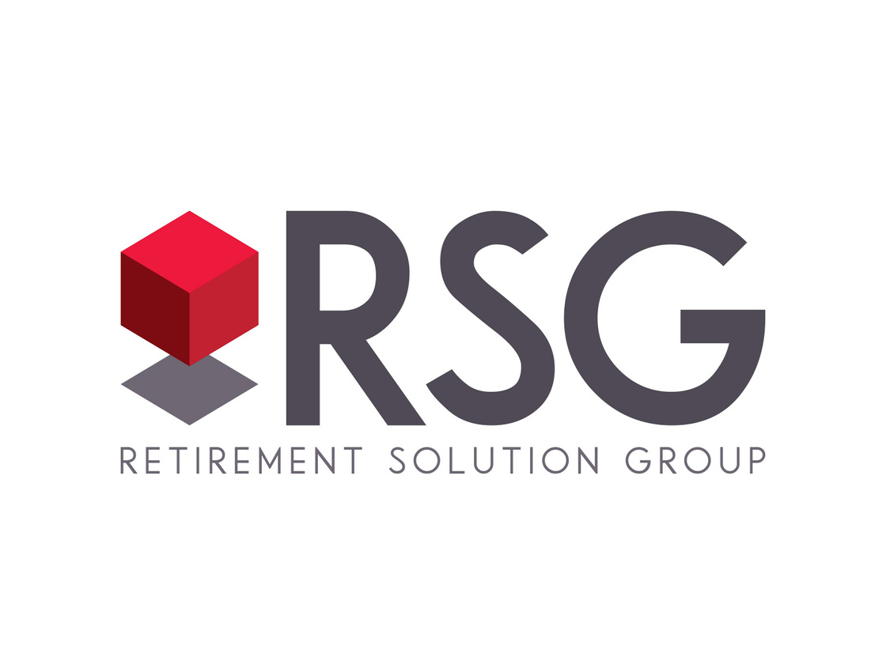

401(k) PlAn: EMPLOYEE MEETING
Client Company Name
Month 2024
Securities are offered through LPL Financial, member FINRA/SIPC. RSG Advisory and LPL Financial are separate, non-affiliated entities. Investment advisory services offered through Global Retirement Partners, LLC dba DBA RSG Advisory, an SEC registered investment advisor.

Slide 2
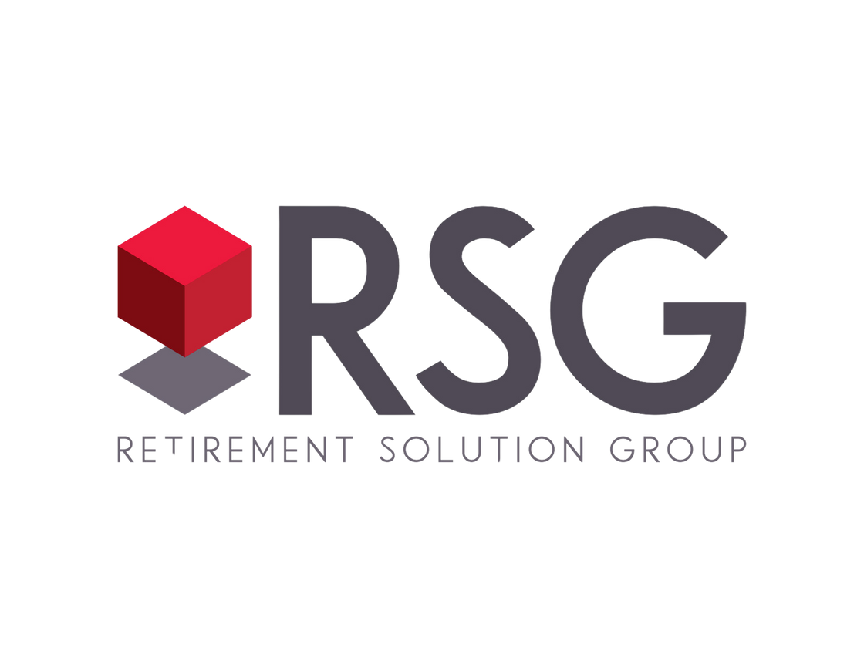

Alt design & Brand for Title Slide
Client Name
Month 2024
Securities are offered through LPL Financial, member FINRA/SIPC. RSG Advisory and LPL Financial are separate, non-affiliated entities. Investment advisory services offered through Global Retirement Partners, LLC dba DBA RSG Advisory, an SEC registered investment advisor.

Slide 3
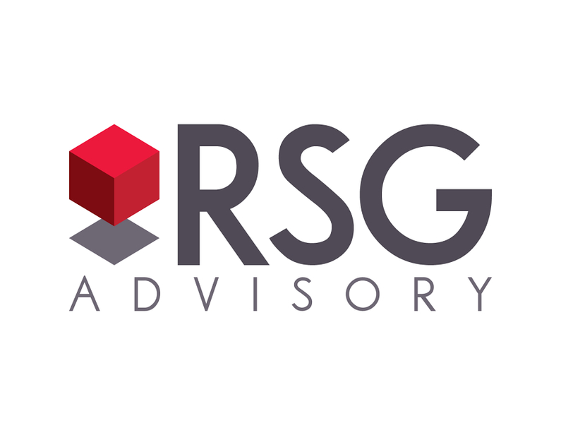
Deck Title
Client Name
Month 2024
Securities are offered through LPL Financial, member FINRA/SIPC. RSG Advisory and LPL Financial are separate, non-affiliated entities. Investment advisory services offered through Global Retirement Partners, LLC dba DBA RSG Advisory, an SEC registered investment advisor.
Notes:
This slide is the only option branded for RSG Advisory. Use it only as appropriate.

Slide 4



ANOTHER TITLE SLIDE COVER DESIGN
this is an option
Securities are offered through LPL Financial, member FINRA/SIPC. RSG Advisory and LPL Financial are separate, non-affiliated entities. Investment advisory services offered through Global Retirement Partners, LLC dba DBA RSG Advisory, an SEC registered investment advisor.

Slide 5

BEYOND THE 401(K)
Exploring Additional Savings Strategies for Your Future
Securities are offered through LPL Financial, member FINRA/SIPC. RSG Advisory and LPL Financial are separate, non-affiliated entities. Investment advisory services offered through Global Retirement Partners, LLC dba DBA RSG Advisory, an SEC registered investment advisor.

Slide 6

MASTER PARTICIPANT PRESENTATION
for XYZ Company
Securities are offered through LPL Financial, member FINRA/SIPC. RSG Advisory and LPL Financial are separate, non-affiliated entities. Investment advisory services offered through Global Retirement Partners, LLC dba DBA RSG Advisory, an SEC registered investment advisor.

Slide 7

ANOTHER TITLE SLIDE COVER DESIGN
this is an option
Securities are offered through LPL Financial, member FINRA/SIPC. RSG Advisory and LPL Financial are separate, non-affiliated entities. Investment advisory services offered through Global Retirement Partners, LLC dba DBA RSG Advisory, an SEC registered investment advisor.

Slide 8

ANOTHER TITLE SLIDE COVER DESIGN
this is an option
Securities are offered through LPL Financial, member FINRA/SIPC. RSG Advisory and LPL Financial are separate, non-affiliated entities. Investment advisory services offered through Global Retirement Partners, LLC dba DBA RSG Advisory, an SEC registered investment advisor.

Slide 9

ANOTHER TITLE SLIDE COVER DESIGN
this is an option
Securities are offered through LPL Financial, member FINRA/SIPC. RSG Advisory and LPL Financial are separate, non-affiliated entities. Investment advisory services offered through Global Retirement Partners, LLC dba DBA RSG Advisory, an SEC registered investment advisor.

Slide 11

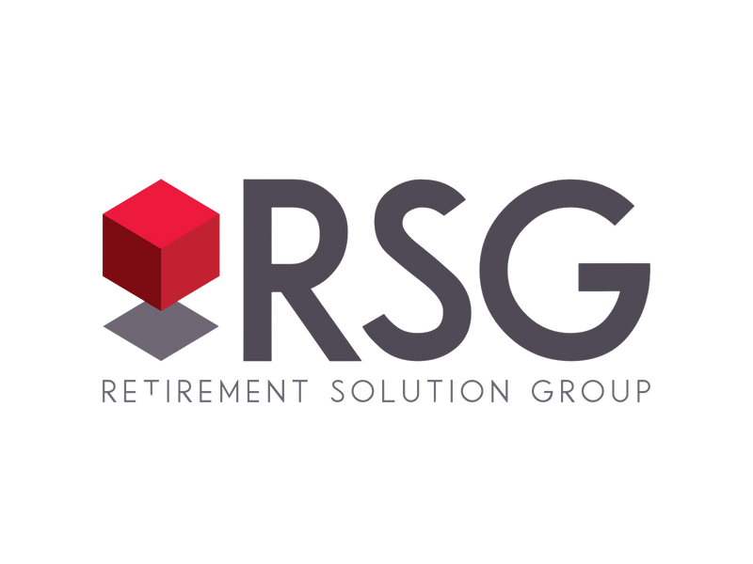

We’re Here to Help
11 | RetirementSolutionGroup.com

Slide 12
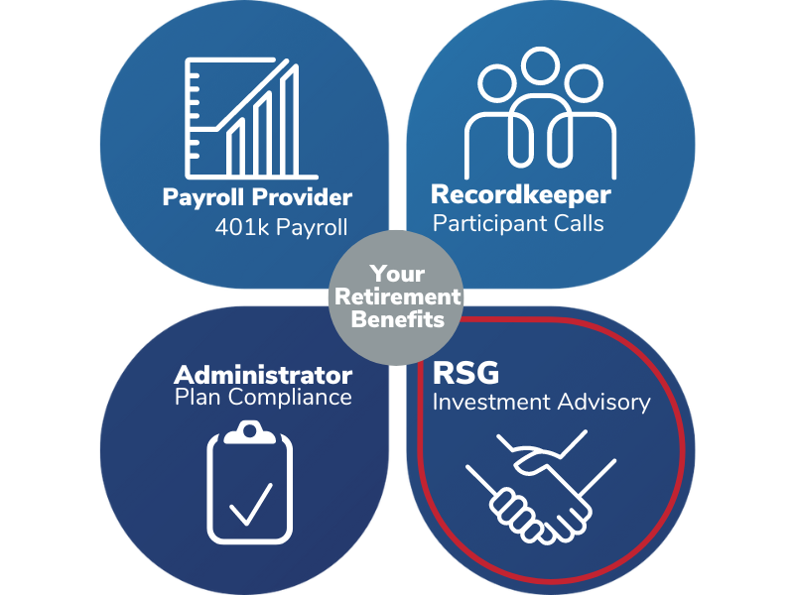

Your Retirement Specialists
Your retirement savings plan is an essential part of your future financial security. It is important to understand how your plan works and how to maximize it’s benefits.
Retirement is our only focus
  Knowledgeable specialist
  Fiduciary Advisors
  Trusted Partners
12 | RetirementSolutionGroup.com

Slide 13




the Core of everything we do
34,000
employees
634
There is great value in education.
Retirement planning starts with understanding our clients’ needs.
Everyone should be empowered to retire with dignity.
small businesses
13 | RetirementSolutionGroup.com

Slide 14








A Balanced Approach to Consulting
With a holistic view of your business and plan customization, we implement proven strategies that maximize your organization’s retirement plan, making it one of your most valuable assets.
Plan Design
Investments
Participant Engagement
Compliance Fiduciary Support
14 | RetirementSolutionGroup.com

Slide 15
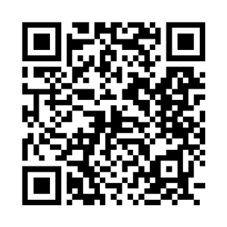
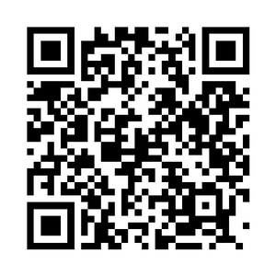

RSG is HEre to Help
Your employer’s retirement savings plan is an essential part of your future financial security. It is important to understand how your plan works and its benefits.
Resources
Contact Us
Ask me anything
  Why participate in a 401(k)
  How to sign up and enrollment
  How much can/should I defer
  How to manage your investments (and risk level)
  Rollover retirement accounts
  How do I create a retirement readiness plan
  Help me understand when I can take money out
Elvia Sanchez
PRINCIPAL, CPFA®
15 | RetirementSolutionGroup.com

Slide 16

RSG is HEre to Help
Your employer’s retirement savings plan is an essential part of your future financial security. It is important to understand how your plan works and its benefits.
Resources
Contact Us
Ask me anything
  Why participate in a 401(k)
  How to sign up and enrollment
  How much can/should I defer
  How to manage your investments (and risk level)
  Rollover retirement accounts
  How do I create a retirement readiness plan
  Help me understand when I can take money out
Christie Cheng
PRINCIPAL, CPFA®
16 | RetirementSolutionGroup.com

Slide 17

RSG is HEre to Help
Your employer’s retirement savings plan is an essential part of your future financial security. It is important to understand how your plan works and its benefits.
Resources
Contact Us
Ask me anything
  Why participate in a 401(k)
  How to sign up and enrollment
  How much can/should I defer
  How to manage your investments (and risk level)
  Rollover retirement accounts
  How do I create a retirement readiness plan
  Help me understand when I can take money out
Kevin Delaney
VP BUSINESS DEVELOPMENT, CPFA®
17 | RetirementSolutionGroup.com

Slide 18

RSG is HEre to Help
Your employer’s retirement savings plan is an essential part of your future financial security. It is important to understand how your plan works and its benefits.
Resources
Contact Us
Ask me anything
  Why participate in a 401(k)
  How to sign up and enrollment
  How much can/should I defer
  How to manage your investments (and risk level)
  Rollover retirement accounts
  How do I create a retirement readiness plan
  Help me understand when I can take money out
Chris Underwood
PRINCIPAL, AIF, CPFA®
18 | RetirementSolutionGroup.com

Slide 19

RSG is HEre to Help
Your employer’s retirement savings plan is an essential part of your future financial security. It is important to understand how your plan works and its benefits.
Resources
Contact Us
Ask me anything
  Why participate in a 401(k)
  How to sign up and enrollment
  How much can/should I defer
  How to manage your investments (and risk level)
  Rollover retirement accounts
  How do I create a retirement readiness plan
  Help me understand when I can take money out
Judy Gutierrez
SR. RELATIONSHIP MANAGER
19 | RetirementSolutionGroup.com

Slide 20


Sharing Our Network with you
Because RSG is focused only on your retirement benefits, we rely on our strategic partners to take that expertise a step further, offering financial planning advice that puts you in charge of your TOTAL financial picture.
    Financial Wellness webinars
    Personal Financial Planning
20 | RetirementSolutionGroup.com

Slide 21

Agenda
  Plan Highlights
  Enrollment
  Rollover
  Pre-Tax vs Roth
  401(k) Loans
  Social Security
  Market Update
  Next Steps
  Questions
Resources
Contact Us
21 | RetirementSolutionGroup.com

Slide 23

Plan Highlights
23 | RetirementSolutionGroup.com

Slide 24
Your Plan
Eligibility: 21 years of age and 3 months of service
Plan Entry: monthly (1st day of every month)
Your Contributions: 1% up to 100% of pay, Pre-tax or Roth (after tax)
    IRS 2023 limit: $23,000 or $30,500 if over age 50 - applies to YOUR contributions only
    Change frequency = per payroll
    Rollovers allowed
Employee Automatic Enrollment:
    QDIA: [age appropriate] Vanguard Target Date Funds
    3% Deferral Contribution
Loans: one outstanding loan allowed
    50% of account balance (min = $1,000, max = $50,000)
    Repaid via payroll (max term = 5 years)
Withdrawals: in-service, hardships and termination
24 | RetirementSolutionGroup.com
Notes:
Please customize the information on this page to match your clients plan and succinctly summarize how the plan operates.

Slide 25




Why Save now?
Retirement can be expensive
Many experts estimate you'll need
of your annual income for
each year of retirement
80%
Retirement income is mostly up to you
34%
66%
  Company retirement plan
  Pension
  Personal savings & investments
  Earnings/income
  Other
Social
Security
All other sources
1 David Blanchett, Estimating the True Cost of Retirement, June 30, 2015.
2 Social Security Administration, Fast Facts & Figures about Social Security, 2015.
25 | RetirementSolutionGroup.com

Slide 26
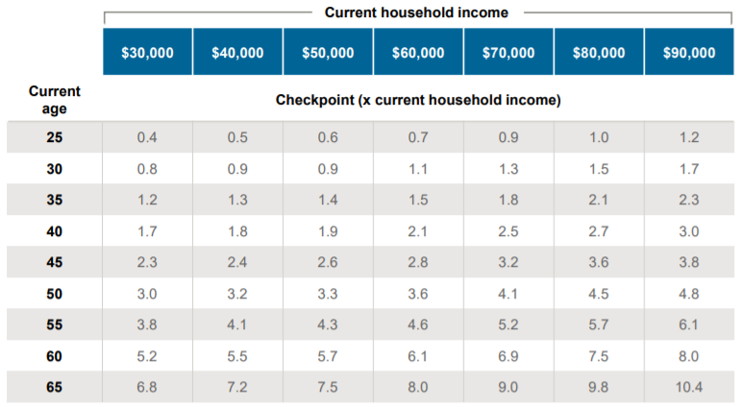
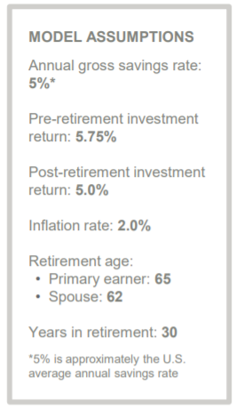


Retirement Savings Check-In
GOAL:
$50,000 x 1.9 = $95,000
household
income
in savings
today
This chart is for illustrative purposes only and must not be relied upon to make investment decisions. J.P. Morgan’s model is based on a blend of J.P. Morgan Asset Management’s (JPMAM) proprietary Long-Term Capital Market Assumptions (first 10 years) and equilibrium returns, and an 80% confidence level through retirement. Household income replacement rates are derived from an inflation-adjusted analysis of: Consumer Expenditure Survey (BLS) data (2013-2016); Social Security benefits using modified scaled earnings in 2019 for a single wage earner at age 65 and a spousal benefit at age 62 reduced by Medicare Part B premiums. For more details, see slide 15. Consult with a financial professional for a more personalized assessment. Allocations, assumptions and expected returns are not meant to represent JPMAM performance. Given the complex risk/reward tradeoffs involved, we advise clients to rely on judgment as well as quantitative optimization approaches in setting strategic allocations. References to future returns for either asset allocation strategies or asset classes are not promises or even estimates of actual returns a client portfolio may achieve.
26 | RetirementSolutionGroup.com
Notes:
How to use this chart:
• This analysis assumes you would like to maintain an equivalent lifestyle in retirement.
• Household income is assumed to be gross income (before taxes and savings).
• Go to the intersection of your current age and your closest current household income.
• Multiply your current household income by the checkpoint shown. This is the amount you should have saved today, assuming you continue contributions of 5% going forward.
• Example: For a 40-year-old with a household income of $50,000: $50,000 x 1.9 = $95,000

Slide 28

Enrollment
28 | RetirementSolutionGroup.com

Slide 29




The Power of Time On Your Side
Jessica
John
24 years old
Saves $250/mo.
40 years old
Saves $500/mo.
41
$4,114
$2,358
years
until
retirement
25
years
until
retirement
monthly
retirement income
monthly
retirement income
$123,000
$583,738
$706,738
$150,000
$255,036
$405,036
save
earn
at retirement
save
earn
at retirement
The illustrations above assume a retirement age of 65 and that the individual receives the monthly retirement payment shown until age 90. The amount saved until retirement assumes an annual investment return of 7%. The monthly payment amount in retirement assumes an annual investment return of 5%. The investment performance shown does not represent the return of any particular investment and does not guarantee any future rate of return. The final account balance does not reflect any taxes or penalties that may be due upon distribution. Withdrawals from a tax-deferred account before age 59½ are subject to a 10% federal penalty tax unless an exception applies. Source: Vanguard
29 | RetirementSolutionGroup.com
Notes:
This slide is about compounding interest and its benefit of saving for retirement starting at a young age. With more time, even a smaller contribution goes much further.

Slide 30
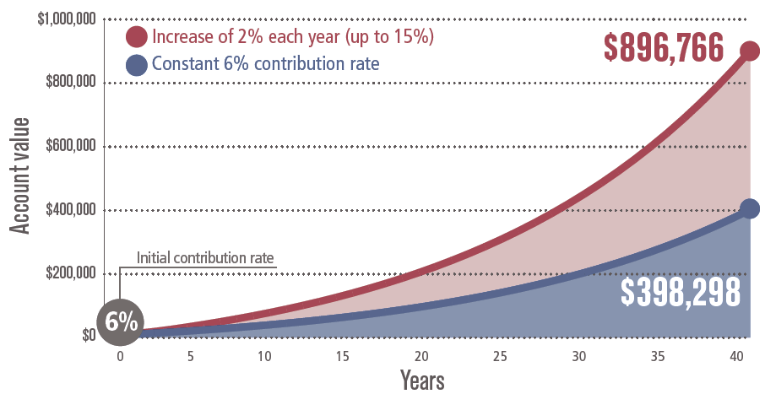
Increasing contributions Add Up
EXAMPLE:
Salary: $50,000
Pay Frequency: semi-monthly
6% contribution ≈ $125/ pay
Impact to Paycheck:
  Pre-tax ≈ $110
    1% increase ≈ $20
  Roth ≈ $145
    1% increase ≈ $21
This chart is for illustrative purposes only. The chart assumes an annual starting salary of $40K, adjusted annually for inflation. The assumed annual rate of return is 6%. No employer contributions were considered. Source: J.P. Morgan Asset Management
30 | RetirementSolutionGroup.com
Notes:
This slide shows how increasing contributions each year has an increasingly larger impact over time.
Need to verify this source: https://am.jpmorgan.com/content/dam/jpm-am-aem/global/en/insights/retirement-insights/guide-to-retirement-us.pdf

Slide 31
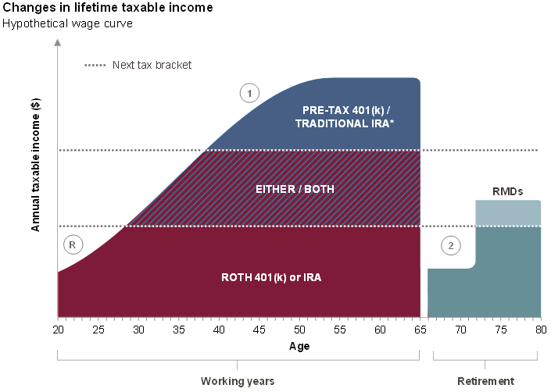
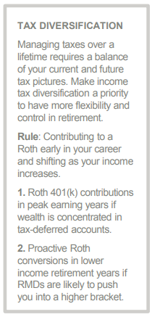
KNOWING WHEN ROTH IS right for you
*If eligible to make a deductible contribution (based on your MAGI). The illustration reflects savings options into Traditional and Roth IRA accounts, as well as into pre-tax and Roth 401(k) accounts. RMD = Required Minimum Distributions, which are typically due no later than April 1 following the year the owner turns 70½ and are calculated every year based on the year-end retirement account value and the owner/plan participant’s life expectancy using the IRS Uniform or Joint Life Expectancy Table. Employer contributions are typically pre-tax and are subject to tax upon distribution. The above example is for illustrative purposes only. Source: J.P. Morgan Asset Management, Guide to Retirement
31 | RetirementSolutionGroup.com
Notes:
Introducing the tax benefits of multiple ways to contribute.
here is the original source from :
https://am.jpmorgan.com/content/dam/jpm-am-aem/global/en/insights/retirement-insights/guide-to-retirement-us.pdf

Slide 32
Tailoring to your INVESTment style
You have little time or desire to research investment options on your own
You want to stay actively involved in the investment selection process
You are looking for a solution to take the complexity out of investment decision making
You have the time and desire to make investment decisions on your own
Guided Investor
Engaged Investor
Source: Vanguard
32 | RetirementSolutionGroup.com
Notes:
You have a choice of how to invest your retirement savings based on your risk tolerance.

Slide 33
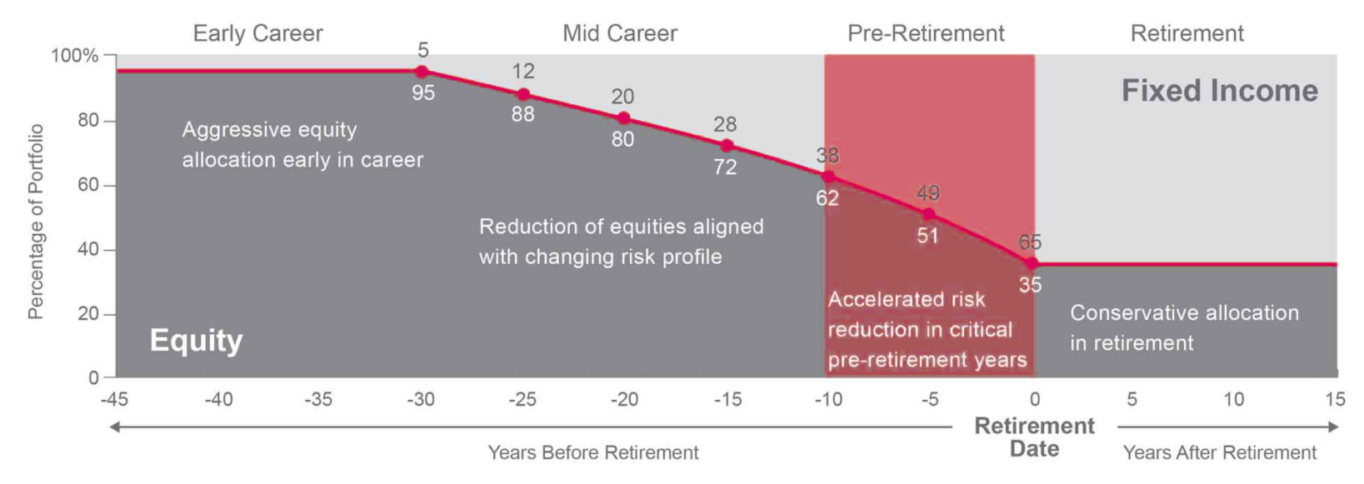
Target date funds
Build a portfolio that adjusts as your career progresses. The way your portfolio adjusts to changes in risk tolerance over time is a primary determinant of its returns and volatility.
Glide Path
Select year closest aligned to your targeted retirement age (default is age 65)
Source: Voya Target Date Retirement Fund; Voya Advantages | 2Q24.
17 | RetirementSolutionGroup.com
Notes:
Balancing risk and time.

Slide 34
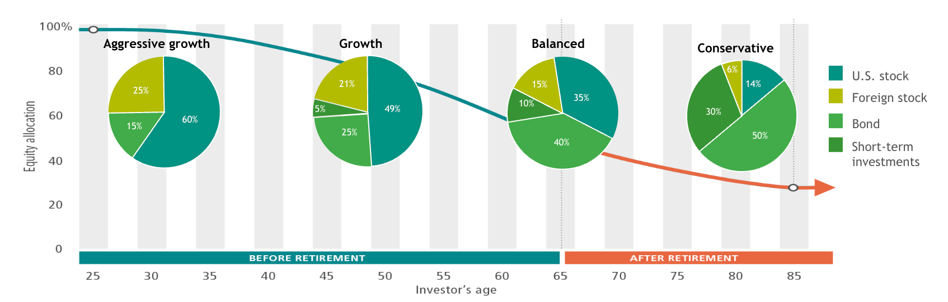
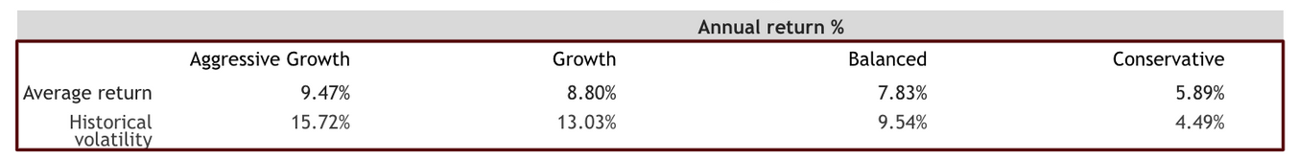
Target date funds
The closer a fund gets to its target date (your retirement date), the more it focuses on assets that traditionally have a lower risk profile, such as fixed income, cash and cash equivalents.
Data source: Ibbotson Associates, 2018 (1926–2018). Past performance is no guarantee of future results. Returns include the reinvestment of dividends and other earnings. This chart is for illustrative purposes only and does not represent actual or implied performance of any investment option. See endnote 1 for detailed information.
34 | RetirementSolutionGroup.com

Slide 35
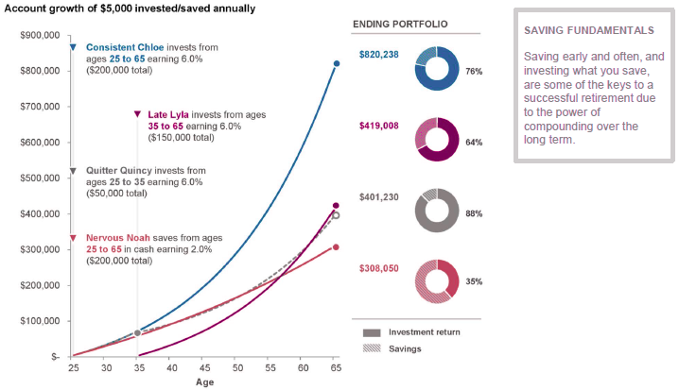
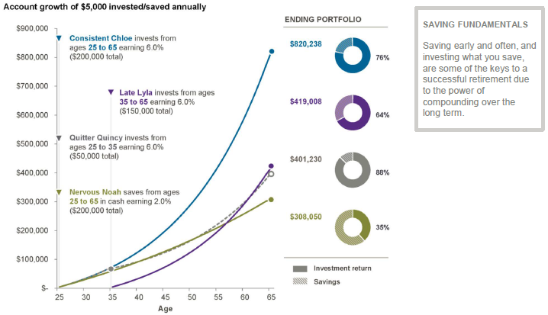
Investing early Makes a difference
The above example is for illustrative purposes only and not indicative of any investment. Account value in this example assumes a 6.0% annual return and cash assumes a 2.0% annual return. Source: J.P. Morgan Asset Management, Long-Term Capital Market Assumptions. Compounding is the increasing value of assets due to investment return earned on both principal and prior investment gains. Source: J.P. Morgan Asset Management, Guide to Retirement
35 | RetirementSolutionGroup.com

Slide 36
Age and volatility
The impact of a volatile market is greatly different, based on how long you have left in the market.
Early Career
Near Retiree
22
60
Age
$1,000
$500,000
Portfolio Balance
-$250
Impact of 25% loss
-$125,000
$300
Next Monthly Contribution
$637
$1,050
Balance in
subsequent month
$375,637
Contributions essentially
erase loss
Losses
are
impactful
$50
Net gail/loss
-$124,363
36 | RetirementSolutionGroup.com

Slide 37

Beneficiary Designation
Review and update regularly
401 (k) distributed using named beneficiary
  no beneficiary = probate
Name primary and contingent
  primary = spouse unless otherwise consented to
  contingent = anyone
  sum of each must = 100%
State determines custodian of minors
37 | RetirementSolutionGroup.com

Slide 39

Rollover
39 | RetirementSolutionGroup.com

Slide 40




Step by Step Rollover Guidance
  Choose your account type
  Understand the investment choices, fees and other details your plan
  Consolidate past 401(k)s into your current plan or roll over your money to an IRA
  Name beneficiaries
40 | RetirementSolutionGroup.com

Slide 41

The benefits of Consolidation
ONE
complete view
a single
  ONE statement
  ONE website
  ONE support center
Strategy
for managing your retirement funds
Simplify
your
financial life
potential
simplify
Savings
Distributions
with fewer fees
than you may
be paying separately
and avoid potential costly tax penalties
41 | RetirementSolutionGroup.com

Slide 42

Weigh Your Options thoughtfully
When you change jobs or retire, you’ll need to decide what to do with your retirement plan savings.
The decisions you make today will impact your future, so it’s important to weigh each option and decide which may be best for your situation.
You may be charged higher fees and no longer have an HR team at your disposal
LEAVE IT WHERE IT IS
TAKE IT IN CASH
You will be
penalized 10% for
early withdrawal and taxed on this money
ROLL IT INTO YOUR NEW EMPLOYER’S PLAN
ROLL IT OVER TO A QUALIFIED RETIREMENT ACCOUNT
and simplify your finances
like an IRA
42 | RetirementSolutionGroup.com

Slide 43
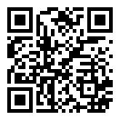
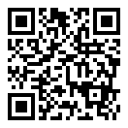

How to find past retirement accounts
Labor Department
www.efast.dol.gov/welcome.html
National Registry of Unclaimed Retirement Benefits unclaimedretirementbenefits.com
National Association of Unclaimed Property Administrators
unclaimed.org/search
43 | RetirementSolutionGroup.com

Slide 45

Pre-Tax vs ROTH
45 | RetirementSolutionGroup.com

Slide 46








Types of Retirement accounts
Employer sponsored retirement plans
Individual
retirement plans
401(k)/ 403(b)s / 457(b)
  Higher contribution limits
  No income restrictions
  Automated payroll contributions
  Employer contributions*
  Limited investment options
IRA
  Lower contribution limits
  Income restrictions
  Manual contributions
  No employer contributions
  More investment options
  Save for retirement
  Potential investment growth
  Tax advantages
  Pre-tax & Roth options available
sets up & may contribute
% out of paycheck
sets up & contributes
46 | RetirementSolutionGroup.com

Slide 47


Understanding Contributions
Employer Match
Employee Pre-Tax
Employee Roth
Contributions made before tax
Contributions made after-tax
Reduce your current taxable income
Does not reduce your current taxable income
Taxes paid on withdrawals
Taxed now
Taxed as income when withdrawn
Taxed at current rate, through payroll
Total
combine 401(k) contribution
Earnings are tax-deferred
Earnings are tax free
Money available penalty-free at age 59 ½
Money available penalty-free at age 59 ½ and account needs to be open for 5+ years
Early withdrawals with penalty
Early withdrawals with penalty
10% penalty plus federal and state taxes (where applicable)
10% penalty plus income taxes paid on earnings
(not to exceed annual IRS limits)
47 | RetirementSolutionGroup.com

Slide 49

401(k) Loans
49 | RetirementSolutionGroup.com

Slide 50
Impact of taking a 401(k) Loan
Borrowing from your future should always be your last option and one you should not consider until you’ve assessed the implications
IT IS NOT FREE MONEY
THE MONEY CAN NO LONGER GROW
YOU MUST REPAY THE LOAN
WHAT HAPPENS TO 401(K) LOANS?
1
1
  Payments are typically deducted from your payroll each month, leaving you with less take home pay
  There is a structured repayment plan
  Interest payments are due on the loan principle
Withdrawn money will miss out on potential:
  Capital appreciation
  Dividends
  Rising markets
  Compounded growth
  Even if you leave your job, you are responsible for repaying the loan
  If you are younger than 59 ½, defaulting on the loan would incur a 10% tax-penalty, in addition to federal and possible state tax
$10,400
Average unpaid
loan balance
10%
of employees default
on 401(k) loans
50 | RetirementSolutionGroup.com

Slide 51




Long-Term Impact of a Loan
Kathy
  Takes a loan
  Reduces contributions from 5% to 3% while repaying loan
Jim
  Doesn’t take a loan
  Contributes 5%
LOAN:
$10,000
$316,613
$295,350
1
Annual Salary:
$30,000
Denise
  Takes a loan
  Continues contributing 5% while repaying loan
Bryan
  Takes a loan
  Stops contributing while repaying loan
$312,433
$269,725
This is a hypothetical mathematical illustration only. It represents no particular investment and does not account for taxes. Figures are based on assumptions as set out, and individual circumstances may vary. Assumes a loan of $10,000, an annual salary of $30,000, a beginning balance of $20,000, 30 years until retirement, a 7% annual rate of return compounded monthly, and a loan interest rate of 4.25%. There is no guarantee that any investment objective will be met. Source: John Hancock
51 | RetirementSolutionGroup.com

Slide 52



importance of emergency savings
Keep money in reserve for a serious unexpected predicament
Fund an
EMERGENCY RESERVE
1
3 6
1
in the amount of
to
1 2
Put away an amount equal to
Build savings within
20%
to
months of expenses
years
of salary
52 | RetirementSolutionGroup.com

Slide 54

Social Security
54 | RetirementSolutionGroup.com

Slide 55


collecting Your Full BEnefits
Social Security benefits are based on your Full Retirement Age (FRA).
Year of Birth
Full Retirement Age
1943 - 1954
1955
1956
1957
1958
1959
1960+
66 years
66 years + 2 months
66 years + 4 months
66 years + 6 months
66 years + 8 months
66 years + 10 months
67 years
SOURCE: Social Security Administration
55 | RetirementSolutionGroup.com
Notes:
The Social Security Administration (SSA) uses something called your Full Retirement Age (FRA) as the basis for calculating Social Security benefits.
The full retirement age is 66 if your were born 1943-1954. FRA increases gradually if you were born from 1955 to 1960 until it reaches 67. For anyone born 1960 or later, full retirement benefits are payable at age 67.
Knowing your Full Retirement Age (FRA), makes it a lot easier to understand Social Security.
If you take any Social Security benefits before FRA, they will be reduced. If you apply for any benefit at or after FRA, the benefits grow or are maximized.
You’ll also notice that a lot of Social Security calculations are based on your FRA

Slide 56
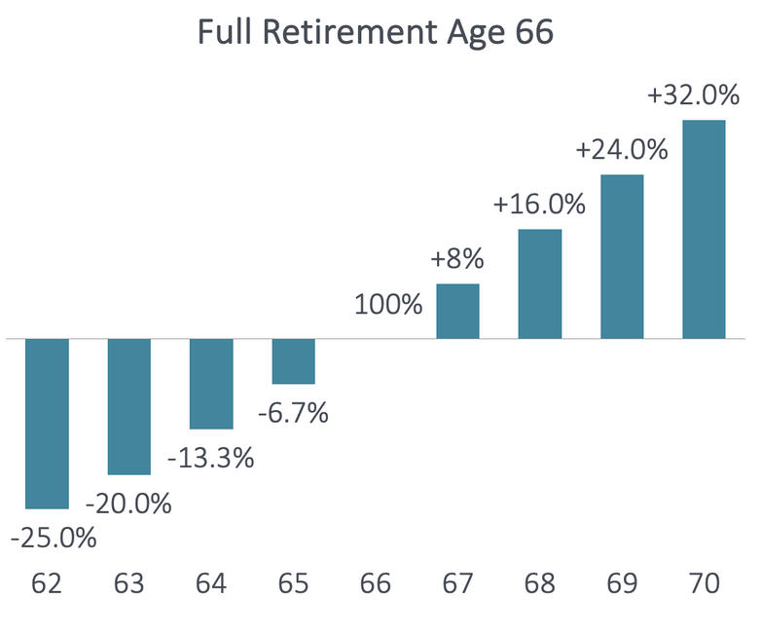
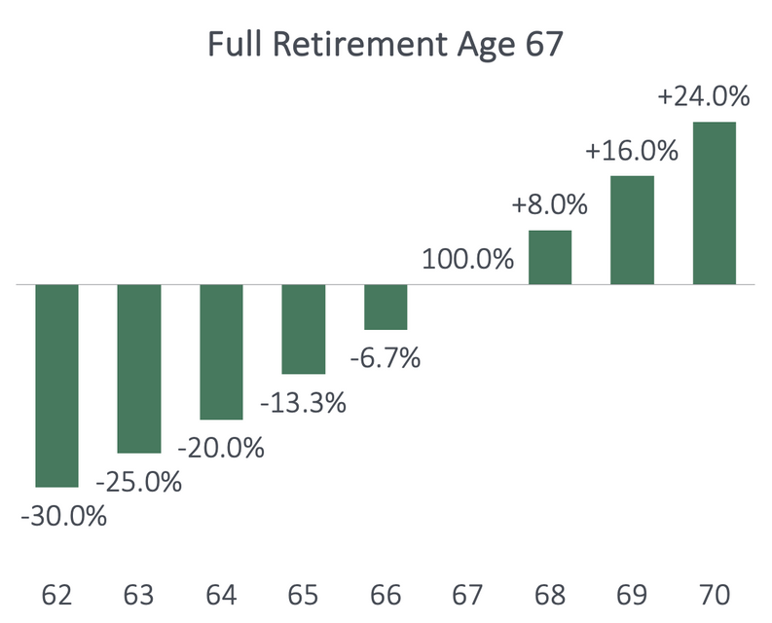
Eligibility for Retirement Benefits
You need at least 10 years of work (40 credits) to qualify for Social Security retirement benefits.
The amount of your benefit is based on your highest 35 years of earnings.
62
66
70
62
67
70
SOURCE: Social Security Administration
56 | RetirementSolutionGroup.com
Notes:
For all workers, you are eligible for Social Security retirement benefits after you have worked for 40 quarters. In 2023, you qualify for a quarter of work if you have earned income of $1,640. The Social Security Administration then averages your earnings over your 35 highest years of work to determine your Social Security retirement benefit.
If you claim Social Security before Full Retirement Age, your Social Security retirement benefits will be permanently reduced. If, however, you take your Social Security benefits at or after Full Retirement Age, your retirement benefits grow by 8% per year* up until age 70. This is in addition to any annual cost-of-living adjustments. The maximum Social Security retirement benefit is available at age 70.

Slide 57
How Working Affects your Benefits
Retirees can work and still receive Social Security benefits. However, if earnings exceed a certain threshold, benefits may be reduced.
Through Year
Before FRA
In Year Of FRA
Month Turn FRA
& Older
Earnings Limit (2023)
$21,240
($1,770 per month)
$ 56,520
($4,710 per month)
No Restrictions
Withholding Amount
$1 of benefits withheld for every $2 of earnings above limit
$1 of benefits withheld for every $3 of earnings above limit
No Restrictions
  Earnings limits look at wages only. Unearned income (pensions, IRAs, rental income, etc.) does not cause Social Security benefits to be withheld
  Earnings limit only affects wages received after you start your Social Security benefit
  If married, Social Security only considers the wages of the spouse receiving Social Security
SOURCE: Social Security Administration, SSA Publication No. 05-10147, SSA Publication No. 05-10069.
57 | RetirementSolutionGroup.com
Notes:
If you’re younger than full retirement age, there is a limit to how much you can earn and still receive full Social Security benefits.
If you’re younger than full retirement age during all of 2023, the Social Security Administration (SSA) will deduct $1 from your benefits for each $2 you earn above $21,240.
If you reach full retirement age during 2023, the Social Security Administration will deduct $1 from your benefits for each $3 you earn above $56,520 until the month you reach full retirement age
This withholding applies to ANY Social Security benefit you receive. It affects your retirement, spousal, survivors and the divorce benefits.
If you are married, the Social Security Administration only looks at the earnings of the individual who is collecting Social Security before FRA. For example: One spouse is age 62, retired and receives their Social Security retirement benefit. The other spouse is age 65 working and earning $50,000. Social Security only looks at the wages of the spouse collecting Social Security – not both of their wages.
Earnings limit looks at wages only. Unearned income (pensions, IRAs, rental income, etc.) does not cause Social Security benefits to be withheld while working and under FRA.
Additional Information if the clients ask: If you are collecting Social Security before Full Retirement Age and then return to work, the SSA will recalculate your benefit as if you had applied x months later. For example: if you claimed your retirement benefit at age 62, and then later went back to work for twelve months, the SSA will recalculate your benefits as if you had applied at age 63 (twelve months later). You will see this increase when you attain Full Retirement Age.
Sources for this page: SSA Publication No. 05-10147 , SSA Publication No. 05-10069.

Slide 58
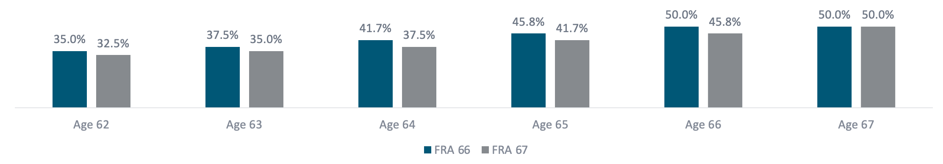
Spousal Benefits
At your Full Retirement Age, you may receive up to 50% of your spouse’s Social Security benefit. Spousal benefits can be reduced if you begin receiving them before your FRA.
  You receive the greater of either your retirment or your spousal benefit.
  Available even if you did not work.
  Amount is based on your spouse’s FRA benefit amount.
SOURCE: Social Security Administration, SSA Publication No. 05-10147, SSA Publication No. 05-10069.
58 | RetirementSolutionGroup.com
Notes:
The SSA also offers a spousal benefit. Even if you never worked, you may receive up to 50% of your spouse's benefit at Full Retirement Age. You could receive a reduced spousal benefit at age 62 of 32.5%-35% of your spouse's benefit at their retirement age.
In order to receive a spousal benefit, your spouse must have applied for his or her retirement benefit. Some other important things to know are:
Only one spouse a time can receive a spousal benefit. If you both worked, you generally receive the greater of your personal or spousal benefit.
The spousal benefits are always based on your spouse's benefit at Full Retirement Age, regardless of when he or she claim Social Security.
Notice that the spousal benefits do not grow after your Full Retirement Age. Even though the retirement benefit grows past your Full Retirement Age, the spousal benefit is maxed out at your Full Retirement Age.
By the way, if you are eligible for a divorced spousal benefit, it's calculated the same way. We'll get to the divorcee qualifications at the end of the section.

Slide 59
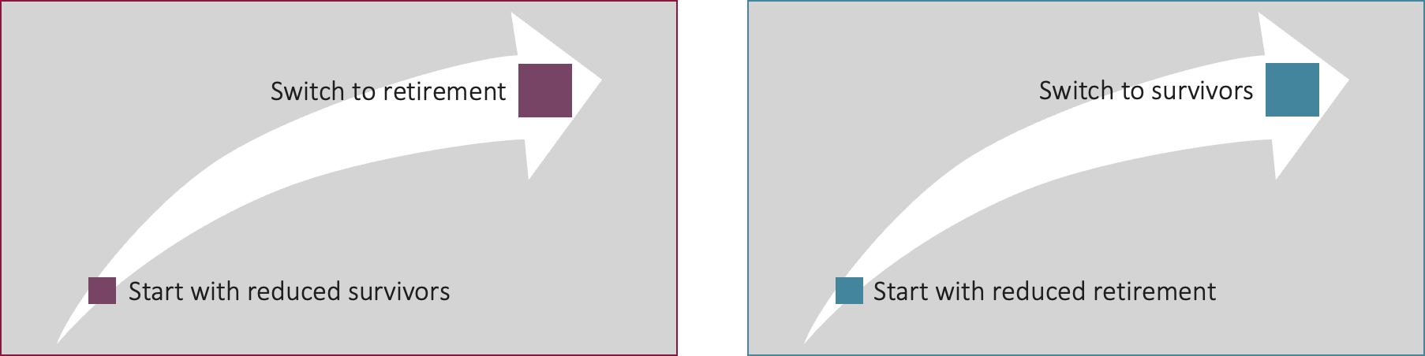
Survivors Benefits
Social Security survivors' benefits are paid to widows, widowers, and dependents of eligible workers. Surviving spouses may have a couple of additional options.
  May start with one benefit and switch; earnings limit applies to any benefit received before Full Retirement Age (FRA).
Option 1
Option 2
SOURCE: Social Security Administration
59 | RetirementSolutionGroup.com
Notes:
Surviving spouses aged 60-70 may have a couple of additional options:
Option 1: Start with reduced survivor, switch to retirement: Under this option, the widow (widower) starts with reduced survivors benefit as early as age 60. They then switch to their retirement benefit at any time between age 62 and 70.
Option 2: Start with reduced retirement, switch to full survivors. Under this option, the widow (widower) starts with the reduced retirement benefit as early as age 62. They then switch to the survivor benefit at any time. The survivor benefit is maximized if the survivor claims the survivor benefit at their (the survivor's) Full Retirement Age.
Remember: The earnings limit applies to any benefit that is received before Full Retirement.

Slide 60
Divorcee Benefits
A divorced spouse may receive up to 50% of an ex-spouse's Social Security benefits. The benefit doesn’t increase existing payments or reduce the ex-spouse’s benefits.
All must be true:
Marriage Requirements
Current Marital Status
Benefits
  The marriage lasted at least 10 years
  Your divorced spouse is 62+, deceased or disabled
  You are divorced at least 2 years
  You are unmarried
  Your benefit (based on your own work history) is less than the Social Security divorced spouse benefit.
  Your ex-spouse is entitled to Social Security retirement benefits.
SOURCE: Social Security Administration
60 | RetirementSolutionGroup.com
Notes:
If you are divorced, but your marriage lasted 10 consecutive years or longer, you may qualify for benefits off your ex-spouse.
You can receive a spousal benefit off your ex-spouse's record (even if he/she has remarried) if:
You are unmarried
You and your former spouse are age 62 or older
Your ex-spouse is entitled to Social Security retirement or disability benefits.
Unlike married couples (where your spouse needs to apply in order for you to receive a spousal benefit), if you are divorced, your former spouse does not need to apply for their retirement benefits in order for you to receive a divorced spousal benefit. If you can provide the Social Security office with your former spouse's name and SSN, a copy of the marriage license and divorce decree, the SSA will check to see if you qualify for a benefit off of your former spouse.
If both divorced spouses worked, each spouse generally receive the greater of their retirement or spousal benefit. However, if you were born on or before January 1, 1954, you may be eligible for restricted application (start with spousal, switch to your retirement benefit at a later age) as long as your ex-spouse is age 62 or older or disabled
If your former spouse has passed away, you are entitled to a survivors benefit as long as you:
Are age 60
Are unmarried or remarried after age 60.
If you are working and under FRA, the earnings limit applies to your divorce spousal benefits.

Slide 62

Market Update
62 | RetirementSolutionGroup.com

Slide 63
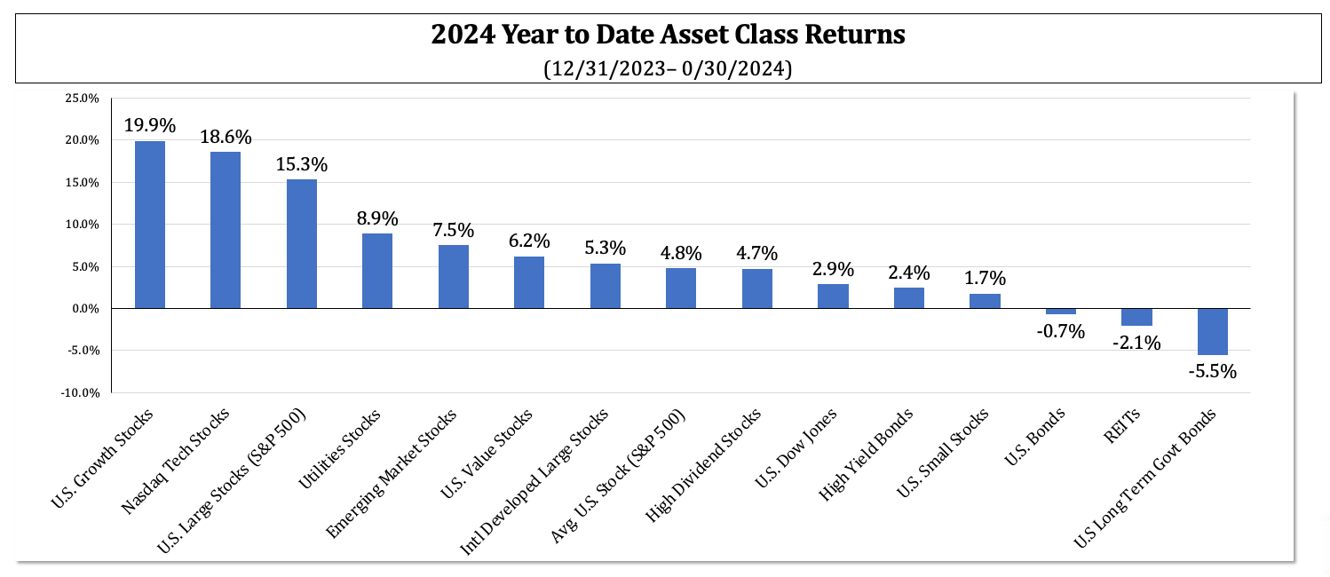
2024: Year to Date Performance
The ‘Important Disclosures’ section provides index definitions. Index data source is YCharts and are inclusive of reinvested dividends. U.S. Large Stocks (S&P 500), U.S. Value Stocks (Russell 3000 Value), U.S. Growth Stocks (Russell 3000 Growth), U.S. Small Stocks (Russell 2000), Nasdaq Tech Stocks (Nasdaq Composite), Intl Developed Large Stocks (MSCI EAFE International Developed), Emerging Market Stocks (MSCI Emerging Markets), U.S. Long Term Govt Bonds (ICE U.S. Treasury 20+ Year Bond), REITs (Wilshire U.S. REITs), U.S. Bonds (Bloomberg Barclays Aggregate Bond), “Average” U.S. Stock is the S&P 500 (S&P 500 Equal Weight Index).
63 | RetirementSolutionGroup.com
Notes:
This slide is from Mid-Year Update 2024

Slide 64
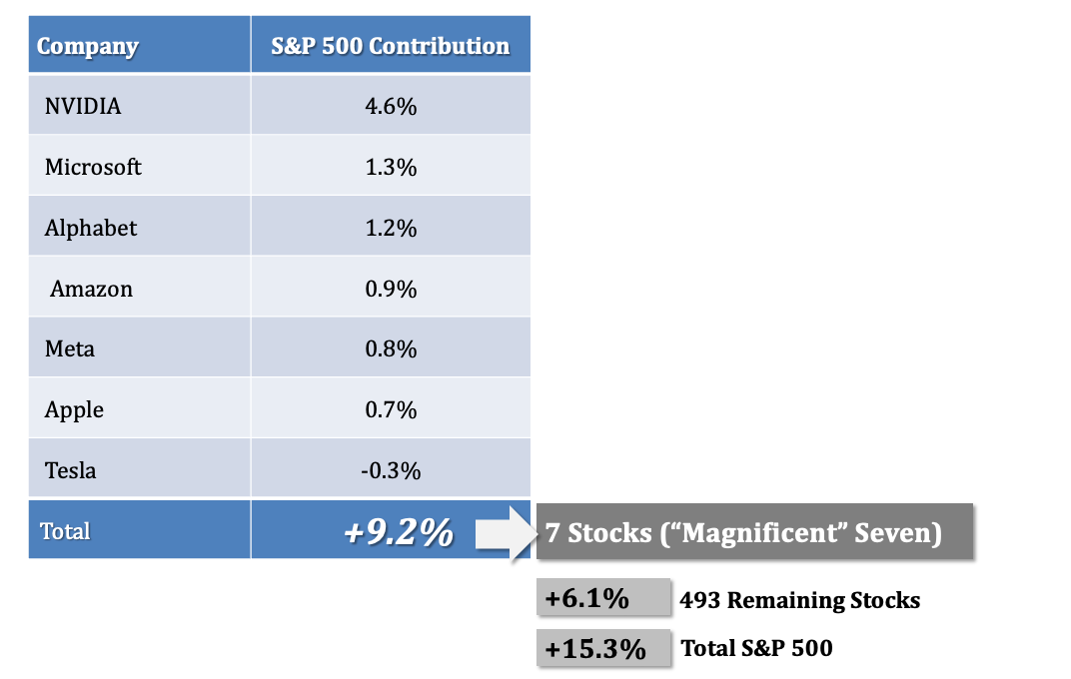
2024: Year to Date S&P 500 Stock Contribution
Source: YCharts, estimates. total returns assume dividends reinvested. .
64 | RetirementSolutionGroup.com
Notes:
This slide is from Mid-Year Update 2024

Slide 65
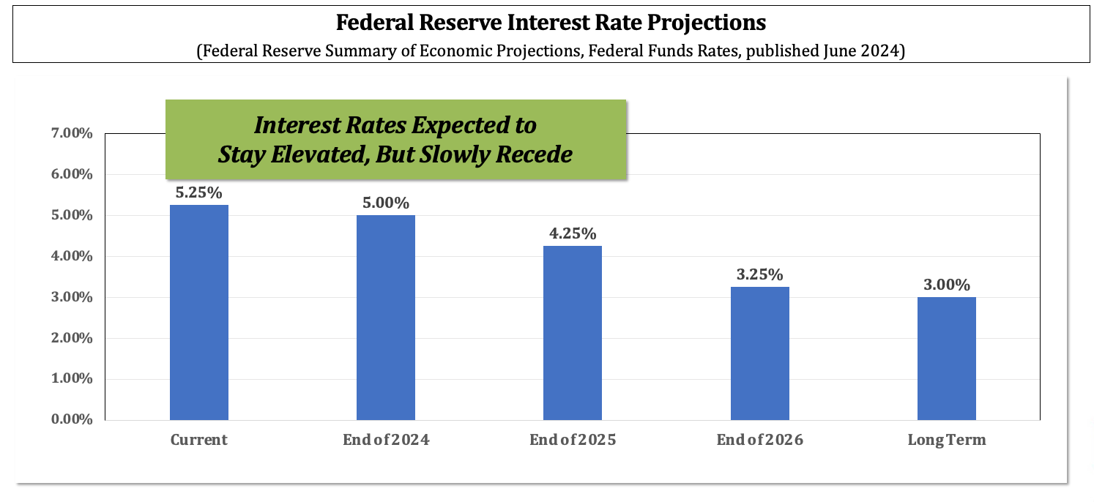
Current Interest Rate Expectations
Source: Federal Reserve, Barron’s June 14, 2024.
65 | RetirementSolutionGroup.com
Notes:
This slide is from Mid-Year Update 2024

Slide 66
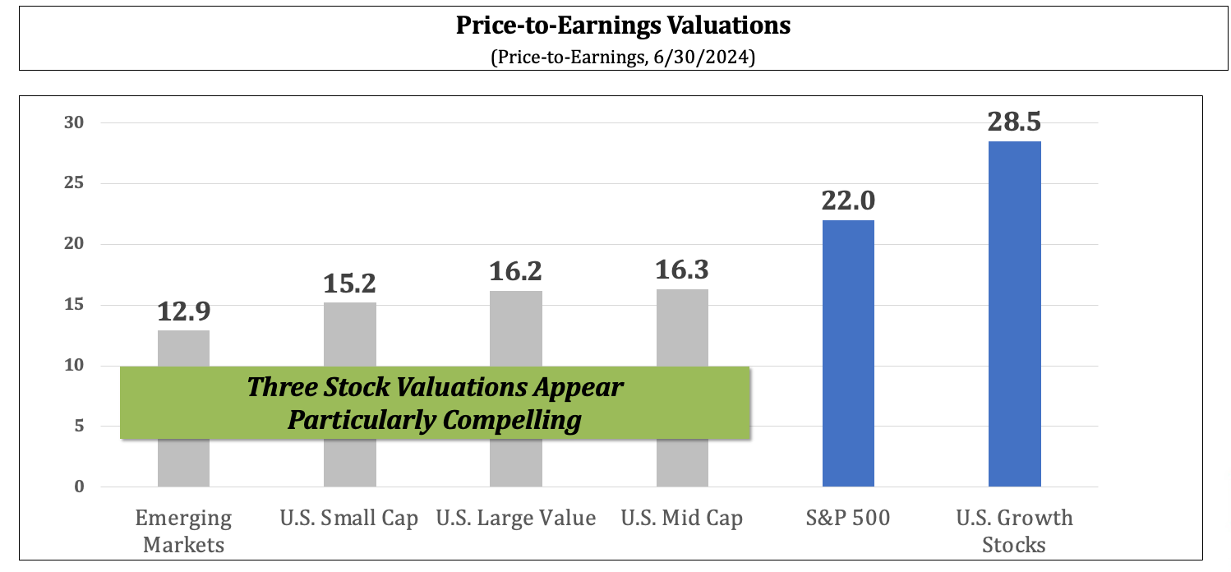
Current Stock Market Valuations
The ‘Important Disclosures’ section provides index definitions. Data source is YCharts.
66 | RetirementSolutionGroup.com
Notes:
This slide is from Mid-Year Update 2024

Slide 68

NEXT STEPS
68 | RetirementSolutionGroup.com

Slide 69








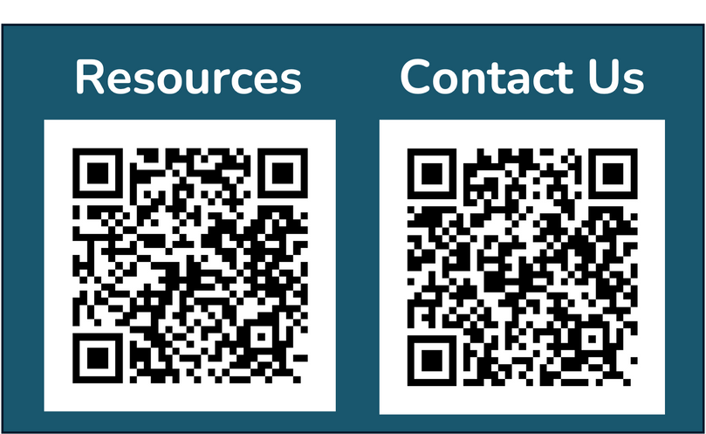
We’re Here to Help
Your Team:
Chicago, IL | Portsmouth, NH
866.352.7731
www.RSGadvisory.net
69 | RetirementSolutionGroup.com

Slide 70
We’re Here to Help
Your Team:
Chicago, IL | Portsmouth, NH
866.352.7731
www.RetirementSolutionGroup.com
70 | RetirementSolutionGroup.com

Slide 71
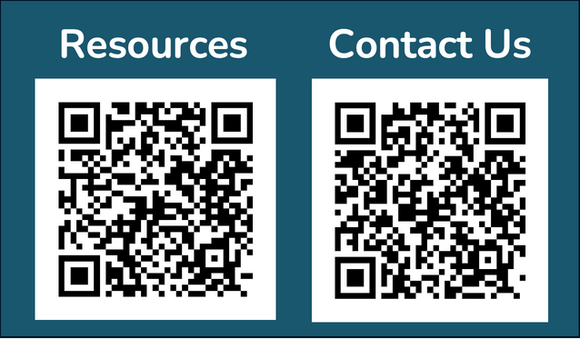
Questions?
How can I help?
Elvia Sanchez, CPFA
Principal
Retirement Solution Group
elvia@retirementsolutiongroup.com
1-866-352-7731 ext. 410
®
Elvia Sanchez
PRINCIPAL, CPFA®
Securities offered through LPL Financial, Member FINRA/SIPC. Investment advisory services offered through RSG Advisory, a registered investment advisor. RSG Advisory and LPL Financial are separate, non-affiliated entities. Investors should carefully consider the investment objectives, risks, charges and expenses. This and other important information is contained in the prospectus, which can be obtained from your investment professional and should be read carefully before investing or sending money. Investments are not FDIC-insured, nor are they deposits of or guaranteed by a bank or any other entity.
71 | RetirementSolutionGroup.com

Slide 72


Additional Questions?
John Hancock Retirement
Plan Id #: 165604
myplan.johnhancock.com
1-800-395-1118
Securities offered through LPL Financial, Member FINRA/SIPC. Investment advisory services offered through RSG Advisory, a registered investment advisor. RSG Advisory and LPL Financial are separate, non-affiliated entities. Investors should carefully consider the investment objectives, risks, charges and expenses. This and other important information is contained in the prospectus, which can be obtained from your investment professional and should be read carefully before investing or sending money. Investments are not FDIC-insured, nor are they deposits of or guaranteed by a bank or any other entity.
72 | RetirementSolutionGroup.com

Slide 73
Questions?
How can I help?
Christie Cheng, CPFA
Principal
Retirement Solution Group
christie@retirementsolutiongroup.com
1-866-352-7731 ext. 310
®
Christie Cheng
PRINCIPAL, CPFA®
Securities offered through LPL Financial, Member FINRA/SIPC. Investment advisory services offered through RSG Advisory, a registered investment advisor. RSG Advisory and LPL Financial are separate, non-affiliated entities. Investors should carefully consider the investment objectives, risks, charges and expenses. This and other important information is contained in the prospectus, which can be obtained from your investment professional and should be read carefully before investing or sending money. Investments are not FDIC-insured, nor are they deposits of or guaranteed by a bank or any other entity.
73 | RetirementSolutionGroup.com

Slide 74
Questions?
How can I help?
Kevin Delaney, CPFA
VP of Business Development
Retirement Solution Group
kevin@retirementsolutiongroup.com
1-866-352-7731 ext. 415
®
Kevin Delaney
VP BUSINESS DEVELOPMENT, CPFA®
Securities offered through LPL Financial, Member FINRA/SIPC. Investment advisory services offered through RSG Advisory, a registered investment advisor. RSG Advisory and LPL Financial are separate, non-affiliated entities. Investors should carefully consider the investment objectives, risks, charges and expenses. This and other important information is contained in the prospectus, which can be obtained from your investment professional and should be read carefully before investing or sending money. Investments are not FDIC-insured, nor are they deposits of or guaranteed by a bank or any other entity.
74 | RetirementSolutionGroup.com

Slide 75
Questions?
How can I help?
Chris Underwood, AIF, CPFA
Principal
Retirement Solution Group
chris@retirementsolutiongroup.com
1-866-352-7731 ext. 160
®
Chris Underwood
PRINCIPAL, AIF, CPFA®
Securities offered through LPL Financial, Member FINRA/SIPC. Investment advisory services offered through RSG Advisory, a registered investment advisor. RSG Advisory and LPL Financial are separate, non-affiliated entities. Investors should carefully consider the investment objectives, risks, charges and expenses. This and other important information is contained in the prospectus, which can be obtained from your investment professional and should be read carefully before investing or sending money. Investments are not FDIC-insured, nor are they deposits of or guaranteed by a bank or any other entity.
75 | RetirementSolutionGroup.com

Slide 76
Questions?
How can I help?
Judy Gutierrez
Senior Relationship Manager
Retirement Solution Group
judy@retirementsolutiongroup.com
1-866-352-7731 ext. 185
Judy Gutierrez
SR. RELATIONSHIP MANAGER
Securities offered through LPL Financial, Member FINRA/SIPC. Investment advisory services offered through RSG Advisory, a registered investment advisor. RSG Advisory and LPL Financial are separate, non-affiliated entities. Investors should carefully consider the investment objectives, risks, charges and expenses. This and other important information is contained in the prospectus, which can be obtained from your investment professional and should be read carefully before investing or sending money. Investments are not FDIC-insured, nor are they deposits of or guaranteed by a bank or any other entity.
76 | RetirementSolutionGroup.com

Slide 78

Plan Compliance
78 | RetirementSolutionGroup.com

Slide 79

Investment Monitoring
79 | RetirementSolutionGroup.com

Slide 80

RecordKeeper Update
80 | RetirementSolutionGroup.com

Slide 81

Industry Update
81 | RetirementSolutionGroup.com

Slide 82

Participant Education
82 | RetirementSolutionGroup.com

Slide 84
Important disclosures
Securities are offered through LPL Financial, member FINRA/SIPC. Investment Advisory Services offered through RSG Advisory a registered Investment Advisor. RSG Advisory and LPL Financial are separate, non-affiliated entities.
The opinions voiced in this material are for general information only and are not intended to provide specific advice or recommendations for any individual. We suggest that you discuss your specific situation with your financial advisor prior to investing.
All indices are unmanaged and may not be invested into directly. Unmanaged index returns do not reflect fees, expenses, or sales charges inherent to investing. All performance referenced is historical and is no guarantee of future results.
The economic forecasts set forth in this material may not develop as predicted and there can be no guarantee that strategies promoted will be successful.
Investing in stock includes numerous specific risks including: the fluctuation of dividend, loss of principal and potential illiquidity of the investment in a falling market.
The prices of small cap stocks are generally more volatile than large cap stocks.
The payment of dividends is not guaranteed. Companies may reduce or eliminate the payment of dividends at any given time.
Bonds are subject to market and interest rate risk if sold prior to maturity. Bond values will decline as interest rates rise and bonds are subject to availability and change in price.
High yield/junk bonds (grade BB or below) are not investment grade securities, and are subject to higher interest rate, credit, and liquidity risks than those graded BBB and above. They generally should be part of a diversified portfolio for sophisticated investors.
Government bonds and Treasury bills are guaranteed by the US government as to the timely payment of principal and interest and, if held to maturity, offer a fixed rate of return and fixed principal value.
Investing in Real Estate Investment Trusts (REITs) involves special risks such as potential illiquidity and may not be suitable for all investors. There is no assurance that the investment objectives of this program will be attained.
The fast price swings in commodities and currencies will result in significant volatility in an investor’s holdings.
Precious metal investing involves greater fluctuation and potential for losses.
International investing involves special risks such as currency fluctuation and political instability and may not be suitable for all investors. These risks are often heightened for investments in emerging markets.
Technical analysis is based on the study of historical price movements and past trend patterns. There is no assurance that these movements or trends can or will be duplicated in the near future.
84 | RetirementSolutionGroup.com

Slide 85
Important disclosures
Rebalancing a portfolio may cause investors to incur tax liabilities and/or transaction costs and does not assure a profit or protect against a loss.
There is no guarantee that a diversified portfolio will enhance overall returns or outperform a non-diversified portfolio. Diversification does not protect against market risk.
All investing involves risk including loss of principal. No strategy assures success or protects against loss.
Index definitions and terms:
S&P 500 Index is a capitalization weighted index of 500 stocks designed to measure performance of the broad domestic economy through changes in the aggregate market value of 500 stocks representing all major industries.
NASDAQ Composite Index measures all NASDAQ domestic and non-U.S. based common stocks listed on The NASDAQ Stock Market. The market value, the last sale price multiplied by total shares outstanding, is calculated throughout the trading day, and is related to the total value of the Index.
Russell 3000 Index is a market-capitalization-weighted equity index maintained by the FTSE Russell that provides exposure to the entire U.S. stock market. The index tracks the 3,000 largest U.S.-traded stocks which represent about 98% of all U.S incorporated equity securities.
Russell 3000 Value Index is a market-capitalization weighted equity index maintained by the Russell Investment Group and based on the Russell 3000 Index, which measures how U.S. stocks in the equity value segment perform. Included in the Russell 3000 Value Index are stocks from the Russell 3000 Index with lower price-to-book ratios and lower expected growth rates.
Russell 3000 Growth Index is a market capitalization weighted index based on the Russell 3000 index. The Russell 3000 Growth Index includes companies that display signs of above average growth. The index is used to provide a gauge of the performance of growth stocks.
Russell 2000 Index is an index measuring the performance of approximately 2,000 small-cap companies in the Russell 3000 Index. The index serves as a benchmark for U.S. small-cap stocks.
MSCI EAFE Index is a stock index that is a performance benchmark for the major international equity markets as represented by 21 major MSCI indices from Europe, Australia and Middle East.
MSCI EAFE Small Cap Index is an equity index which captures small cap representation across Developed Markets as represented by MSCI indices from Europe, Australia and the Middle East.
MSCI Emerging Markets Index consists of 23 economies: Brazil, Chile, China, Colombia, Czech Republic, Egypt, Greece, Hungary, India, Indonesia, Korea, Malaysia, Mexico, Peru, Philippines, Poland, Qatar, Russia, South Africa, Taiwan, Thailand, Turkey and the UAE.
Dividend Aristocrats Index are S&P 500 index constituents that have increased their dividend payouts for 25 consecutive years or more.
Wilshire REIT Index defines and measures the investable universe of publicly traded real estate investment trusts domiciled in the U.S.
85 | RetirementSolutionGroup.com

Slide 86
Important disclosures
Goldman Sachs Crude Oil Total Return Index reflects available through an unleveraged investment in the West Texas Intermediate (WTI) crude oil futures contract plus the Treasury Bill rate of interest that could be earned on funds committed to the trading of the underlying contracts.
Bank of America Merrill Lynch U.S. Corporate AAA Index is an index of U.S. AAA corporate bonds. The Bank of America Merrill Lynch U.S. Corporate BBB Index includes U.S. BBB corporate bonds
S&P U.S. Preferred Stock Index is designed to serve the investment community's need for an investable benchmark representing the U.S. preferred stock market. Preferred stocks provide investors with a dividend, but do not offer equity in shares.
Bloomberg High Yield Bond Index measures the USD-denominated, high yield, fixed-rate corporate bond market. Securities are classified as high yield if the middle rating of Moody's, Fitch and S&P is Ba1/BB+/BB+ or below. High Yield bonds are considered low quality bonds.
Market Vectors Floating Rate Bond Index This index provides exposure to the floating rate segment of the U.S. investment grade bond market. Floating rate notes are bonds that have coupon payments that change based on various market characteristics- including rises and falls in interest rates. Holdings are chosen based on amount of debt issued.
Barclays US Aggregate Bond Index is a market capitalization-weighted index, meaning the securities in the index are weighted according to the market size of each bond type. Most U.S. traded investment grade bonds are represented.
Barclays Corporate Bond measures the performance of the investment grade U.S. corporate bond market. Securities must be fixed rate, U.S. dollar denominated, taxable and rated investment grade as defined by the Index methodology. Inclusion is based on currency of issue, not its domicile.
Barclays US Treasury Index is a market-capitalization weighted index that measures the performance of public obligations of the U.S. Treasury that have a maturity of one year or more.
Citigroup USBIG Treasury Bill 3M index “T-bill” is an unmanaged index representing monthly return equivalents of yield averages of the last 3-month Treasury Bill issues.
CBOE Volatility Index® (VIX®) is meant to be forward looking, showing the market's expectation of 30-day volatility in either direction, and is considered by many to be a barometer of investor sentiment and market volatility, commonly referred to as “Investor Fear Gauge”.
Gross Domestic Product (GDP) is the monetary value of all the finished goods and services produced within a country’s borders in a specific time period, though GDP is usually calculated on an annual basis. It includes all of private and public consumption, government outlays, investments and exports less imports that occur within a defined territory.
86 | RetirementSolutionGroup.com

