Slide 1
This document is a sample sales and trustee deck, which can be used as a starting point. All plan specific info throughout is for exemplary purposes only and should be replaced, customizing for the individual client with actual plan specific information.
  Sections can be removed when not necessary.
  Links embedded (such as Venrollment) should be replaced with client specific links.
  Sections such as About RSG and Market Outlook have been updated to reflect 2025 data.

Slide 2
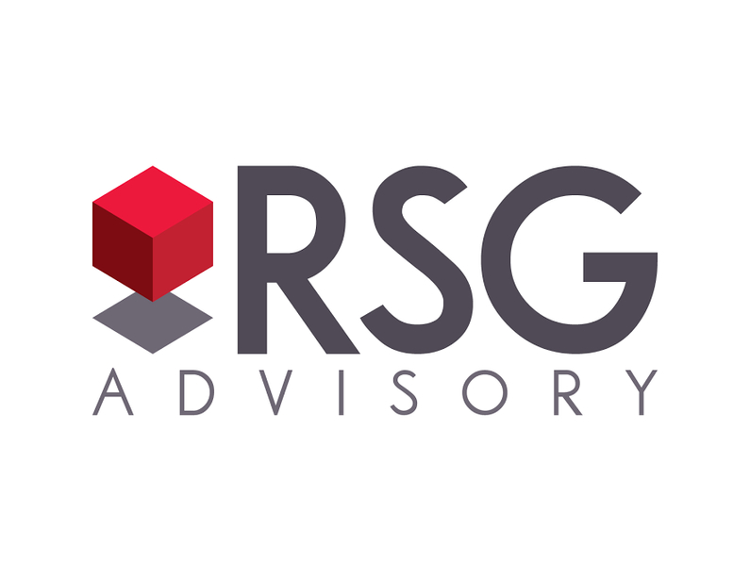

Deck Title
Client Name
Month 2024
Securities are offered through LPL Financial, member FINRA/SIPC. RSG Advisory and LPL Financial are separate, non-affiliated entities. Investment advisory services offered through Global Retirement Partners, LLC dba DBA RSG Advisory, an SEC registered investment advisor.

Slide 3
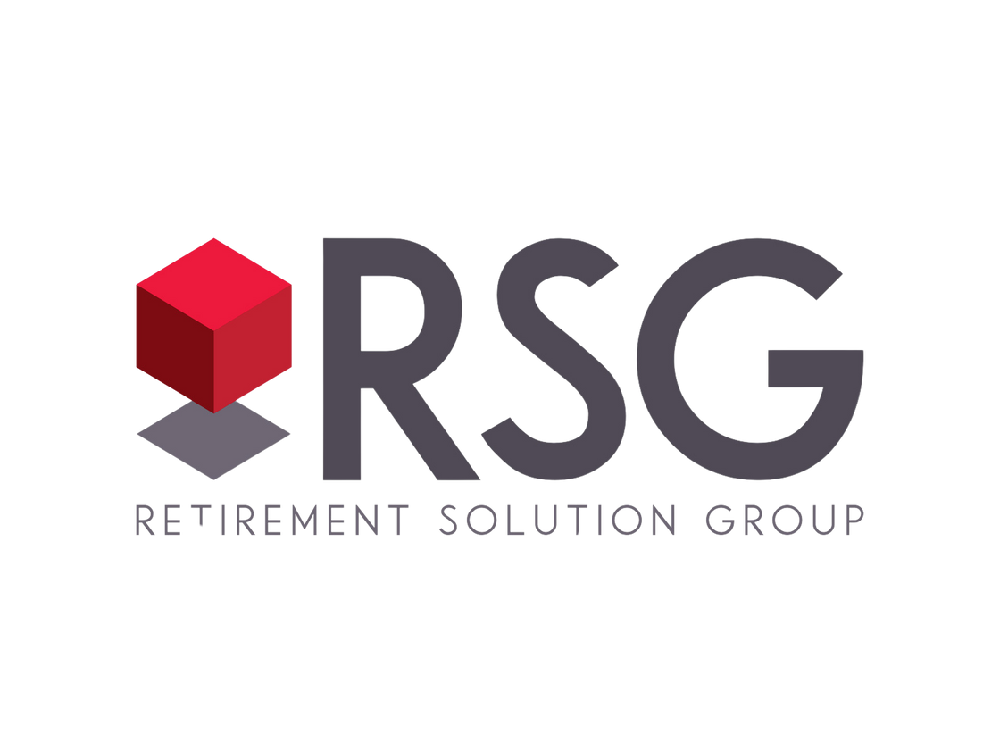

Alt design/Brand for Title Slide
Client Name
Month 2024
Securities are offered through LPL Financial, member FINRA/SIPC. RSG Advisory and LPL Financial are separate, non-affiliated entities. Investment advisory services offered through Global Retirement Partners, LLC dba DBA RSG Advisory, an SEC registered investment advisor.

Slide 4
Alt design/Brand for Title Slide
Client Name
Month 2024
Securities are offered through LPL Financial, member FINRA/SIPC. RSG Advisory and LPL Financial are separate, non-affiliated entities. Investment advisory services offered through Global Retirement Partners, LLC dba DBA RSG Advisory, an SEC registered investment advisor.

Slide 5



Alt design/Brand for Title Slide
this is an option
Securities are offered through LPL Financial, member FINRA/SIPC. RSG Advisory and LPL Financial are separate, non-affiliated entities. Investment advisory services offered through Global Retirement Partners, LLC dba DBA RSG Advisory, an SEC registered investment advisor.

Slide 6

Alt design/Brand for Title Slide
this is an option
Securities are offered through LPL Financial, member FINRA/SIPC. RSG Advisory and LPL Financial are separate, non-affiliated entities. Investment advisory services offered through Global Retirement Partners, LLC dba DBA RSG Advisory, an SEC registered investment advisor.

Slide 7

Alt design/Brand for Title Slide
this is an option
Securities are offered through LPL Financial, member FINRA/SIPC. RSG Advisory and LPL Financial are separate, non-affiliated entities. Investment advisory services offered through Global Retirement Partners, LLC dba DBA RSG Advisory, an SEC registered investment advisor.

Slide 8



Agenda
Plan Compliance
Plan Health
Education
Market Update
Investment Monitoring
Recordkeeper Update
Other New Business
8 | RSGAdvisory.net

Slide 9





Our Core business
At RSG Advisory we specialize in employer sponsored retirement plans.
Full service, holistic, independent approach
Knowledgable Advisory Specialists
Fiduciary administrators
Trusted Partners
We believe:
There is great value in education.
Retirement planning starts with understanding our clients’ needs.
Everyone should be empowered to retire with dignity.
9 | RSGAdvisory.net

Slide 10
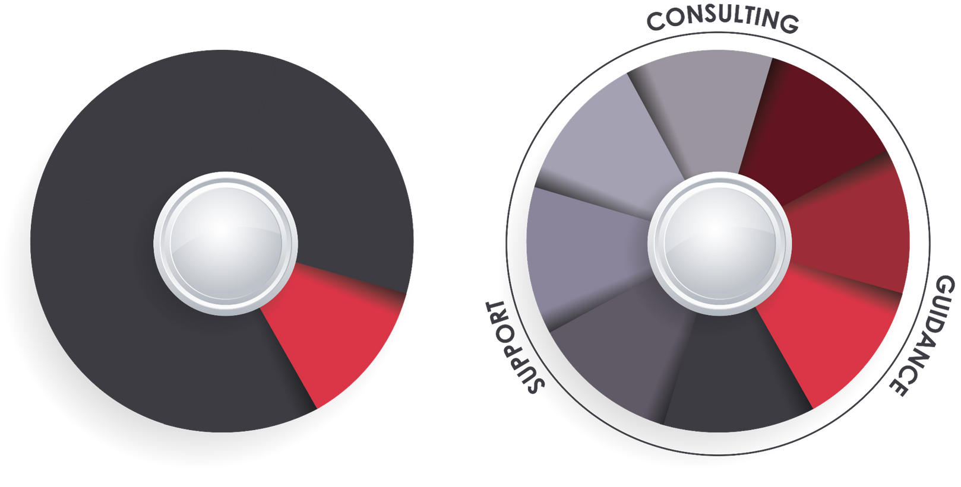
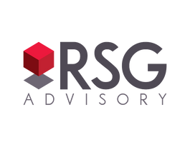
Purpose driven difference
Your business' future matters. This is not a one size fits all world. RSG embraces creating highly customized plan solutions for your business both today and into the future.
Investment Analysis
Plan Design
Fiduciary Oversight
ERISA Compliance
Plan Governance
Investment Analysis
Fee Benchmarking
Participant engagement
Financial Wellness
Most Advisors
10 | RSGAdvisory.net

Slide 11




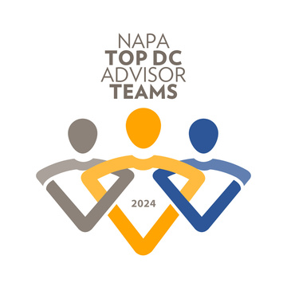

RSG: Purpose driven Results
  $1.88B Direct Assets Under Influence
  632 retirement plans serviced + 2 PEPs
  Servicing 34,000 participants
  Industry recognition & awards
634
$1.88B
34k
7x
11 | RSGAdvisory.net
Notes:
Ρετιρεμεντ πλανσ:
• Single employer plans: 182
• PEPs: 2
• PEP Adopting employers: 450

Slide 12

Plan Compliance
12 | RSGAdvisory.net

Slide 13
Important Changes for 2024
  Census request (2023 Plan year) - sent 12/23
  Plan Limits 2024
2025
2024
Compensation
$350,000
$345,000
Highly Compensated Employee (HCE)
$160,000
$155,000
Deferral
$23,500
$23,000
Maximum Catch-Up – Age 50+
$7,500
$7,500
  SECURE Act:
    SECURE Act 2.0 multi-year roll-out
    Auto-Features
13 | RSGAdvisory.net

Slide 14
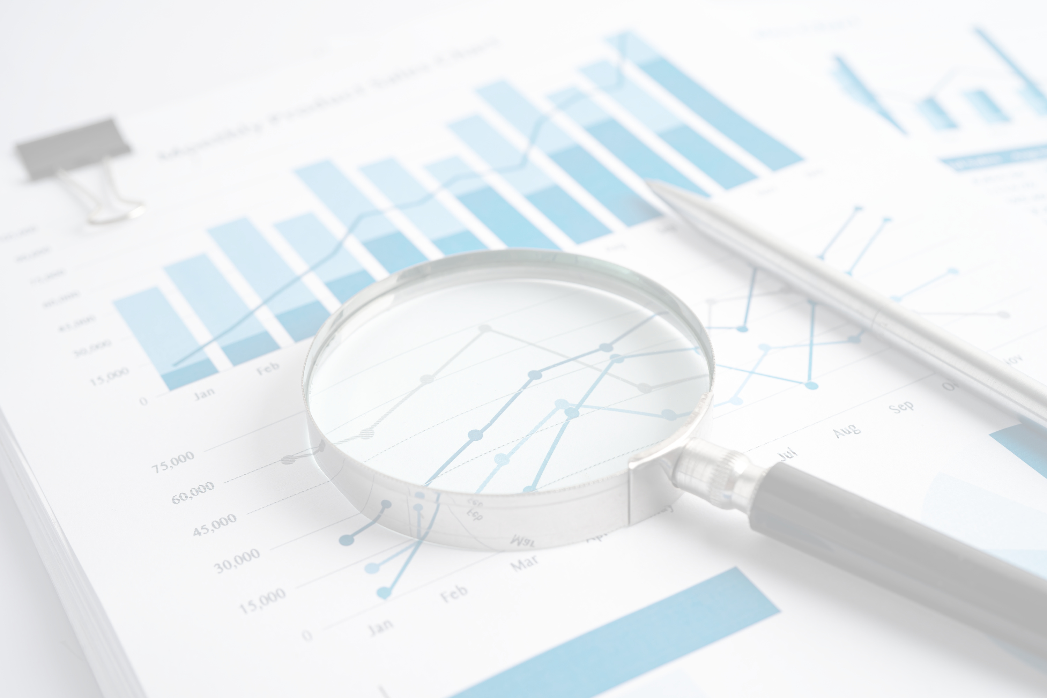
Plan Health
14 | RSGAdvisory.net

Slide 15
Plan Growth
  Current Assets 04/17/2024:
$36,354,025.05
 | 2022 | 2023 | YTD 2024 (1/1/24-3/31/24)
Opening Balance | $32,288,097 | $26,458,928 | $33,511,064
Money In | $2,783,880 | $3,361,700 | $1,920,284
Money Out | $1,894,536 | $1,740,503 | $98,958
Closing Balance | $26,458,928 | $33,511,064 | $37,639,993
Plan Growth | $5,829,169 | $7,052,136 | $4,128,929
Earnings | $6,718,513 | $5,430,939 | $2,307,603
Plan Level R.O.R. | -20.5% | 19.92% | 6.70%
15 | RSGAdvisory.net

Slide 16
Plan Participation
  Participants:
    150 Participants (Active: 131, Term: 19)
    92.3% Particpation rate (131 out of 142 eligible)
    6.5% Average deferral rate
    Asset allocation
      25.92% Target Retirement Fund
      68.17% Individual Investments
      5.91% Cash Equivalent
  Leakage:
    Loans: 10 = $198,738
    YTD 2024 loans issued: 3 = $73,245
      2023: 5 = $100,912
      2022: 4 = $94,634
    YTD 2024 withdrawals issued: 11 = $25,713
      2023: 30 = $1,639,591
      2022: 23 = $1,799,902
    Forfeitures: $
16 | RSGAdvisory.net

Slide 17
Plan Fees
  Fees: 0.67%
    Participant Expenses: 0.66%
      Average Investment Expense: 0.42%
      Recordkeeping: 0.09%
      RSG Advisory: 0.15%
    Company Expenses: 0.01%
      RSG Annual Administration Billable: $4,000.00
    Benchmark: 0.95% (total average bundled expenses)
      Peer group: 200 participants & $20,000,000 in assets
17 | RSGAdvisory.net

Slide 18

Participant Education
18 | RSGAdvisory.net

Slide 19
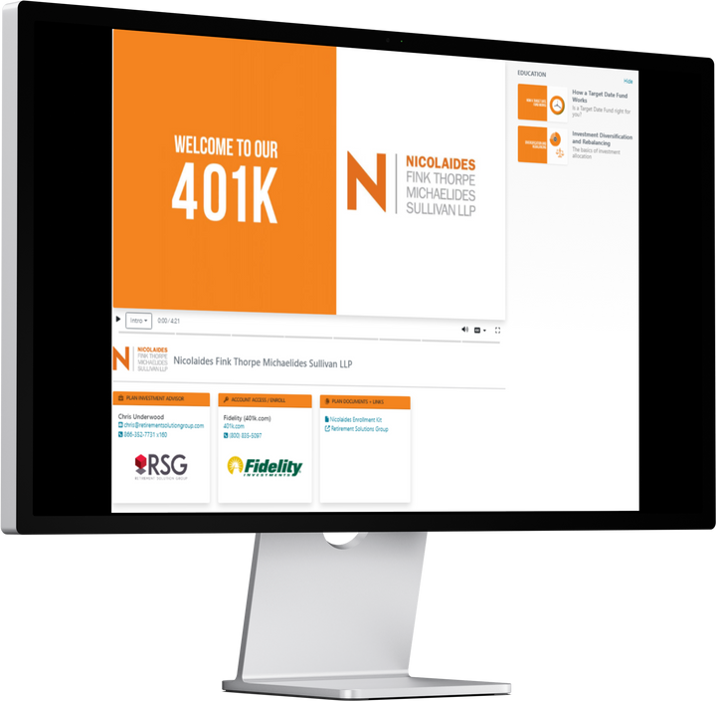
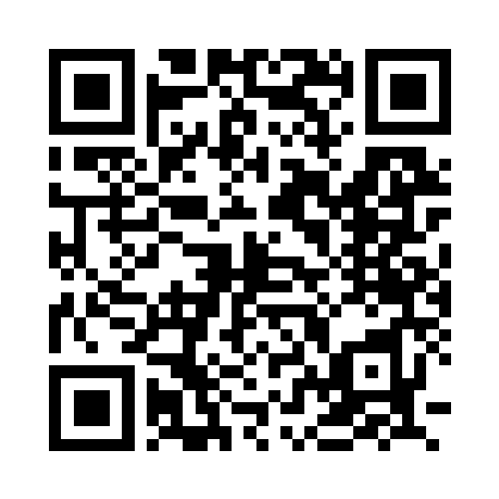
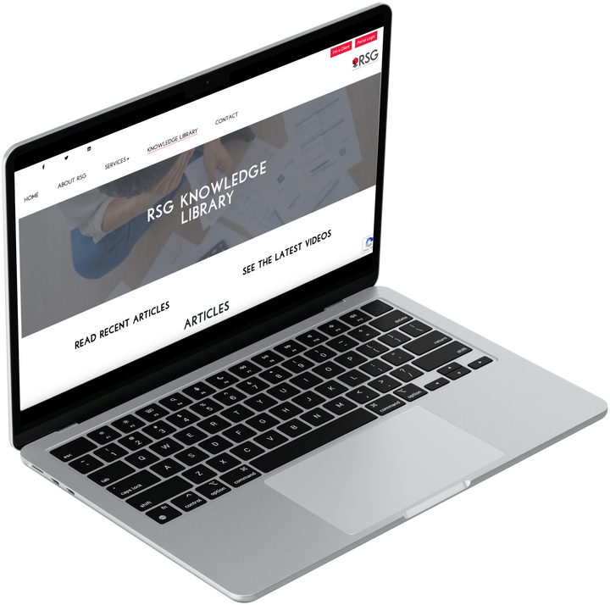
Participant Learning
  Employee Meetings/ Last meeting: 09/20/2023
  Customized education: Video learning portal
  RSG Knowledge Library
  Quarterly 2024 RSG Education Calendar
    1/29: 2025 Market Outlook Webinar
    4/29: How much should I save for retirement?
    7/10: 2025 Mid-Year Market Update
    11/11: Roundtable: Preparing for Retirement
19 | RSGAdvisory.net

Slide 20

Market Update
20 | RSGAdvisory.net

Slide 21
Full Year 2024: Solid Performance
Asset Class Returns
(12/31/2023– 12/31/2024)
The ‘Important Disclosures’ section provides index definitions. Index data source is YCharts and are inclusive of reinvested dividends. U.S. Large Stocks (S&P 500), U.S. Value Stocks (Russell 3000 Value), U.S. Growth Stocks (Russell 3000 Growth), U.S. Small Stocks (Russell 2000), Nasdaq Tech Stocks (Nasdaq Composite), Intl Developed Large Stocks (MSCI EAFE International Developed), Emerging Market Stocks (MSCI Emerging Markets), U.S. Long Term Govt Bonds (ICE U.S. Treasury 20+ Year Bond), REITs (Wilshire U.S. REITs), U.S. Bonds (Bloomberg Barclays Aggregate Bond), U.S. High Yield Bonds (Bloomberg U.S. High Yield Bond), S&P Equal Weight (S&P 500 Equal Weighted Index).
21 | RSGAdvisory.net

Slide 22
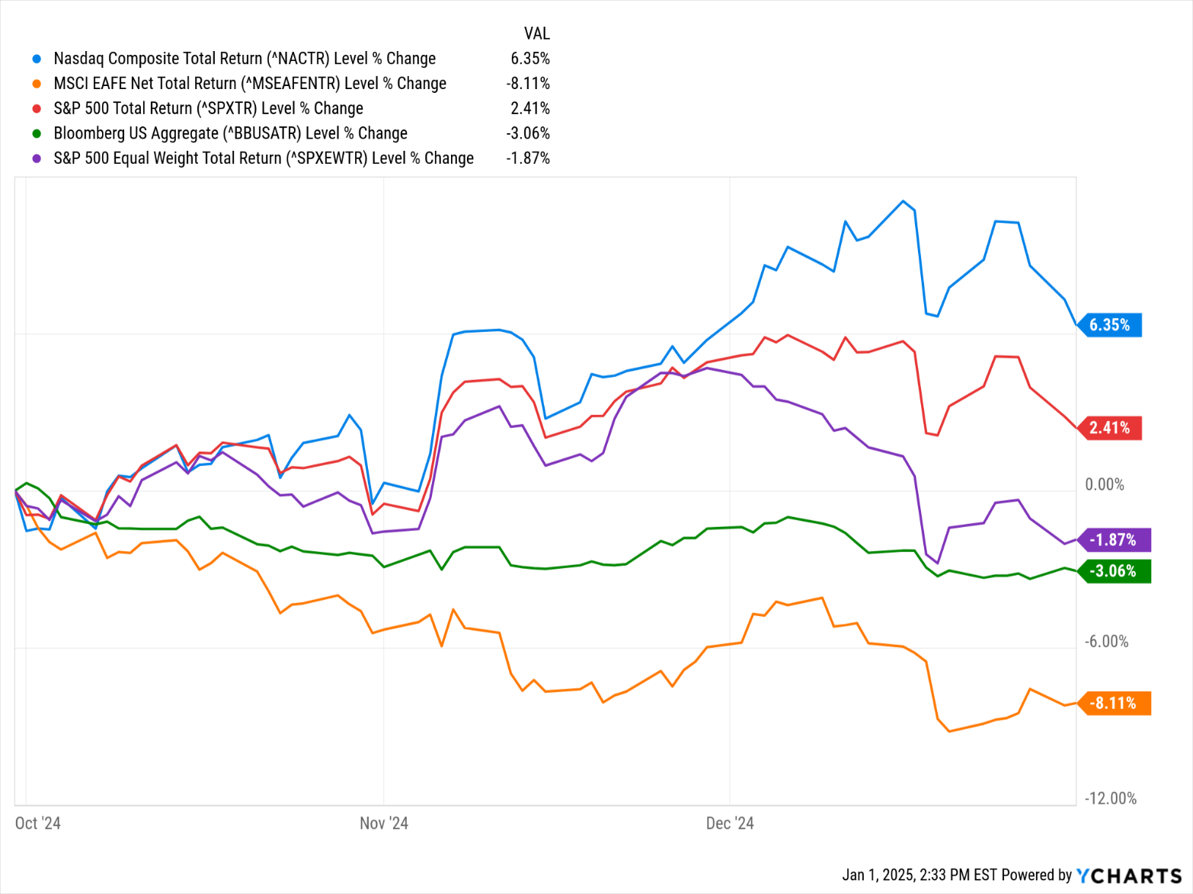
Q4 2024: A Loss of Momentum
Fourth Quarter 2024 Asset Class Returns
(09/30/2024 - 12/31/2024)
+6.4% Tech Stocks
+2.4% S&P 500 Index
-1.9% Avg. U.S. Stock (S&P 500)
-3.0% U.S. Bonds
-8.1% Intl Developed Stocks
The ‘Important Disclosures’ section provides index definitions. Index data source is YCharts and are inclusive of reinvested dividends. U.S. Large Stocks (S&P 500), U.S. Value Stocks (Russell 3000 Value), U.S. Growth Stocks (Russell 3000 Growth), U.S. Small Stocks (Russell 2000), Nasdaq Tech Stocks (Nasdaq Composite), Intl Developed Large Stocks (MSCI EAFE International Developed), Emerging Market Stocks (MSCI Emerging Markets), U.S. Long Term Govt Bonds (ICE U.S. Treasury 20+ Year Bond), REITs (Wilshire U.S. REITs), U.S. Bonds (Bloomberg Barclays Aggregate Bond), U.S. High Yield Bonds (Bloomberg U.S. High Yield Bond), S&P Equal Weight (S&P 500 Equal Weighted Index).
.
22 | RSGAdvisory.net

Slide 23
S&P 500 Concentration: All Time High
2025 S&P Returns – as of 12/31/24
Top 10 as % Weighting of S&P 500
(12/31/1989 – 12/31/2024)
Stock | % Weight | 2024 S&P 500 Contribution
Apple | 7.6% | 2.1%
NVIDIA | 6.6% | 5.2%
Microsoft | 6.3% | 0.9%
Amazon | 4.1% | 1.5%
Meta | 2.6% | 1.3%
Tesla | 2.3% | 1.1%
Alphabet (GOOGL) | 2.2% | 0.7%
Broadcom | 2.2% | 1.3%
Alphabet (GOOG) | 1.8% | 0.6%
Berkshire | 1.7% | 0.4%
Total | 37.2% | +15.3%
10 Stocks = +37.2% Weight
10 Stocks = +26.6% Weight
Remaining 490 Stocks
+ 9.7%
Source: Strategies, Bloomberg. The ‘Important Disclosures’ section provides index definitions. Index data source is YCharts and are inclusive of reinvested dividends.
S&P 500 Total Index
= 25.0%
23 | RSGAdvisory.net

Slide 24
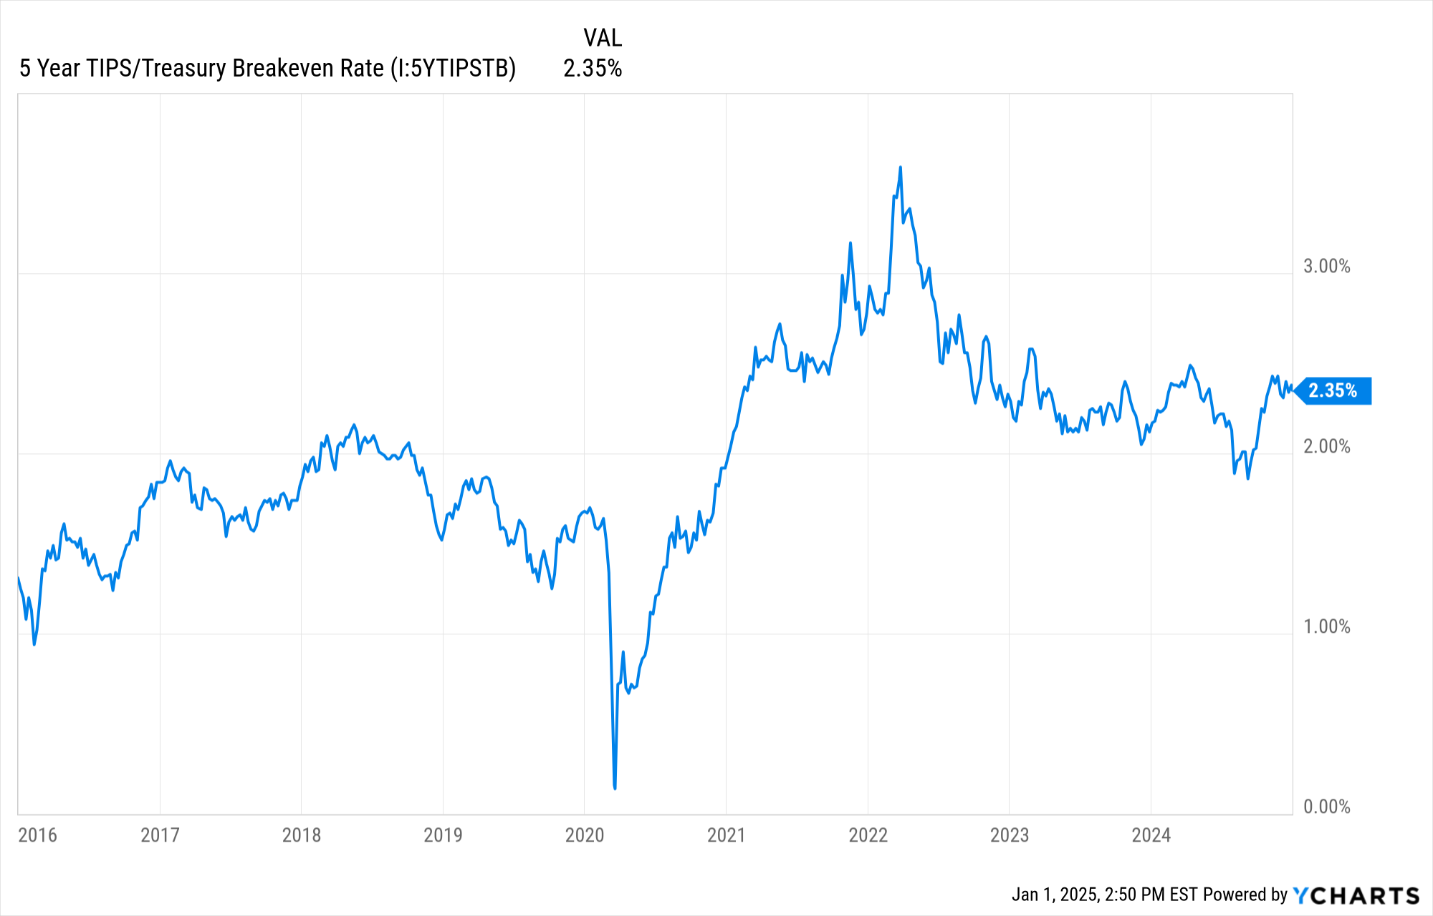
Inflation: Lower, but remains above fed Target
U.S. Inflation Expectations
(5 Year TIPS/Treasury Breakeven Rate, Federal Reserve)
+2.4% Expected Inflation
+2.0% Fed Inflation Target
The ‘Important Disclosures’ section provides index definitions. Index data source is YCharts and are inclusive of reinvested dividends.
24 | RSGAdvisory.net

Slide 25
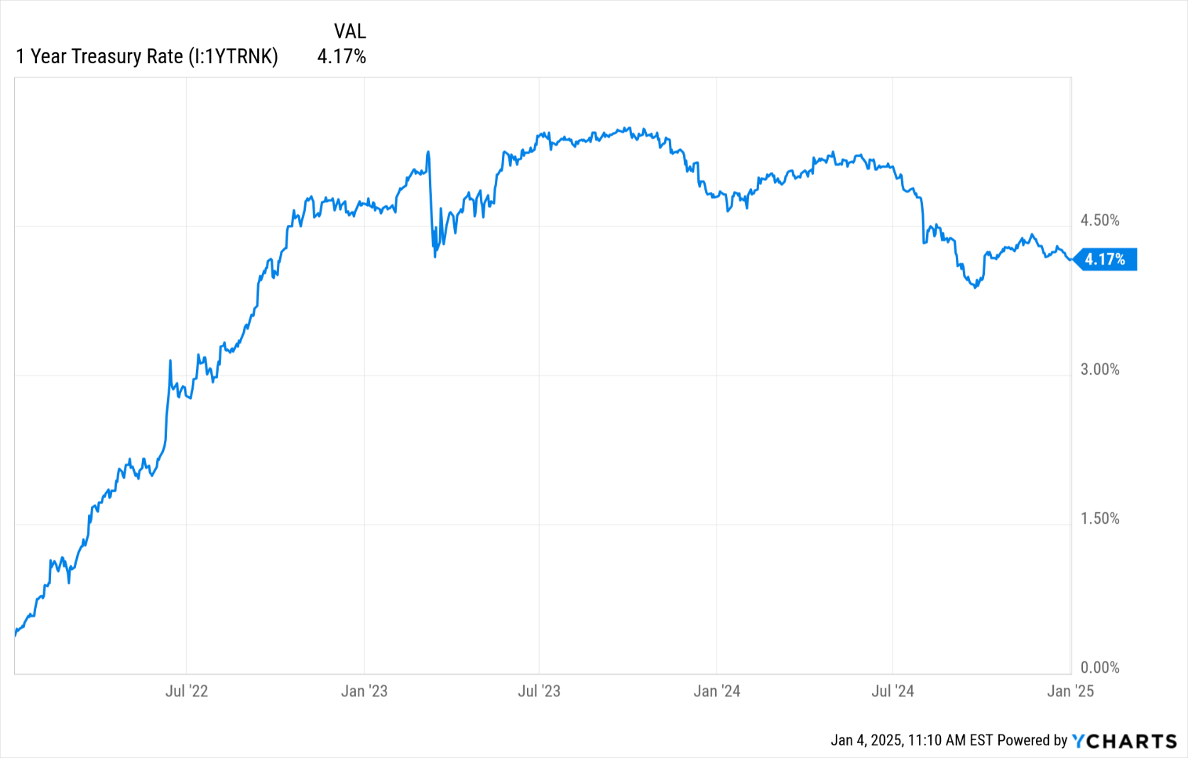
InTerest Rates: Lower, but Easing has slowed
Short Term Interest Rates
(1 Year Treasury Rate, Federal Reserve)
+4.2% Interest Rate
The ‘Important Disclosures’ section provides index definitions. Index data source is YCharts and are inclusive of reinvested dividends.
25 | RSGAdvisory.net

Slide 26
Compelling value outside S&P 500
Asset Class Price-to-Earnings Valuations
(Price-to-Earnings 12 Months Forward, 12/31/2024)
Relatively Cheap
Relatively Expensive
The ‘Important Disclosures’ section provides index definitions. Index data source is YCharts. U.S. Large Stocks (S&P 500), U.S. Value Stocks (Russell 3000 Value), U.S. Growth Stocks (Russell 3000 Growth), U.S. Small Stocks (Russell 2000), Emerging Market Stocks (MSCI Emerging Markets).
26 | RSGAdvisory.net

Slide 27
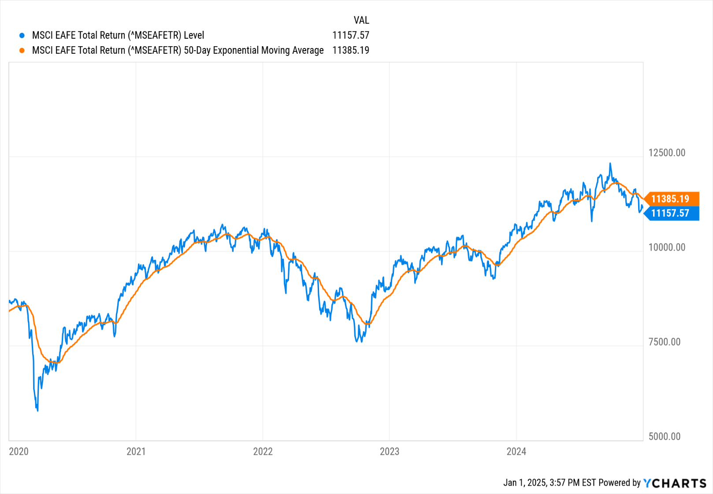
Waiting for international Stock trends to improve
International Developed Stock Index Chart
(12/31/2019 - 12/31/2024, MSCI EAFE International Stock Index)
50 Day Moving Average
International Stock Index Level
The ‘Important Disclosures’ section provides index definitions. Index data source is YCharts and are inclusive of reinvested dividends. International Developed Large Stocks (MSCI EAFE International Developed Stock Index).
.
27 | RSGAdvisory.net

Slide 28

Investment Monitoring
28 | RSGAdvisory.net

Slide 29
Investment Lineup
  Review
  Total Investments: 28 (Target Date Suite = 1)
    Active Investments: 20
    Index Investments: 8
  Weighted Average Investments Expense: 0.31%
  Average Fi360 Score: 23 (out of 100) – 1st quartile
29 | RSGAdvisory.net

Slide 30
Investment Monitoring
  Watch List
  Change Recommendations
Fund Name | Fund Ticker | Current Score | 1 Yr Score | 3 Yr Score | Expense | Participants | Assets
ClearBridge Small Cap Growth I | SBPYX | 65 | 51 | 23 | 0.91 | 20 | $1,030,782.34
Fidelity Advisor Freedom 2005 Z6 | FYGLX | 69 | 66 | 54 | 0.24 | 0 | $0.00
Fidelity Advisor Freedom Income Z6 | FEGLX | 73 | 64 | 47 | 0.24 | 0 | $0.00
30 | RSGAdvisory.net

Slide 31

RecordKeeper Update
31 | RSGAdvisory.net

Slide 32
Enter Slide Title
  Point
  Point
    Participant Expenses: 0.66%
      Average Investment Expense: 0.42%
      Recordkeeping: 0.09%
      RSG Advisory: 0.15%
32 | RSGAdvisory.net

Slide 33

New Business
33 | RSGAdvisory.net

Slide 34




04 | RSG Advisory
Four Point Immediate Action Plan
Implement Systematic Plan Governance
Conduct Comprehensive Investment Review
Enhance Participant Education & Support Services
Market Test
Current
Recordkeeper
34 | RSGAdvisory.net

Slide 35
04 | RSG Advisory
First Step/Point
Initial Findings
Action Plan
  Action 1
  Action 2
  Action 3
  Action 4
  Action 5
  Finding
  Findings
35 | RSGAdvisory.net

Slide 36
04 | RSG Advisory
Second Point/Step
Initial Findings
Action Plan
  Finding
  Finding
  Action 1
  Action 2
  Action 3
  Action 4
  Action 5
36 | RSGAdvisory.net

Slide 37
04 | RSG Advisory
Enhance Participant Education & Support Services
Initial Findings
Action Plan
  Findings
  Findings
  Action 1
    Additional detail
    More details
  Longer action plan step can be described here
    This is where you can put a longer detail
    More detials
37 | RSGAdvisory.net

Slide 38
04 | RSG Advisory
Market Test Current Recordkeeper
Initial Findings
Action Plan
  Findings
  Findings
  Action 1
    Additional detail
    More details
  Longer action plan step can be described here
    This is where you can put a longer detail
    More detials
38 | RSGAdvisory.net

Slide 39


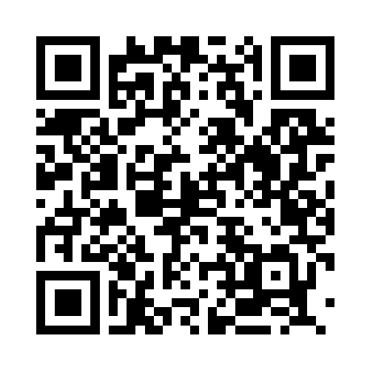
We’re Here to Help
Your Team:
Scott Emering​, MBA, CPFA®
Partner
scott@retirementsolutiongroup.com
ext. 110
Chris Underwood, AIF, CPFA®
Principal
chris@retirementsolutiongroup.com
ext. 160
Scott Emering
Chris Underwood
PARTNER, MBA, CPFA®
PRINCIPAL, AIF, CPFA®
39 | RSGAdvisory.net

Slide 40
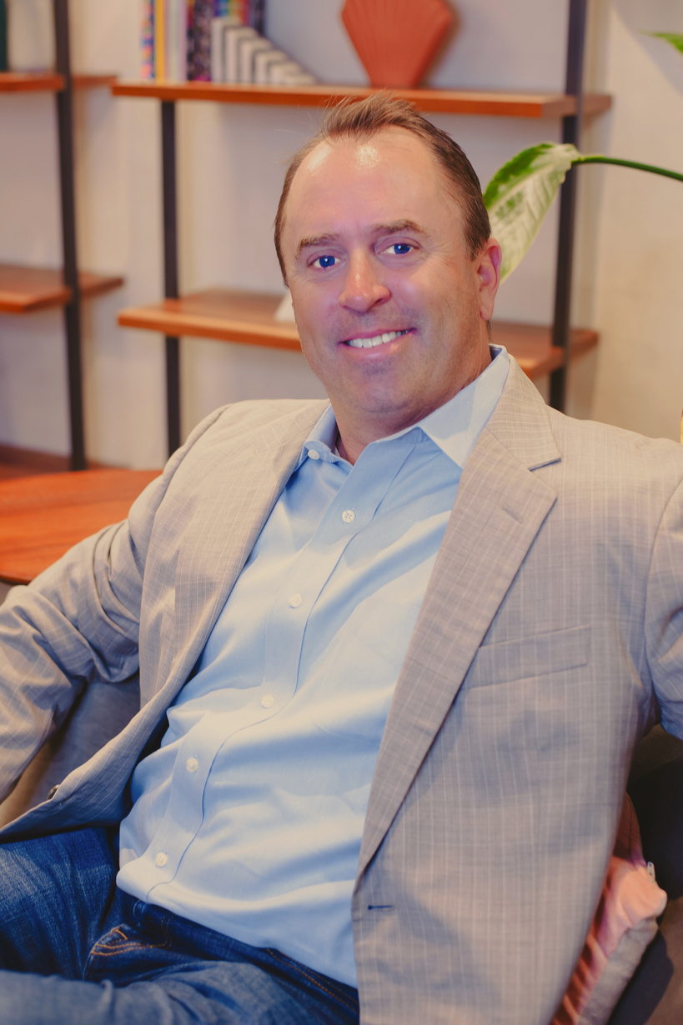




Steve Scott
Kevin Delaney
Elvia Sanchez
Christie Cheng
Judy Gutierrez
PARTNER, AIF, CPFA®
CO-FIDUCIARY
VP OF BUSINESS DEVELOPMENT, CPFA®
PRINCIPAL, CPFA®
PRINCIPAL, CPFA®
SR. RELATIONSHIP MANAGER, CPFA®
40 | RSGAdvisory.net

Slide 41
Important disclosures
Securities are offered through LPL Financial, member FINRA/SIPC. Investment Advisory Services offered through RSG Advisory a registered Investment Advisor. RSG Advisory and LPL Financial are separate, non-affiliated entities.
The opinions voiced in this material are for general information only and are not intended to provide specific advice or recommendations for any individual. We suggest that you discuss your specific situation with your financial advisor prior to investing.
All indices are unmanaged and may not be invested into directly. Unmanaged index returns do not reflect fees, expenses, or sales charges inherent to investing. All performance referenced is historical and is no guarantee of future results.
The economic forecasts set forth in this material may not develop as predicted and there can be no guarantee that strategies promoted will be successful.
Investing in stock includes numerous specific risks including: the fluctuation of dividend, loss of principal and potential illiquidity of the investment in a falling market.
The prices of small cap stocks are generally more volatile than large cap stocks.
The payment of dividends is not guaranteed. Companies may reduce or eliminate the payment of dividends at any given time.
Bonds are subject to market and interest rate risk if sold prior to maturity. Bond values will decline as interest rates rise and bonds are subject to availability and change in price.
High yield/junk bonds (grade BB or below) are not investment grade securities, and are subject to higher interest rate, credit, and liquidity risks than those graded BBB and above. They generally should be part of a diversified portfolio for sophisticated investors.
Government bonds and Treasury bills are guaranteed by the US government as to the timely payment of principal and interest and, if held to maturity, offer a fixed rate of return and fixed principal value.
Investing in Real Estate Investment Trusts (REITs) involves special risks such as potential illiquidity and may not be suitable for all investors. There is no assurance that the investment objectives of this program will be attained.
The fast price swings in commodities and currencies will result in significant volatility in an investor’s holdings.
Precious metal investing involves greater fluctuation and potential for losses.
International investing involves special risks such as currency fluctuation and political instability and may not be suitable for all investors. These risks are often heightened for investments in emerging markets.
Technical analysis is based on the study of historical price movements and past trend patterns. There is no assurance that these movements or trends can or will be duplicated in the near future.
41 | RSGAdvisory.net

Slide 42
Important disclosures
Rebalancing a portfolio may cause investors to incur tax liabilities and/or transaction costs and does not assure a profit or protect against a loss.
There is no guarantee that a diversified portfolio will enhance overall returns or outperform a non-diversified portfolio. Diversification does not protect against market risk.
All investing involves risk including loss of principal. No strategy assures success or protects against loss.
Index definitions and terms:
S&P 500 Index is a capitalization weighted index of 500 stocks designed to measure performance of the broad domestic economy through changes in the aggregate market value of 500 stocks representing all major industries.
NASDAQ Composite Index measures all NASDAQ domestic and non-U.S. based common stocks listed on The NASDAQ Stock Market. The market value, the last sale price multiplied by total shares outstanding, is calculated throughout the trading day, and is related to the total value of the Index.
Russell 3000 Index is a market-capitalization-weighted equity index maintained by the FTSE Russell that provides exposure to the entire U.S. stock market. The index tracks the 3,000 largest U.S.-traded stocks which represent about 98% of all U.S incorporated equity securities.
Russell 3000 Value Index is a market-capitalization weighted equity index maintained by the Russell Investment Group and based on the Russell 3000 Index, which measures how U.S. stocks in the equity value segment perform. Included in the Russell 3000 Value Index are stocks from the Russell 3000 Index with lower price-to-book ratios and lower expected growth rates.
Russell 3000 Growth Index is a market capitalization weighted index based on the Russell 3000 index. The Russell 3000 Growth Index includes companies that display signs of above average growth. The index is used to provide a gauge of the performance of growth stocks.
Russell 2000 Index is an index measuring the performance of approximately 2,000 small-cap companies in the Russell 3000 Index. The index serves as a benchmark for U.S. small-cap stocks.
MSCI EAFE Index is a stock index that is a performance benchmark for the major international equity markets as represented by 21 major MSCI indices from Europe, Australia and Middle East.
MSCI EAFE Small Cap Index is an equity index which captures small cap representation across Developed Markets as represented by MSCI indices from Europe, Australia and the Middle East.
MSCI Emerging Markets Index consists of 23 economies: Brazil, Chile, China, Colombia, Czech Republic, Egypt, Greece, Hungary, India, Indonesia, Korea, Malaysia, Mexico, Peru, Philippines, Poland, Qatar, Russia, South Africa, Taiwan, Thailand, Turkey and the UAE.
Dividend Aristocrats Index are S&P 500 index constituents that have increased their dividend payouts for 25 consecutive years or more.
Wilshire REIT Index defines and measures the investable universe of publicly traded real estate investment trusts domiciled in the U.S.
42 | RSGAdvisory.net

Slide 43
Important disclosures
Goldman Sachs Crude Oil Total Return Index reflects available through an unleveraged investment in the West Texas Intermediate (WTI) crude oil futures contract plus the Treasury Bill rate of interest that could be earned on funds committed to the trading of the underlying contracts.
Bank of America Merrill Lynch U.S. Corporate AAA Index is an index of U.S. AAA corporate bonds. The Bank of America Merrill Lynch U.S. Corporate BBB Index includes U.S. BBB corporate bonds.
S&P U.S. Preferred Stock Index is designed to serve the investment community's need for an investable benchmark representing the U.S. preferred stock market. Preferred stocks provide investors with a dividend, but do not offer equity in shares.
Bloomberg High Yield Bond Index measures the USD-denominated, high yield, fixed-rate corporate bond market. Securities are classified as high yield if the middle rating of Moody's, Fitch and S&P is Ba1/BB+/BB+ or below. High Yield bonds are considered low quality bonds.
Market Vectors Floating Rate Bond Index This index provides exposure to the floating rate segment of the U.S. investment grade bond market. Floating rate notes are bonds that have coupon payments that change based on various market characteristics- including rises and falls in interest rates. Holdings are chosen based on amount of debt issued.
Barclays US Aggregate Bond Index is a market capitalization-weighted index, meaning the securities in the index are weighted according to the market size of each bond type. Most U.S. traded investment grade bonds are represented.
Barclays Corporate Bond measures the performance of the investment grade U.S. corporate bond market. Securities must be fixed rate, U.S. dollar denominated, taxable and rated investment grade as defined by the Index methodology. Inclusion is based on currency of issue, not its domicile.
Barclays US Treasury Index is a market-capitalization weighted index that measures the performance of public obligations of the U.S. Treasury that have a maturity of one year or more.
Citigroup USBIG Treasury Bill 3M index “T-bill” is an unmanaged index representing monthly return equivalents of yield averages of the last 3-month Treasury Bill issues.
CBOE Volatility Index® (VIX®) is meant to be forward looking, showing the market's expectation of 30-day volatility in either direction, and is considered by many to be a barometer of investor sentiment and market volatility, commonly referred to as “Investor Fear Gauge”.
Gross Domestic Product (GDP) is the monetary value of all the finished goods and services produced within a country’s borders in a specific time period, though GDP is usually calculated on an annual basis. It includes all of private and public consumption, government outlays, investments and exports less imports that occur within a defined territory.
43 | RSGAdvisory.net

