Slide 1
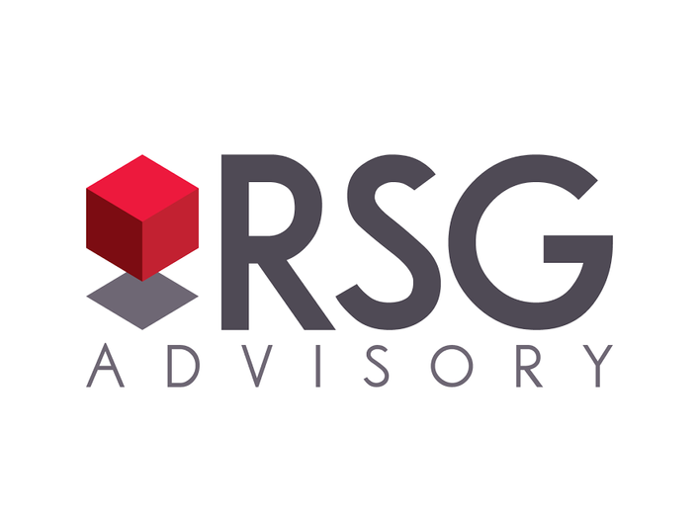

Investment Update
Fourth Quarter 2023
Please refer to Important Disclosures on last pages.

Slide 2


Areas of interest
Volatility - with a focus on geopolitical issues
Interest Rates higher for longer
Cash alternatives strategies
02 | RSGadvisory.net
Notes:
And that’s what I’m here to talk to you about today.
First, we’ll discuss the transformation of retirement. How it has changed. What makes it different from your parents’ retirement.
Then we’ll talk about the five most pressing challenges of the new retirement.
And lastly, we’ll discuss ways that Lincoln Financial Group can help you create a financial strategy that can help you seek the retirement income you’ll need to enjoy your retirement to its fullest.
(click)

Slide 3


Volatility & Geopolitics

Slide 4
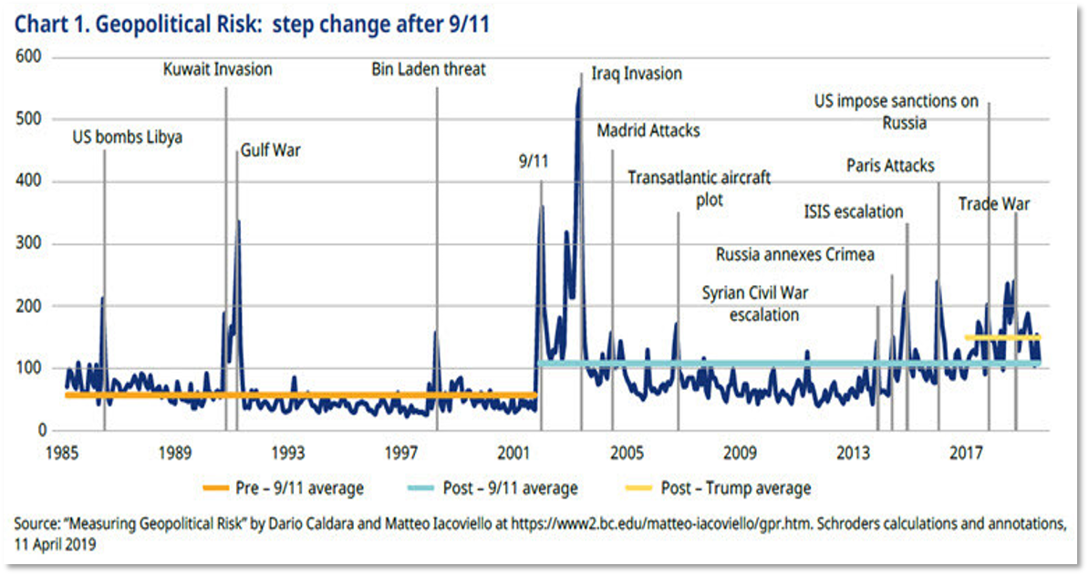
We are, in fact, in A more dangerous world
We have been living with higher geopolitical risk since 9/11, 2001.
Risks can’t be forecast. Market moving risks are spiking events that occur out of left field.
Geopolitical Risk Index referred is that used in this study. Schroeders “Measuring the Impact of Geopolitics” (Sept. 2019).
Please read the ‘Important Disclosures’ section.
04 | RSGadvisory.net

Slide 5
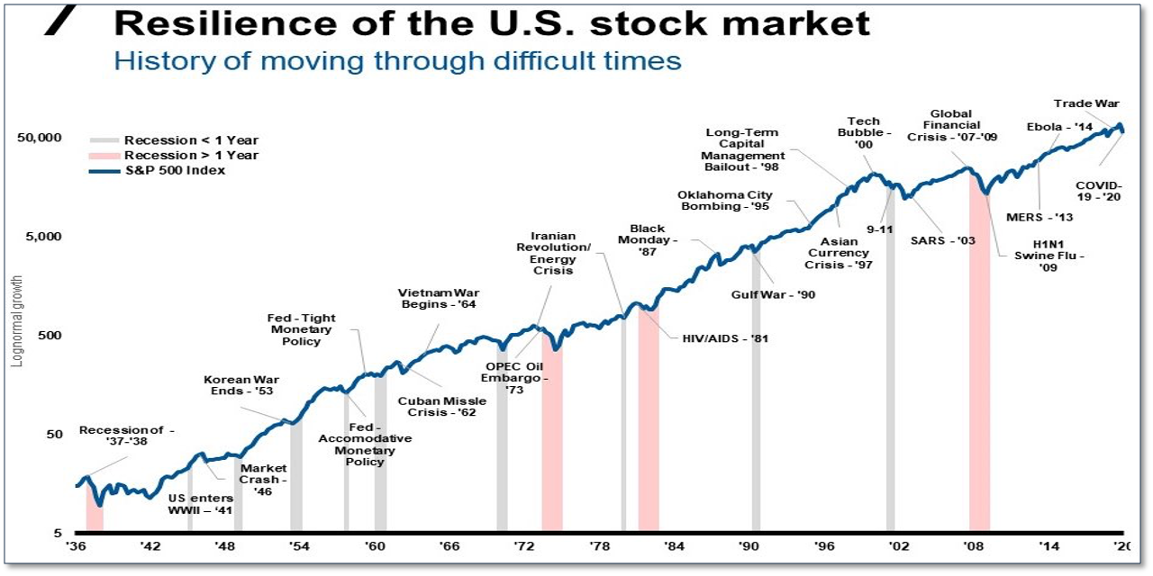

Markets go Up despite risk
Markets have historically moved up despite geopolitical risk.
How Does Geopolitical Risk Affect Stock Prices? Financial Samurai.
Please read the ‘Important Disclosures’ section.
05 | RSGadvisory.net

Slide 6
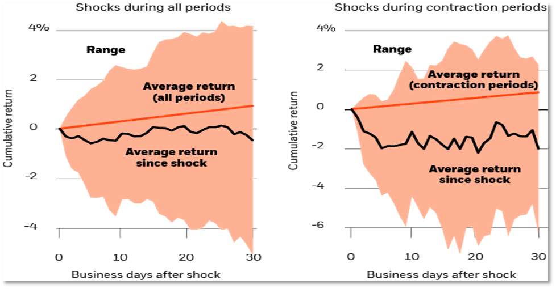
Markets Typically muted response to Geopolitical risk
U.S. equity returns after exogenous geopolitical shocks, 1962–2017
Muted response on average to geopolitical risk.
But, slightly higher response in poor ecoomic environments
Sources: BlackRock Investment Institute, with data from Thomson Reuters Datastream and Bloomberg, June 2019. Notes: The charts focus on 31 "exogenous" (unexpected) geopolitical shock events between October 1962 and January 2019.
Please read the ‘Important Disclosures’ section.
06 | RSGadvisory.net

Slide 7

Higher Interest Rates for longer

Slide 8
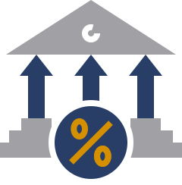


the fed believes it
Asked why Fed officials expect rates to remain higher through 2026,
Mr. Powell pointed to recent strong economic activity, which he said generally suggested,
We have to do more with rates.
The Federal Reserve
September 20, 2023
We believe it too
  Mortgage rates of +7% are showing no signs of coming down (the Fed needs to be more aggressive)
  Inflation will likely be stubbornly higher
  Growing budget concerns: At some point need to impact rates (negatively)
See ‘Important Disclosures’ section.
08 | RSGadvisory.net

Slide 9
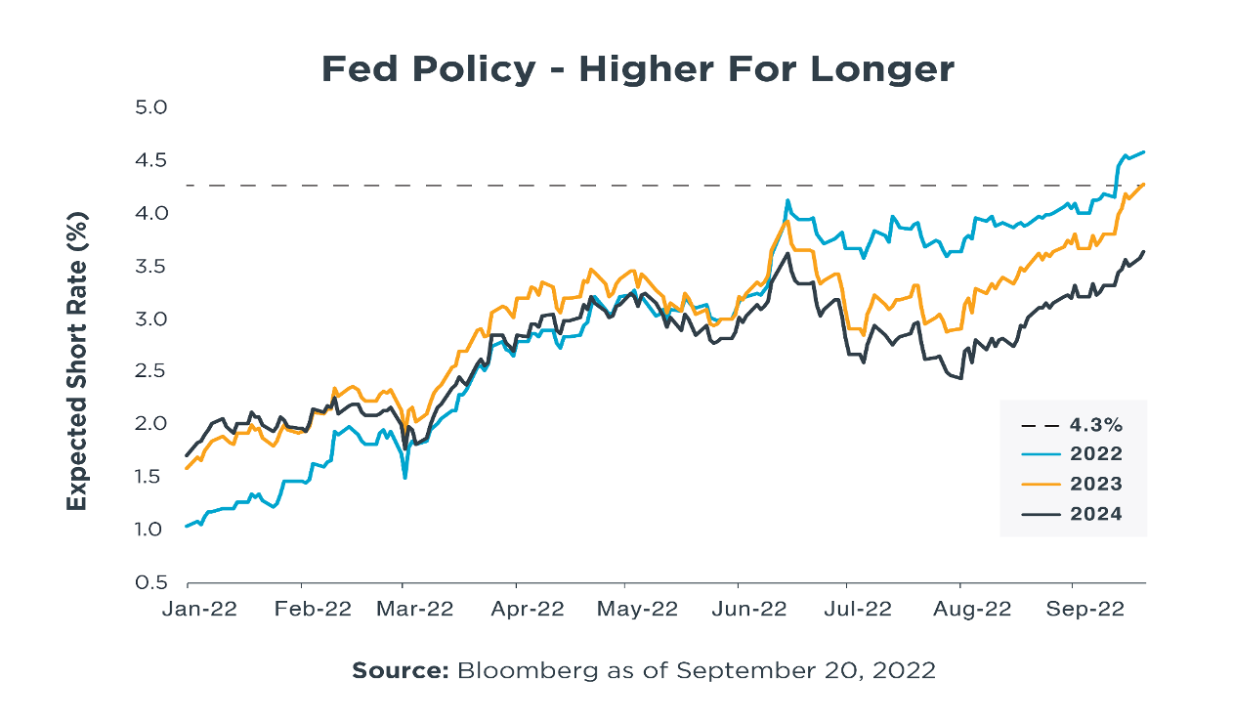
The Market Believes Higher interest rates
for longer
  The Market believes it
See ‘Important Disclosures’ section.
09 | RSGadvisory.net

Slide 10
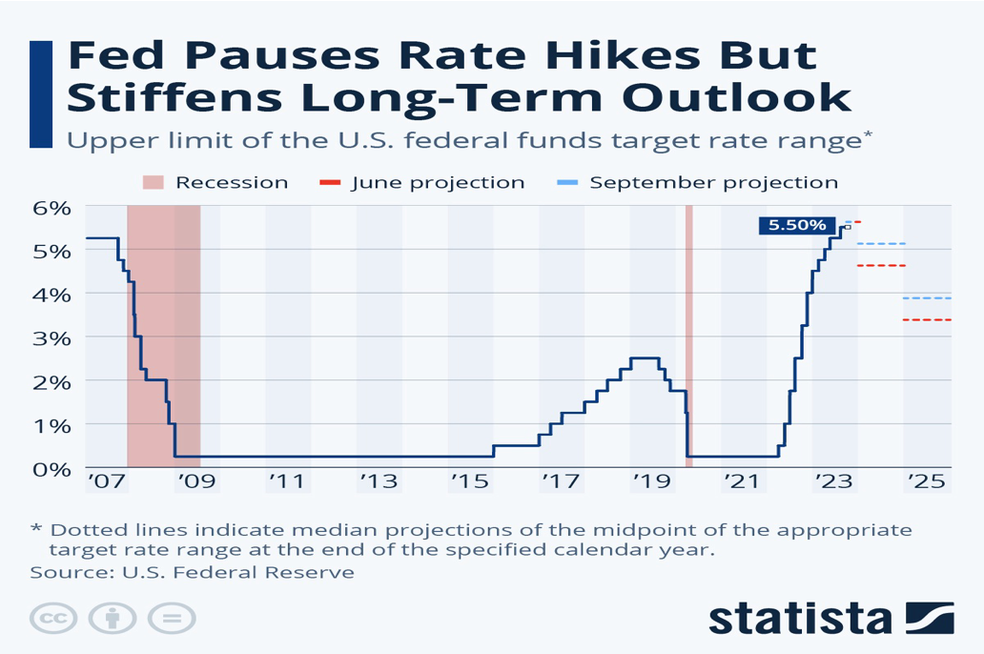
Fed pauses rate hikes but stiffens
long-term outlook
  The Market believes higher interest rates for longer
See ‘Important Disclosures’ section.
10 | RSGadvisory.net

Slide 11
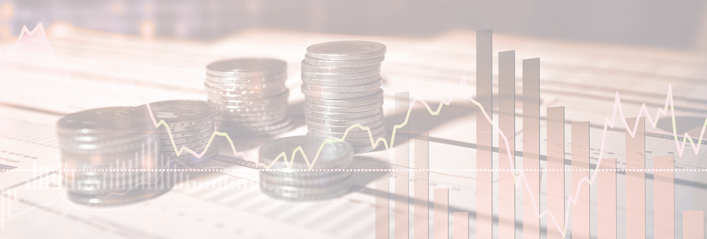
Cash strategy

Slide 12
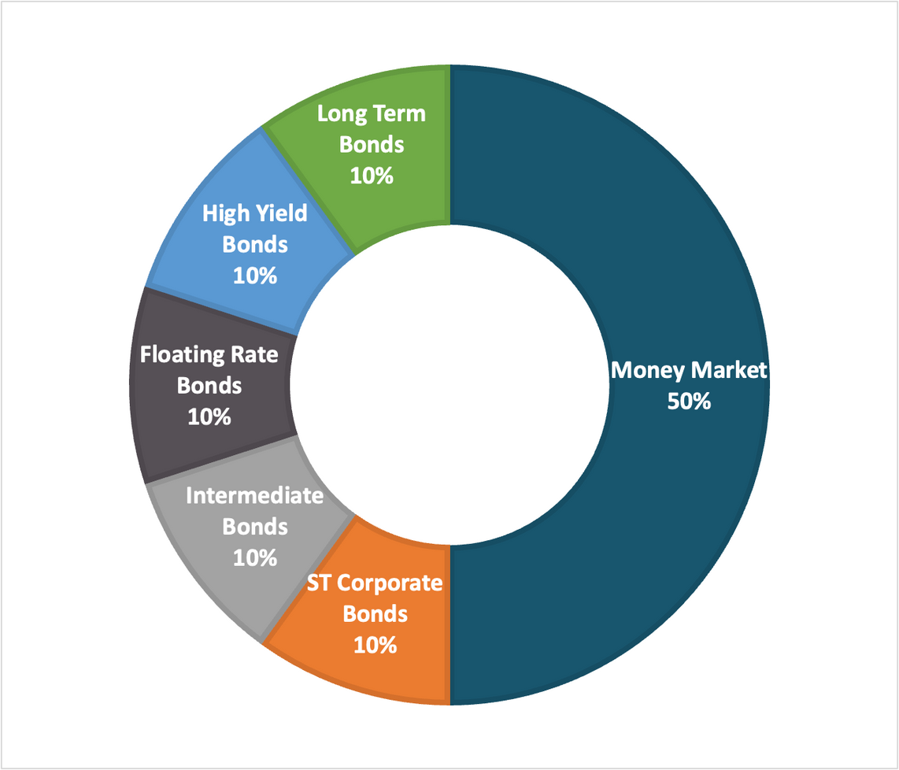
enhanced cash alternative strategy
Summary
Example
Investment Allocation
  Explicitly designed to beat Money Markets
  “Lock-in” yields over 2-3 years (vs 1 year for treasuries)
  Very low interest rate sensitivity
  Liquidity is an asset/opportunity in volatile markets
See ‘Important Disclosures’ section.
12 | RSGadvisory.net
Notes:
Raise your hand if you want to retire someday…
Great. If your hand is in the air, there are some things to consider. Retirement won’t just happen—at least not the retirement you may be envisioning. You have to take steps to prepare for a long, enjoyable retirement.
Retirement is expensive.
Saving for retirement is a personal responsibility, and your retirement plan will likely be your largest source of income.
Social Security will only cover a small portion of what you’ll need—the rest is up to you.
[click to go to the next slide]

Slide 13

Thank You
We're here to help
Steve Scott​, AIF®, CPFA®
Partner
steve@rsgadvisory.net
866.352.7731 x210
Steve Scott
PARTNER, AIF, CPFA®
CO-FIDUCIARY
13 | RSGadvisory.net

Slide 14
Important Disclosures
Securities are offered through LPL Financial, member FINRA/SIPC. Investment Advisory Services offered through RSG Advisory a registered Investment Advisor. RSG Advisory and LPL Financial are separate, non-affiliated entities.
The opinions voiced in this material are for general information only and are not intended to provide specific advice or recommendations for any individual. We suggest that you discuss your specific situation with your financial advisor prior to investing.
All indices are unmanaged and may not be invested into directly. Unmanaged index returns do not reflect fees, expenses, or sales charges inherent to investing. All performance referenced is historical and is no guarantee of future results.
The economic forecasts set forth in this material may not develop as predicted and there can be no guarantee that strategies promoted will be successful.\
Investing in stock includes numerous specific risks including: the fluctuation of dividend, loss of principal and potential illiquidity of the investment in a falling market.
The prices of small cap stocks are generally more volatile than large cap stocks.
The payment of dividends is not guaranteed. Companies may reduce or eliminate the payment of dividends at any given time.
Bonds are subject to market and interest rate risk if sold prior to maturity. Bond values will decline as interest rates rise and bonds are subject to availability and change in price.
High yield/junk bonds (grade BB or below) are not investment grade securities, and are subject to higher interest rate, credit, and liquidity risks than those graded BBB and above. They generally should be part of a diversified portfolio for sophisticated investors.
Government bonds and Treasury bills are guaranteed by the governments as to the timely payment of principal and interest and, if held to their stated maturities (e.g., 10 years), offer a fixed rate of return and fixed principal value. International bonds share this same characteristic. Currency can also move their prices.
Investing in Real Estate Investment Trusts (REITs) involves special risks such as potential illiquidity and may not be suitable for all investors. There is no assurance that the investment objectives of this program will be attained.
The fast price swings in commodities and currencies will result in significant volatility in an investor’s holdings.
Precious metal investing involves greater fluctuation and potential for losses.
International investing involves special risks such as currency fluctuation and political instability and may not be suitable for all investors. These risks are often heightened for investments in emerging markets.
14 | RSGadvisory.net
Notes:
Planning for retirement income is a multifaceted process, but in addition to your lifestyle and expenses, there are a few “outside” factors to consider – things that are out of your control.
Pension plans, once a major portion of retirement income, are slowly fading out of existence, and if you don’t have one, you’ll need to figure out where your income is going to come from. That means considering how those assets are invested so that you are not penalized for taking them out as income.
Generally speaking, Americans are living longer, which means you may need your income for a longer period of time. Factors such as your longevity, taxes, inflation, market volatility and increasing healthcare costs can significantly affect your retirement income over time. These are things you should keep in mind when figuring out how to create your sustainable income.

Slide 15
Important Disclosures
Technical analysis is based on the study of historical price movements and past trend patterns. There is no assurance that these movements or trends can or will be duplicated in the near future.
Rebalancing a portfolio may cause investors to incur tax liabilities and/or transaction costs and does not assure a profit or protect against a loss.
There is no guarantee that a diversified portfolio will enhance overall returns or outperform a non-diversified portfolio. Diversification does not protect against market risk.
All investing involves risk including loss of principal. No strategy assures success or protects against loss.
Index definitions and terms:
S&P 500 Index is a capitalization weighted index of 500 stocks designed to measure performance of the broad domestic economy through changes in the aggregate market value of 500 stocks representing all major industries.
NASDAQ Composite Index measures all NASDAQ domestic and non-U.S. based common stocks listed on The NASDAQ Stock Market. The market value, the last sale price multiplied by total shares outstanding, is calculated throughout the trading day, and is related to the total value of the Index.
Russell 3000 Index is a market-capitalization-weighted equity index maintained by the FTSE Russell that provides exposure to the entire U.S. stock market. The index tracks the 3,000 largest U.S.-traded stocks which represent about 98% of all U.S incorporated equity securities.
Russell 3000 Value Index is a market-capitalization weighted equity index maintained by the Russell Investment Group and based on the Russell 3000 Index, which measures how U.S. stocks in the equity value segment perform. Included in the Russell 3000 Value Index are stocks from the Russell 3000 Index with lower price-to-book ratios and lower expected growth rates.
Russell 3000 Growth Index is a market capitalization weighted index based on the Russell 3000 index. The Russell 3000 Growth Index includes companies that display signs of above average growth. The index is used to provide a gauge of the performance of growth stocks.
Russell 2000 Index is an index measuring the performance of approximately 2,000 small-cap companies in the Russell 3000 Index. The index serves as a benchmark for U.S. small-cap stocks.
MSCI EAFE Index is a stock index that is a performance benchmark for the major international equity markets as represented by 21 major MSCI indices from Europe, Australia and Middle East.
MSCI EAFE Small Cap Index is an equity index which captures small cap representation across Developed Markets as represented by MSCI indices from Europe, Australia and the Middle East.
MSCI Emerging Markets Index consists of 23 economies: Brazil, Chile, China, Colombia, Czech Republic, Egypt, Greece, Hungary, India, Indonesia, Korea, Malaysia, Mexico, Peru, Philippines, Poland, Qatar, Russia, South Africa, Taiwan, Thailand, Turkey and the UAE.
15| RSGadvisory.net
Notes:
Planning for retirement income is a multifaceted process, but in addition to your lifestyle and expenses, there are a few “outside” factors to consider – things that are out of your control.
Pension plans, once a major portion of retirement income, are slowly fading out of existence, and if you don’t have one, you’ll need to figure out where your income is going to come from. That means considering how those assets are invested so that you are not penalized for taking them out as income.
Generally speaking, Americans are living longer, which means you may need your income for a longer period of time. Factors such as your longevity, taxes, inflation, market volatility and increasing healthcare costs can significantly affect your retirement income over time. These are things you should keep in mind when figuring out how to create your sustainable income.

Slide 16
Important Disclosures
Dividend Aristocrats Index includes a list of constituents that have increased their dividend payouts for at least 25 years.
The U.S. Stock Achievers Dividend Index includes a list of constituents which have managed to increase dividends every year for at least a decade.
Wilshire REIT Index defines and measures the investable universe of publicly traded real estate investment trusts domiciled in the U.S.
Goldman Sachs Crude Oil Total Return Index reflects available through an unleveraged investment in the West Texas Intermediate (WTI) crude oil futures contract plus the Treasury Bill rate of interest that could be earned on funds committed to the trading of the underlying contracts.
Bank of America Merrill Lynch U.S. Corporate AAA Index is an index of U.S. AAA corporate bonds. The Bank of America Merrill Lynch U.S. Corporate BBB Index includes U.S. BBB corporate bonds
S&P U.S. Preferred Stock Index is designed to serve the investment community's need for an investable benchmark representing the U.S. preferred stock market. Preferred stocks provide investors with a dividend, but do not offer equity in shares.
Bloomberg High Yield Bond Index measures the USD-denominated, high yield, fixed-rate corporate bond market. Securities are classified as high yield if the middle rating of Moody's, Fitch and S&P is Ba1/BB+/BB+ or below. High Yield bonds are considered low quality bonds.
Market Vectors Floating Rate Bond Index This index provides exposure to the floating rate segment of the U.S. investment grade bond market. Floating rate notes are bonds that have coupon payments that change based on various market characteristics- including rises and falls in interest rates. Holdings are chosen based on amount of debt issued.
Barclays US Aggregate Bond Index is a market capitalization-weighted index, meaning the securities in the index are weighted according to the market size of each bond type. Most U.S. traded investment grade bonds are represented.
Barclays Corporate Bond measures the performance of the investment grade U.S. corporate bond market. Securities must be fixed rate, U.S. dollar denominated, taxable and rated investment grade as defined by the Index methodology. Inclusion is based on currency of issue, not its domicile.
Barclays US Treasury Index is a market-capitalization weighted index that measures the performance of public obligations of the U.S. Treasury that have a maturity of one year or more.
Citigroup USBIG Treasury Bill 3M index “T-bill” is an unmanaged index representing monthly return equivalents of yield averages of the last 3-month Treasury Bill issues.
CBOE Volatility Index® (VIX®) is meant to be forward looking, showing the market's expectation of 30-day volatility in either direction, and is considered by many to be a barometer of investor sentiment and market volatility, commonly referred to as “Investor Fear Gauge”.
Gross Domestic Product (GDP) is the monetary value of all the finished goods and services produced within a country’s borders in a specific time period, though GDP is usually calculated on an annual basis. It includes all of private and public consumption, government outlays, investments and exports less imports that occur within a defined territory.
16| RSGadvisory.net
Notes:
Planning for retirement income is a multifaceted process, but in addition to your lifestyle and expenses, there are a few “outside” factors to consider – things that are out of your control.
Pension plans, once a major portion of retirement income, are slowly fading out of existence, and if you don’t have one, you’ll need to figure out where your income is going to come from. That means considering how those assets are invested so that you are not penalized for taking them out as income.
Generally speaking, Americans are living longer, which means you may need your income for a longer period of time. Factors such as your longevity, taxes, inflation, market volatility and increasing healthcare costs can significantly affect your retirement income over time. These are things you should keep in mind when figuring out how to create your sustainable income.

