Slide 1



Understanding your
SOCIAL SECURITY BENEFITS
Securities are offered through LPL Financial,Member FINRA/SIPC. Investment advisory services offered through RSG Advisory a registered investment advisor.
RSG Advisory and LPL Financial are separate, non-affiliated entities.

Slide 2




RSG is HEre to Help
Your employer’s retirement savings plan is an essential part of your future financial security. It is important to understand how your plan works and what are the benefits.
Ask me anything
  Why participate in a 401(k)
  How to sign up
  How much can/should you defer
  How to manage your investments
  Help setting up retirement goals
  Help making financial choices and combining assets
Elvia Sanchez
PRINCIPAL, CPFA®
02 | RetirementSolutionGroup.com

Slide 3

RSG is HEre to Help
Your employer’s retirement savings plan is an essential part of your future financial security. It is important to understand how your plan works and what are the benefits.
Ask me anything
  Why participate in a 401(k)
  How to sign up
  How much can/should you defer
  How to manage your investments
  Help setting up retirement goals
  Help making financial choices and combining assets
Christie Cheng
PRINCIPAL, CPFA®
02 | RetirementSolutionGroup.com

Slide 4

RSG is HEre to Help
Your employer’s retirement savings plan is an essential part of your future financial security. It is important to understand how your plan works and what are the benefits.
Ask me anything
  Why participate in a 401(k)
  How to sign up
  How much can/should you defer
  How to manage your investments
  Help setting up retirement goals
  Help making financial choices and combining assets
Kevin Delaney
VP BUSINESS DEVELOPMENT, CPFA®
02 | RetirementSolutionGroup.com

Slide 5

RSG is HEre to Help
Your employer’s retirement savings plan is an essential part of your future financial security. It is important to understand how your plan works and what are the benefits.
Ask me anything
  Why participate in a 401(k)
  How to sign up
  How much can/should you defer
  How to manage your investments
  Help setting up retirement goals
  Help making financial choices and combining assets
Judy Gutierrez
SR. RELATIONSHIP MANAGER
02 | RetirementSolutionGroup.com

Slide 6

RSG is HEre to Help
Your employer’s retirement savings plan is an essential part of your future financial security. It is important to understand how your plan works and what are the benefits.
Ask me anything
  Why participate in a 401(k)
  How to sign up
  How much can/should you defer
  How to manage your investments
  Help setting up retirement goals
  Help making financial choices and combining assets
Chris Underwood
PRINCIPAL, AIF, CPFA®
02 | RetirementSolutionGroup.com

Slide 7
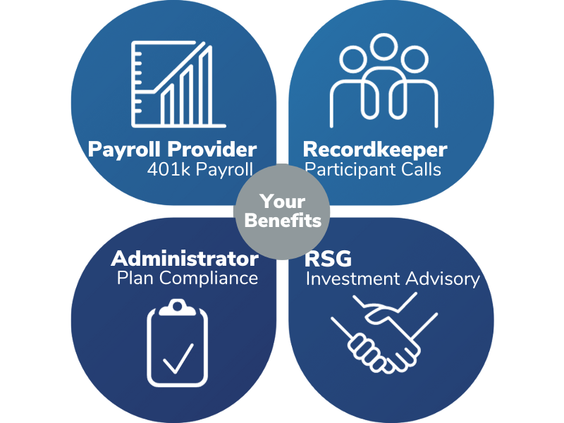
Your Retirement Specialists
Your Plan is our only focus
  Knowledgable specialist
  Fiduciaries
  Trusted Partners
03 | RetirementSolutionGroup.com

Slide 8



collecting Your Full Benefit
Social Security benefits are based on your Full Retirement Age (FRA).
Year of Birth
Full Retirement Age
1943 - 1954
1955
1956
1957
1958
1959
1960+
66 years
66 years + 2 months
66 years + 4 months
66 years + 6 months
66 years + 8 months
66 years + 10 months
67 years
SOURCE: Social Security Administration
04 | RetirementSolutionGroup.com
Notes:
The Social Security Administration (SSA) uses something called your Full Retirement Age (FRA) as the basis for calculating Social Security benefits.
The full retirement age is 66 if your were born 1943-1954. FRA increases gradually if you were born from 1955 to 1960 until it reaches 67. For anyone born 1960 or later, full retirement benefits are payable at age 67.
Knowing your Full Retirement Age (FRA), makes it a lot easier to understand Social Security.
If you take any Social Security benefits before FRA, they will be reduced. If you apply for any benefit at or after FRA, the benefits grow or are maximized.
You’ll also notice that a lot of Social Security calculations are based on your FRA

Slide 9
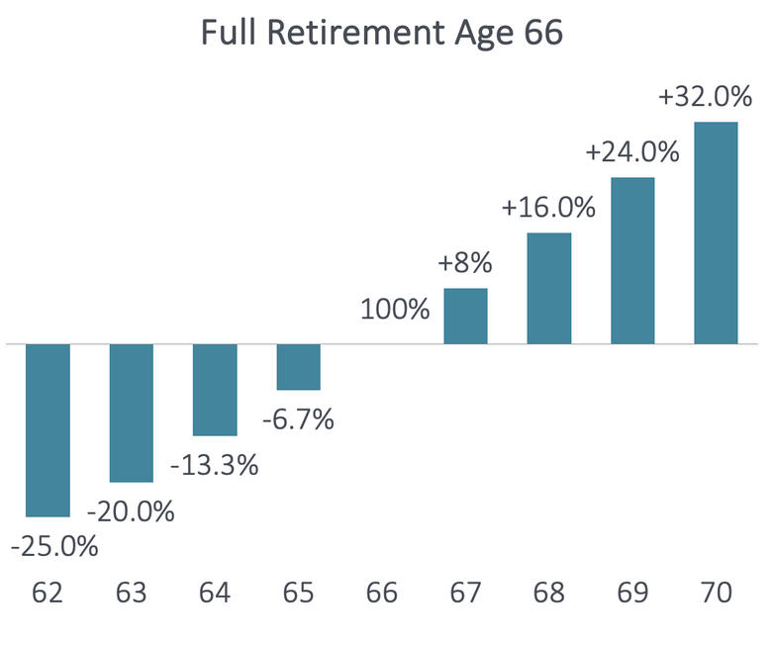
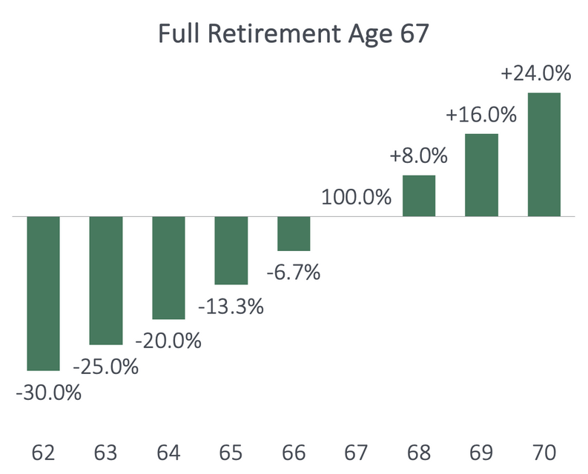
Eligibility for Retirement Benefits
You need at least 10 years of work (40 credits) to qualify for Social Security retirement benefits.
The amount of your benefit is based on your highest 35 years of earnings.
62
66
70
62
67
70
SOURCE: Social Security Administration
05 | RetirementSolutionGroup.com
Notes:
For all workers, you are eligible for Social Security retirement benefits after you have worked for 40 quarters. In 2023, you qualify for a quarter of work if you have earned income of $1,640. The Social Security Administration then averages your earnings over your 35 highest years of work to determine your Social Security retirement benefit.
If you claim Social Security before Full Retirement Age, your Social Security retirement benefits will be permanently reduced. If, however, you take your Social Security benefits at or after Full Retirement Age, your retirement benefits grow by 8% per year* up until age 70. This is in addition to any annual cost-of-living adjustments. The maximum Social Security retirement benefit is available at age 70.

Slide 10
How Working Affects your Benefits
Retirees can work and still receive Social Security benefits. However, if earnings exceed a certain threshold, benefits may be reduced.
Through Year
Before FRA
In Year Of FRA
Month Turn FRA
& Older
Earnings Limit (2023)
$21,240
($1,770 per month)
$ 56,520
($4,710 per month)
No Restrictions
Withholding Amount
$1 of benefits withheld for every $2 of earnings above limit
$1 of benefits withheld for every $3 of earnings above limit
No Restrictions
  Earnings limits look at wages only. Unearned income (pensions, IRAs, rental income, etc.) does not cause Social Security benefits to be withheld
  Earnings limit only affects wages received after you start your Social Security benefit
  If married, Social Security only considers the wages of the spouse receiving Social Security
SOURCE: Social Security Administration, SSA Publication No. 05-10147, SSA Publication No. 05-10069.
06 | RetirementSolutionGroup.com
Notes:
If you’re younger than full retirement age, there is a limit to how much you can earn and still receive full Social Security benefits.
If you’re younger than full retirement age during all of 2023, the Social Security Administration (SSA) will deduct $1 from your benefits for each $2 you earn above $21,240.
If you reach full retirement age during 2023, the Social Security Administration will deduct $1 from your benefits for each $3 you earn above $56,520 until the month you reach full retirement age
This withholding applies to ANY Social Security benefit you receive. It affects your retirement, spousal, survivors and the divorce benefits.
If you are married, the Social Security Administration only looks at the earnings of the individual who is collecting Social Security before FRA. For example: One spouse is age 62, retired and receives their Social Security retirement benefit. The other spouse is age 65 working and earning $50,000. Social Security only looks at the wages of the spouse collecting Social Security – not both of their wages.
Earnings limit looks at wages only. Unearned income (pensions, IRAs, rental income, etc.) does not cause Social Security benefits to be withheld while working and under FRA.
Additional Information if the clients ask: If you are collecting Social Security before Full Retirement Age and then return to work, the SSA will recalculate your benefit as if you had applied x months later. For example: if you claimed your retirement benefit at age 62, and then later went back to work for twelve months, the SSA will recalculate your benefits as if you had applied at age 63 (twelve months later). You will see this increase when you attain Full Retirement Age.
Sources for this page: SSA Publication No. 05-10147 , SSA Publication No. 05-10069.

Slide 11
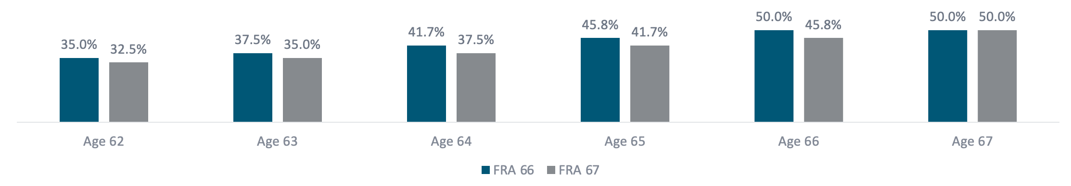
Spousal Benefits
At your Full Retirement Age, you may receive up to 50% of your spouse’s Social Security benefit. Spousal benefits can be reduced if you begin receiving them before your FRA.
  You receive the greater of either your retirment or your spousal benefit.
  Available even if you did not work.
  Amount is based on your spouse’s FRA benefit amount.
SOURCE: Social Security Administration, SSA Publication No. 05-10147, SSA Publication No. 05-10069.
07 | RetirementSolutionGroup.com
Notes:
The SSA also offers a spousal benefit. Even if you never worked, you may receive up to 50% of your spouse's benefit at Full Retirement Age. You could receive a reduced spousal benefit at age 62 of 32.5%-35% of your spouse's benefit at their retirement age.
In order to receive a spousal benefit, your spouse must have applied for his or her retirement benefit. Some other important things to know are:
Only one spouse a time can receive a spousal benefit. If you both worked, you generally receive the greater of your personal or spousal benefit.
The spousal benefits are always based on your spouse's benefit at Full Retirement Age, regardless of when he or she claim Social Security.
Notice that the spousal benefits do not grow after your Full Retirement Age. Even though the retirement benefit grows past your Full Retirement Age, the spousal benefit is maxed out at your Full Retirement Age.
By the way, if you are eligible for a divorced spousal benefit, it's calculated the same way. We'll get to the divorcee qualifications at the end of the section.

Slide 12
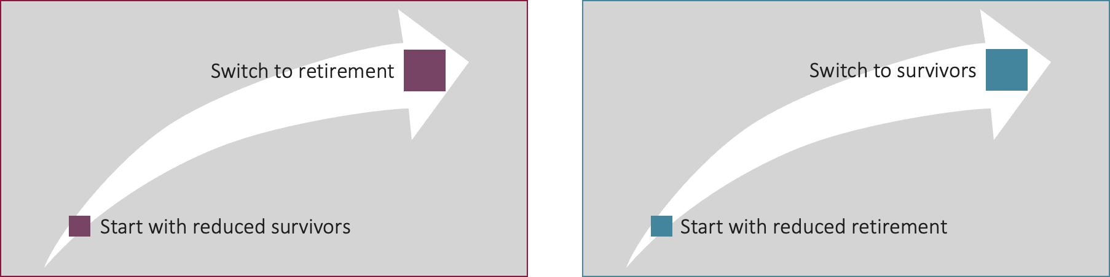
Survivors Benefits
Social Security survivors benefits are paid to widows, widowers, and dependents of eligible workers. Surviving spouses may have a couple of additional options.
  May start with one benefit and switch; earnings limit applies to any benefit received before Full Retirement Age (FRA).
Option 1
Option 2
SOURCE: Social Security Administration
07 | RetirementSolutionGroup.com
Notes:
Surviving spouses aged 60-70 may have a couple of additional options:
Option 1: Start with reduced survivor, switch to retirement: Under this option, the widow (widower) starts with reduced survivors benefit as early as age 60. They then switch to their retirement benefit at any time between age 62 and 70.
Option 2: Start with reduced retirement, switch to full survivors. Under this option, the widow (widower) starts with the reduced retirement benefit as early as age 62. They then switch to the survivor benefit at any time. The survivor benefit is maximized if the survivor claims the survivor benefit at their (the survivor's) Full Retirement Age.
Remember: The earnings limit applies to any benefit that is received before Full Retirement.

Slide 13
Divorcee Benefits
A divorced spouse may receive up to 50% of an ex-spouse's Social Security benefits. The benefit doesn’t increase existing payments or reduce the ex-spouse’s benefits.
All must be true:
Marriage Requirements
Current Marital Status
Benefits
  The marriage lasted at least 10 years
  Your divorced spouse is 62+, deceased or disabled
  You are divorced at least 2 years
  You are unmarried
  Your benefit (based on your own work history) is less than the Social Security divorced spouse benefit.
  Your ex-spouse is entitled to Social Security retirement benefits.
SOURCE: Social Security Administration
07 | RetirementSolutionGroup.com
Notes:
If you are divorced, but your marriage lasted 10 consecutive years or longer, you may qualify for benefits off your ex-spouse.
You can receive a spousal benefit off your ex-spouse's record (even if he/she has remarried) if:
You are unmarried
You and your former spouse are age 62 or older
Your ex-spouse is entitled to Social Security retirement or disability benefits.
Unlike married couples (where your spouse needs to apply in order for you to receive a spousal benefit), if you are divorced, your former spouse does not need to apply for their retirement benefits in order for you to receive a divorced spousal benefit. If you can provide the Social Security office with your former spouse's name and SSN, a copy of the marriage license and divorce decree, the SSA will check to see if you qualify for a benefit off of your former spouse.
If both divorced spouses worked, each spouse generally receive the greater of their retirement or spousal benefit. However, if you were born on or before January 1, 1954, you may be eligible for restricted application (start with spousal, switch to your retirement benefit at a later age) as long as your ex-spouse is age 62 or older or disabled
If your former spouse has passed away, you are entitled to a survivors benefit as long as you:
Are age 60
Are unmarried or remarried after age 60.
If you are working and under FRA, the earnings limit applies to your divorce spousal benefits.

Slide 14

Questions?
How can I help?
Elvia Sanchez, CPFA
Principal
Retirement Solution Group
elvia@retirementsolutiongroup.com
1-866-352-7731 ext. 410
®
Elvia Sanchez
PRINCIPAL, CPFA®
Securities offered through LPL Financial, Member FINRA/SIPC. Investment advisory services offered through RSG Advisory, a registered investment advisor. RSG Advisory and LPL Financial are separate, non-affiliated entities. Investors should carefully consider the investment objectives, risks, charges and expenses. This and other important information is contained in the prospectus, which can be obtained from your investment professional and should be read carefully before investing or sending money. Investments are not FDIC-insured, nor are they deposits of or guaranteed by a bank or any other entity.
08 | RetirementSolutionGroup.com

Slide 15
Questions?
How can I help?
Christie Cheng, CPFA
Principal
Retirement Solution Group
christie@retirementsolutiongroup.com
1-866-352-7731 ext. 310
®
Christie Cheng
PRINCIPAL, CPFA®
Securities offered through LPL Financial, Member FINRA/SIPC. Investment advisory services offered through RSG Advisory, a registered investment advisor. RSG Advisory and LPL Financial are separate, non-affiliated entities. Investors should carefully consider the investment objectives, risks, charges and expenses. This and other important information is contained in the prospectus, which can be obtained from your investment professional and should be read carefully before investing or sending money. Investments are not FDIC-insured, nor are they deposits of or guaranteed by a bank or any other entity.
08 | RetirementSolutionGroup.com

Slide 16
Questions?
How can I help?
Kevin Delaney, CPFA
VP of Business Development
Retirement Solution Group
kevin@retirementsolutiongroup.com
1-866-352-7731 ext. 415
®
Kevin Delaney
VP BUSINESS DEVELOPMENT, CPFA®
Securities offered through LPL Financial, Member FINRA/SIPC. Investment advisory services offered through RSG Advisory, a registered investment advisor. RSG Advisory and LPL Financial are separate, non-affiliated entities. Investors should carefully consider the investment objectives, risks, charges and expenses. This and other important information is contained in the prospectus, which can be obtained from your investment professional and should be read carefully before investing or sending money. Investments are not FDIC-insured, nor are they deposits of or guaranteed by a bank or any other entity.
08 | RetirementSolutionGroup.com

Slide 17
Questions?
How can I help?
Judy Gutierrez
Senior Relationship Manager
Retirement Solution Group
judy@retirementsolutiongroup.com
1-866-352-7731 ext. 185
Judy Gutierrez
SR. RELATIONSHIP MANAGER
Securities offered through LPL Financial, Member FINRA/SIPC. Investment advisory services offered through RSG Advisory, a registered investment advisor. RSG Advisory and LPL Financial are separate, non-affiliated entities. Investors should carefully consider the investment objectives, risks, charges and expenses. This and other important information is contained in the prospectus, which can be obtained from your investment professional and should be read carefully before investing or sending money. Investments are not FDIC-insured, nor are they deposits of or guaranteed by a bank or any other entity.
08 | RetirementSolutionGroup.com

Slide 18
Questions?
How can I help?
Chris Underwood, AIF, CPFA
Principal
Retirement Solution Group
chris@retirementsolutiongroup.com
1-866-352-7731 ext. 160
®
Chris Underwood
PRINCIPAL, AIF, CPFA®
Securities offered through LPL Financial, Member FINRA/SIPC. Investment advisory services offered through RSG Advisory, a registered investment advisor. RSG Advisory and LPL Financial are separate, non-affiliated entities. Investors should carefully consider the investment objectives, risks, charges and expenses. This and other important information is contained in the prospectus, which can be obtained from your investment professional and should be read carefully before investing or sending money. Investments are not FDIC-insured, nor are they deposits of or guaranteed by a bank or any other entity.
08 | RetirementSolutionGroup.com

