Slide 1
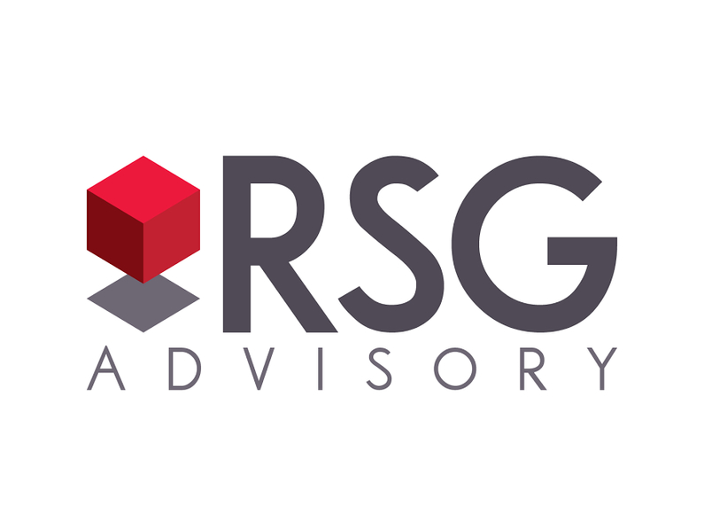

Deck Title
Client Name
Month 2024
Securities are offered through LPL Financial, member FINRA/SIPC. RSG Advisory and LPL Financial are separate, non-affiliated entities. Investment advisory services offered through Global Retirement Partners, LLC dba DBA RSG Advisory, an SEC registered investment advisor.

Slide 2
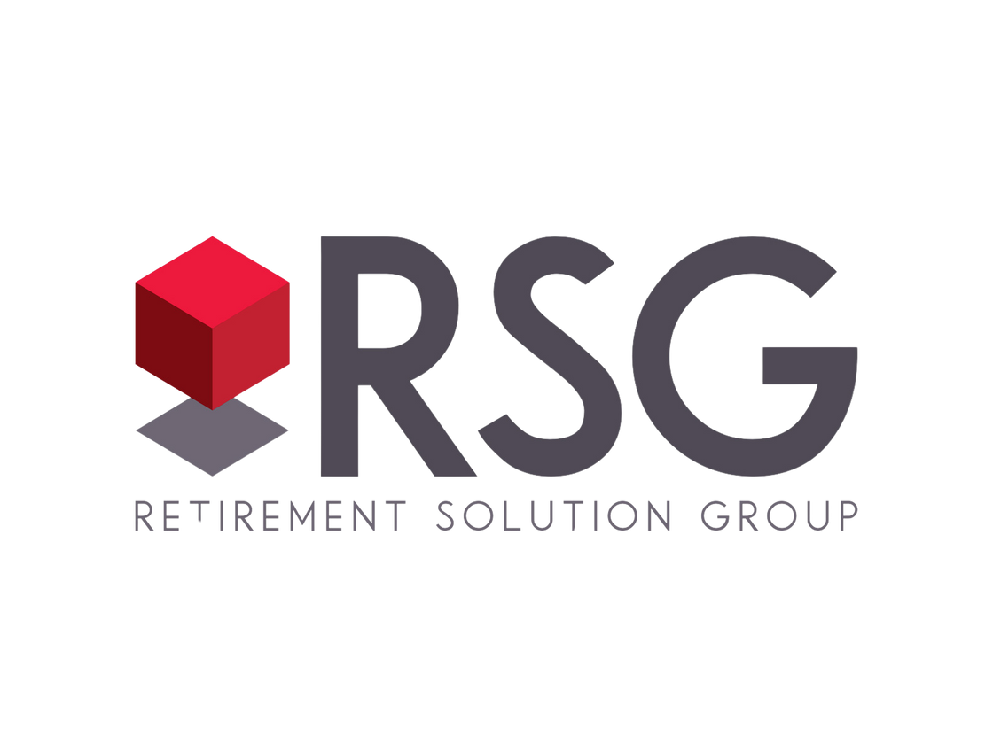

Alt design/Brand for Title Slide
Client Name
Month 2024
Securities are offered through LPL Financial, member FINRA/SIPC. RSG Advisory and LPL Financial are separate, non-affiliated entities. Investment advisory services offered through Global Retirement Partners, LLC dba DBA RSG Advisory, an SEC registered investment advisor.

Slide 3
Alt design/Brand for Title Slide
Client Name
Month 2024
Securities are offered through LPL Financial, member FINRA/SIPC. RSG Advisory and LPL Financial are separate, non-affiliated entities. Investment advisory services offered through Global Retirement Partners, LLC dba DBA RSG Advisory, an SEC registered investment advisor.

Slide 4



Alt design/Brand for Title Slide
this is an option
Securities are offered through LPL Financial, member FINRA/SIPC. RSG Advisory and LPL Financial are separate, non-affiliated entities. Investment advisory services offered through Global Retirement Partners, LLC dba DBA RSG Advisory, an SEC registered investment advisor.

Slide 5

Alt design/Brand for Title Slide
this is an option
Securities are offered through LPL Financial, member FINRA/SIPC. RSG Advisory and LPL Financial are separate, non-affiliated entities. Investment advisory services offered through Global Retirement Partners, LLC dba DBA RSG Advisory, an SEC registered investment advisor.

Slide 6

Alt design/Brand for Title Slide
this is an option
Securities are offered through LPL Financial, member FINRA/SIPC. RSG Advisory and LPL Financial are separate, non-affiliated entities. Investment advisory services offered through Global Retirement Partners, LLC dba DBA RSG Advisory, an SEC registered investment advisor.

Slide 7



Agenda
Plan Compliance
Plan Health
Education
Market Update
Investment Monitoring
Recordkeeper Update
Other New Business
7 | RSGAdvisory.net

Slide 8





Our Core business
At RSG Advisory we specialize in employer sponsored retirement plans.
Full service, holistic, independent approach
Knowledgable Advisory Specialists
Fiduciary administrators
Trusted Partners
We believe:
There is great value in education.
Retirement planning starts with understanding our clients’ needs.
Everyone should be empowered to retire with dignity.
8 | RSGAdvisory.net

Slide 9
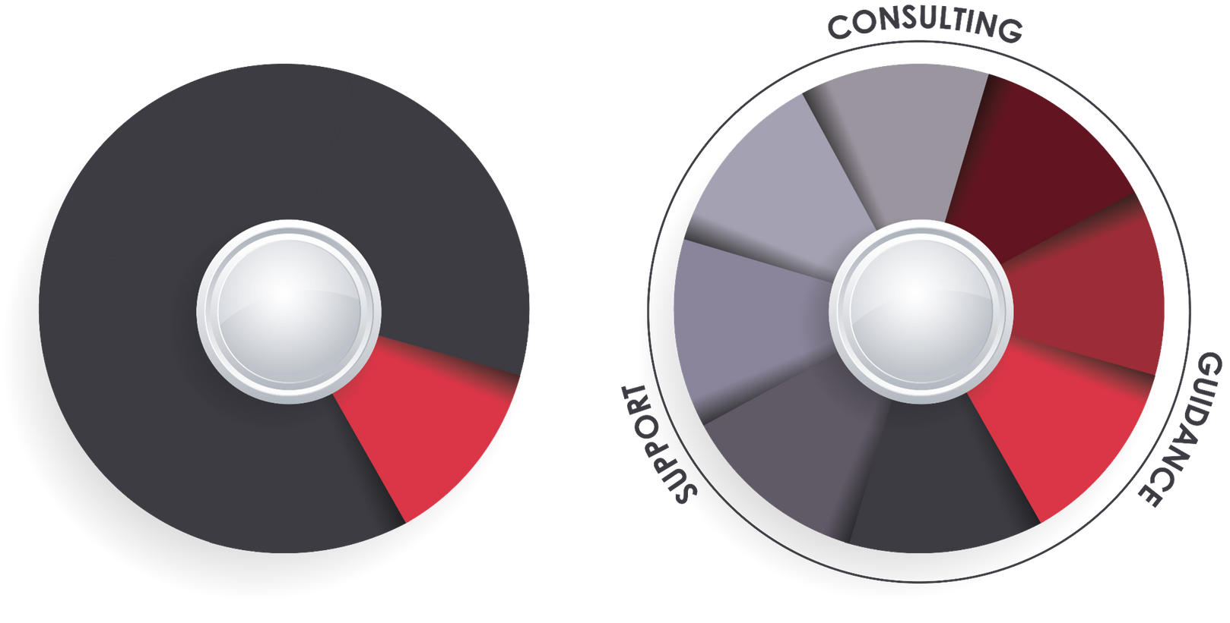
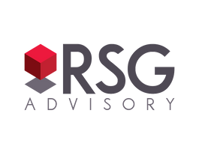
Purpose driven difference
Your business' future matters. This is not a one size fits all world. RSG embraces creating highly customized plan solutions for your business both today and into the future.
Investment Analysis
Plan Design
Fiduciary Oversight
ERISA Compliance
Plan Governance
Investment Analysis
Fee Benchmarking
Participant engagement
Financial Wellness
Most Advisors
9 | RSGAdvisory.net

Slide 10






RSG: Purpose driven Results
  $1.4B Direct Assets Under Influence
  700 retirement plans served + 3 MEPs/PEPs
  Servicing 24,000 participants
  Industry recognition & awards
$1.4B
700
24k
7x
10 | RSGAdvisory.net

Slide 11

Plan Compliance
11 | RSGAdvisory.net

Slide 12
Important Changes for 2024
  Census request (2023 Plan year) - sent 12/23
  Plan Limits 2024
2024
2023
Compensation
$345,000
$330,000
Highly Compensated Employee (HCE)
$155,000
$150,000
Deferral
$23,000
$22,500
Maximum Catch-Up – Age 50+
$7,500
$7,500
  SECURE Act:
    SECURE Act 2.0 Amendement checklist
    Long-Term Part-Time employees
12 | RSGAdvisory.net

Slide 13

Plan Health
13 | RSGAdvisory.net

Slide 14
Plan Growth
  Current Assets 04/17/2024:
$36,354,025.05
 | 2022 | 2023 | YTD 2024 (1/1/24-3/31/24)
Opening Balance | $32,288,097 | $26,458,928 | $33,511,064
Money In | $2,783,880 | $3,361,700 | $1,920,284
Money Out | $1,894,536 | $1,740,503 | $98,958
Closing Balance | $26,458,928 | $33,511,064 | $37,639,993
Plan Growth | $5,829,169 | $7,052,136 | $4,128,929
Earnings | $6,718,513 | $5,430,939 | $2,307,603
Plan Level R.O.R. | -20.5% | 19.92% | 6.70%
14 | RSGAdvisory.net

Slide 15
Plan Participation
  Participants:
    150 Participants (Active: 131, Term: 19)
    92.3% Particpation rate (131 out of 142 eligible)
    6.5% Average deferral rate
    Asset allocation
      25.92% Target Retirement Fund
      68.17% Individual Investments
      5.91% Cash Equivalent
  Leakage:
    Loans: 10 = $198,738
    YTD 2024 loans issued: 3 = $73,245
      2023: 5 = $100,912
      2022: 4 = $94,634
    YTD 2024 withdrawals issued: 11 = $25,713
      2023: 30 = $1,639,591
      2022: 23 = $1,799,902
    Forfeitures: $
15 | RSGAdvisory.net

Slide 16
Plan Fees
  Fees: 0.67%
    Participant Expenses: 0.66%
      Average Investment Expense: 0.42%
      Recordkeeping: 0.09%
      RSG Advisory: 0.15%
    Company Expenses: 0.01%
      RSG Annual Administration Billable: $4,000.00
    Benchmark: 0.95% (total average bundled expenses)
      Peer group: 200 participants & $20,000,000 in assets
16 | RSGAdvisory.net

Slide 17

Participant Education
17 | RSGAdvisory.net

Slide 18
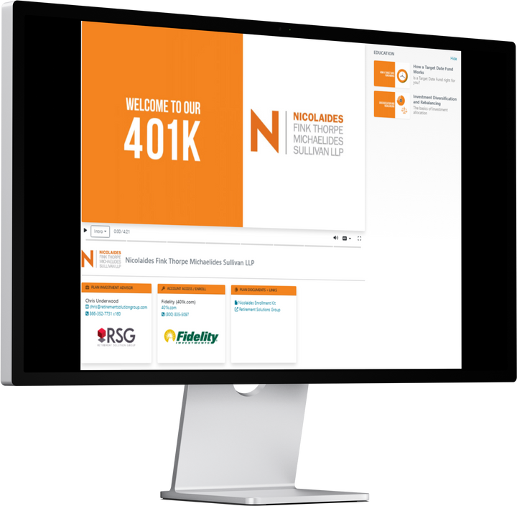
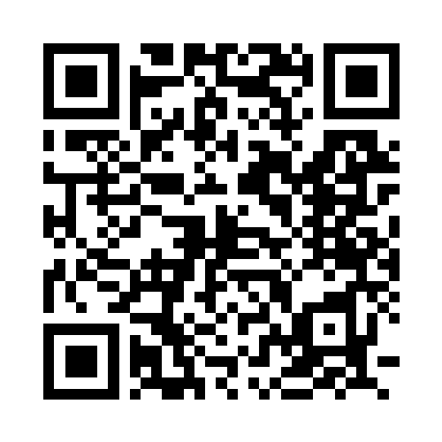
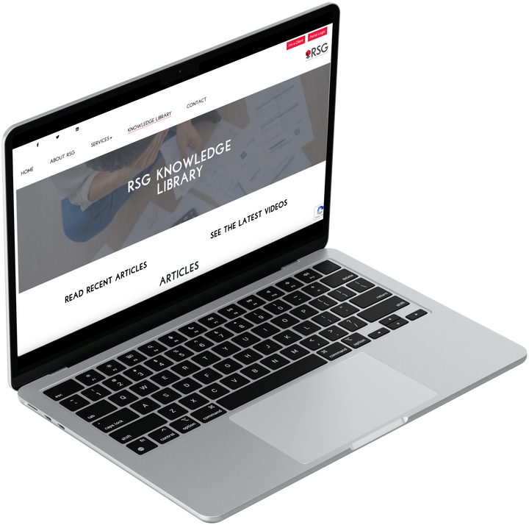
Participant Learning
  Employee Meetings/ Last meeting: 09/20/2023
  Customized education: Video learning portal
  RSG Knowledge Library
  Quarterly 2024 RSG Education Calendar
    2/16: 2024 Market Outlook Webinar
    4/21: Optimizing Tax Strategies
    5/14: Unlocking Financial Success
    7/10: 2024 Mid-Year Market Update
    10/22: Preparing for Retirement: Retirement Income
    11/19: Preparing for Retirement: Medicare
18 | RSGAdvisory.net

Slide 19

Market Update
19 | RSGAdvisory.net

Slide 20
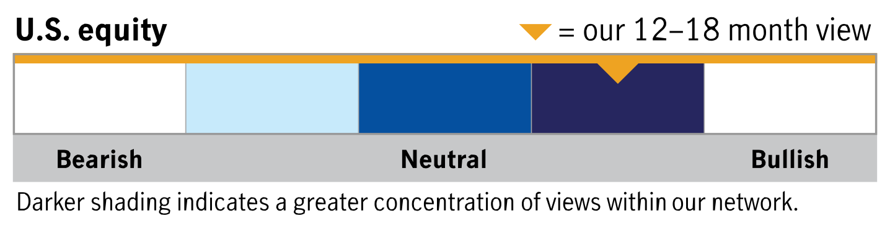
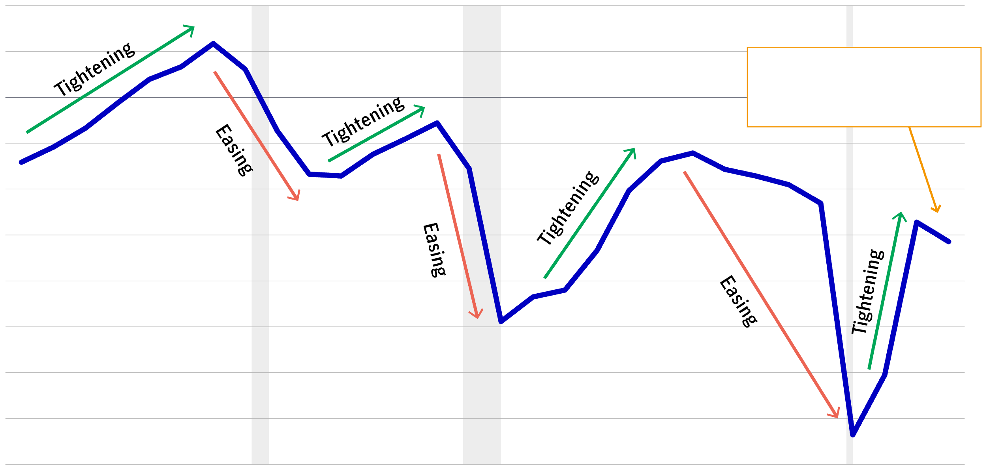
Insights: U.S. Equity
In contrast to majority of history, the deficit is increasing even as the economy remains strong
“High government spending—at all levels of the government—is measurably supporting GDP and keeping inflation stickier for longer.” 1
U.S. deficit as percent of GDP (%)
n
Recessions
The U.S. deficit at nearly 6% of GDP is likely helping to push out a potential recession.
$1.6
trillion
Forecasted deficit in 2024
5.6%
of GDP
Forecasted deficit in 2024
Source: FactSet, CBOE, as of 3/31/24. No forecasts are guaranteed. Past performance does not guarantee future results. 1 Quote is attributed to the subadvisor featured on the page.
20 | RSGAdvisory.net

Slide 21
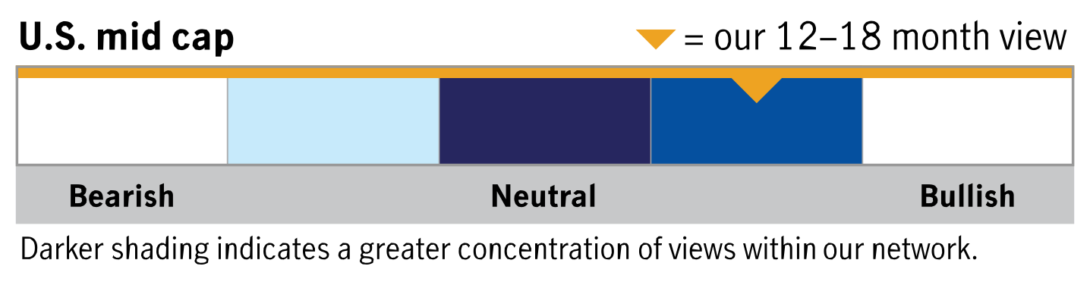
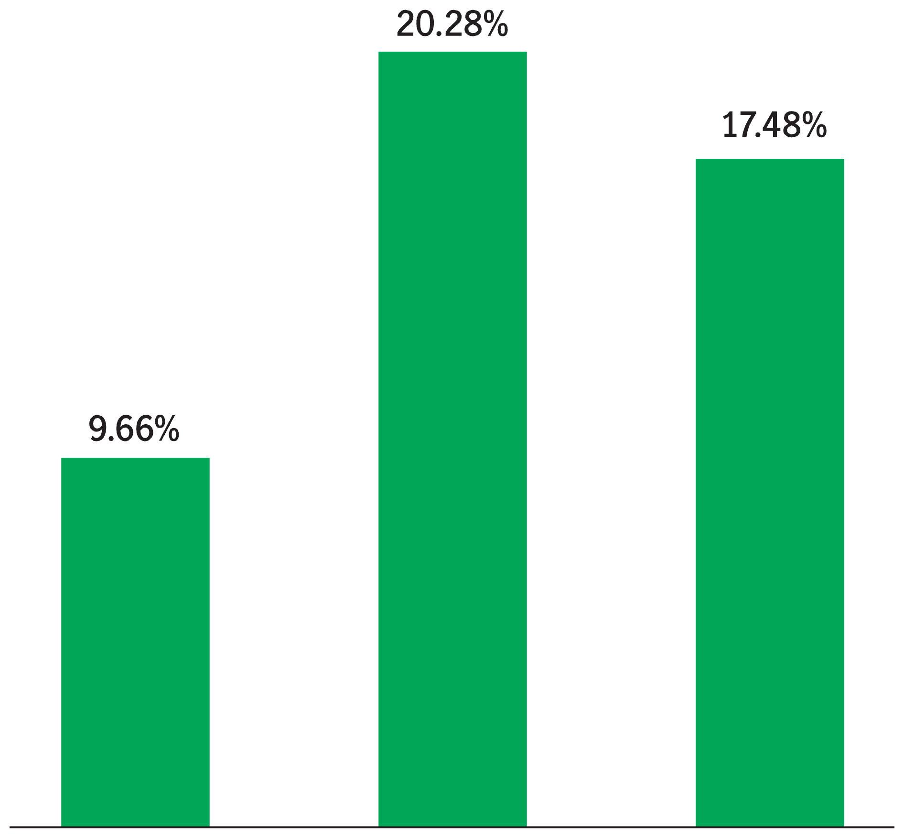
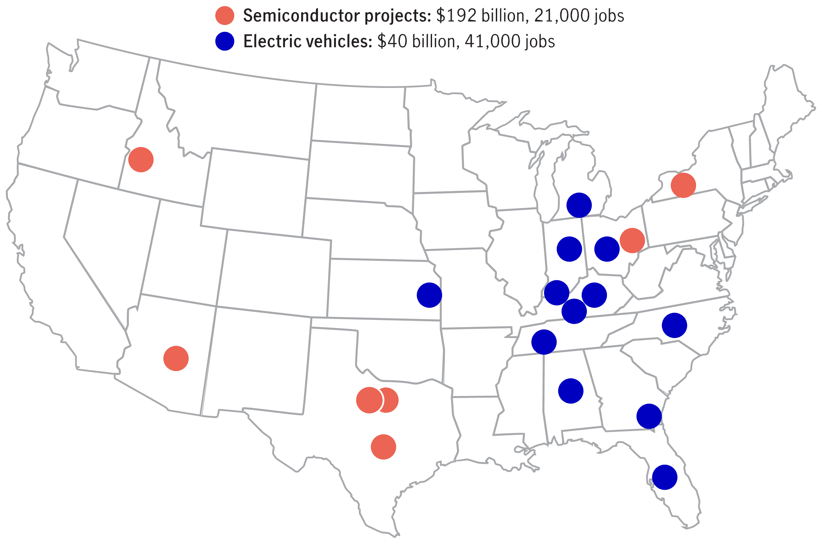


Insights: U.S. Equity
U.S. mid-cap stocks have the largest exposure to the industrials sector across the market cap spectrum
“Middle America is our favorite emerging market.” 1
U.S. mid- and small-cap stocks have significant exposure to the industrials sector
The onshoring trend has boosted job creation and investment throughout the U.S. Auto/semiconductor business investment locations, 2021–2023
Source: FactSet, as of 3/31/24. The Russell 1000 Index tracks the performance of 1,000 large-cap companies in the United States. The Russell Midcap Index tracks the performance of approximately 800 mid-cap companies in the United States. The Russell 2000 Index tracks the performance of 2,000 small-cap companies in the United States. It is not possible to invest directly in an index. Past performance does not guarantee future results.
1 Quote is attributed to the subadvisor featured on the page.
21 | RSGAdvisory.net

Slide 22
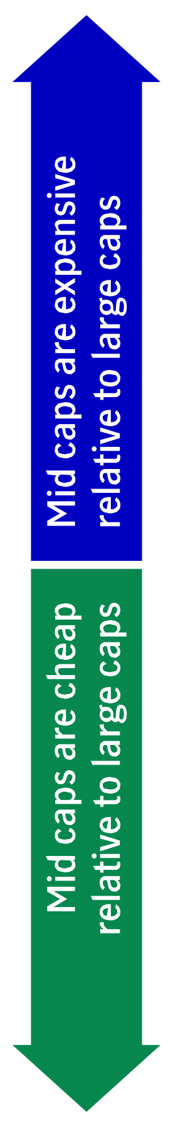
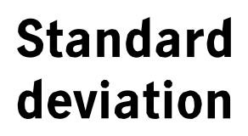
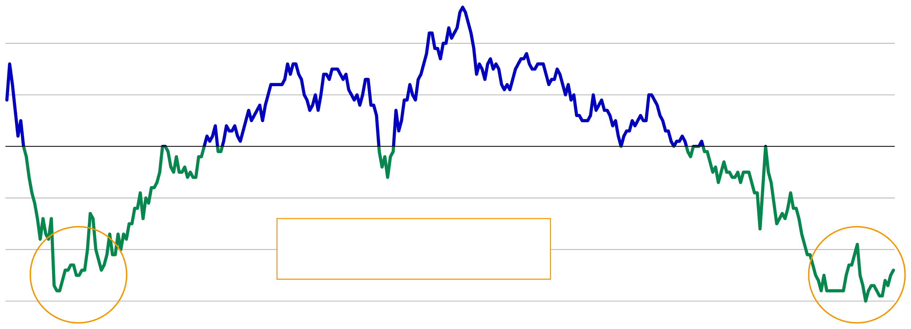
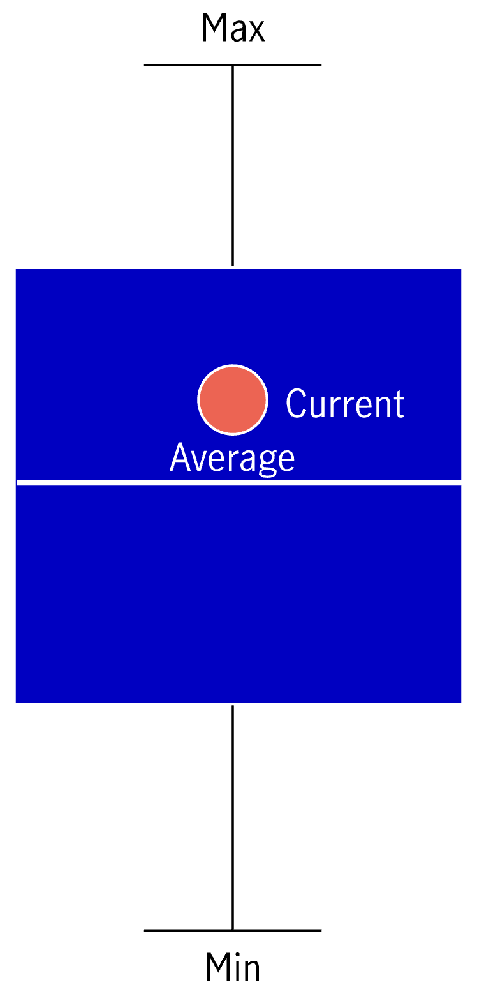
Insights: U.S. Equity
Mid caps look attractive relative to their large-cap counterparts
“Mid-cap stocks often combine the growth potential of a young firm with the financial stability of a company that has survived beyond its early years.” 1
S&P MidCap 400 Index P/E ratio relative to S&P 500 Index P/E ratio
Mid-cap core is at fair value, but tilting toward value can provide a greater discount
Mid caps are trading at about a 24% discount to large-cap equities.
Source: FactSet, as of 3/31/24. The S&P MidCap 400 Index tracks the performance of 400 mid-cap publicly traded companies in the United States. The S&P 500 Index tracks the performance of 500 of the largest publicly traded companies in the United States. It is not possible to invest directly in an index. The forward price-to-earnings (P/E) ratio is a stock valuation measure comparing the current share price of a stock with the underlying company’s estimated earnings per share over the next 12 months. Standard deviation is a statistical measure of the historic volatility of a portfolio. It measures the fluctuation of a fund’s periodic returns from the mean or average. The larger the deviation, the larger the standard deviation and the higher the risk. Past performance does not guarantee future results. 1 Quote is attributed to the subadvisor featured on the page.
22 | RSGAdvisory.net

Slide 23
2023: Broad Based Advances
2023 Asset Class Returns
(Full Year 12/31/2022 - 12/31/2023, Fourth Quarter 9/30/2023 – 12/31/2023)
The ‘Important Disclosures’ section provides index definitions. Index data source is YCharts and are inclusive of reinvested dividends. U.S. Large Stocks (S&P 500), U.S. Value Stocks (Russell 3000 Value), U.S. Growth Stocks (Russell 3000 Growth), U.S. Small Stocks (Russell 2000), Nasdaq Tech Stocks (Nasdaq Composite), Intl Developed Large Stocks (MSCI EAFE International Developed), Emerging Market Stocks (MSCI Emerging Markets), U.S. Long Term Govt Bonds (ICE U.S. Treasury 20+ Year Bond), REITs (Wilshire U.S. REITs), U.S. Bonds (Bloomberg Barclays Aggregate Bond), U.S. High Yield Bonds (Bloomberg U.S. High Yield Bond), S&P Equal Weight (S&P 500 Equal Weighted Index).
23 | RSGAdvisory.net

Slide 24
“Magnificent 7” Drove S&P performance
Full Year 2023 S&P Returns (12/31/22 – 12/31/23)
Mag. seven stocks represent 1.4% of the 500 stocks in the S&P 500 Index.
Yet, contribute 51% of the Index's 26.3% return for 2023.
S&P Returns Through Sept. 30th (12/31/22 – 9/30/23)
Company | Weight | Return | Contribution
Apple | 6.0% | 49.0% | 3.0%
Microsoft | 5.6% | 58.2% | 3.2%
Amazon | 2.3% | 80.9% | 1.9%
NVIDIA | 1.1% | 239.0% | 2.7%
Google | 3.1% | 58.3% | 1.8%
Meta | 0.8% | 194.1% | 1.6%
Tesla | 1.0% | 101.7% | 1.0%
Total | 20.0% | +66.5% | +13.3%
Company | Weight | Return | Contribution
Apple | 6.0% | 32.3% | 2.0%
Microsoft | 5.6% | 32.6% | 1.8%
Amazon | 2.3% | 51.3% | 1.2%
NVIDIA | 1.1% | 197.8% | 2.2%
Google | 3.1% | 48.3% | 1.5%
Meta | 0.8% | 149.5% | 1.3%
Tesla | 1.0% | 103.5% | 1.1%
Total | 20.0% | +55.0% | +11.0%
7 Stocks (Mag. Seven)
+13.0% +
Remaining 493 Stocks
+13.1% for S&P 500 Index
+26.3% =
S&P 500 Total Index
The ‘Important Disclosures’ section provides index definitions. Index data source is YCharts and are inclusive of reinvested dividends.
24 | RSGAdvisory.net

Slide 25
2023: A Reversal Year
Full Year 2023 vs Full Year 2022
(Full Year 2023 12/31/2022 - 12/31/2023, Full Year 2022 12/31/2021 - 12/31/2022)
The ‘Important Disclosures’ section provides index definitions. Index data source is YCharts and are inclusive of reinvested dividends. U.S. Large Stocks (S&P 500), U.S. Value Stocks (Russell 3000 Value), U.S. Growth Stocks (Russell 3000 Growth), U.S. Small Stocks (Russell 2000), Nasdaq Tech Stocks (Nasdaq Composite), Intl Developed Large Stocks (MSCI EAFE International Developed), Emerging Market Stocks (MSCI Emerging Markets), U.S. Long Term Govt Bonds (ICE U.S. Treasury 20+ Year Bond), REITs (Wilshire U.S. REITs), U.S. Bonds (Bloomberg Barclays Aggregate Bond), U.S. High Yield Bonds (Bloomberg U.S. High Yield Bond), S&P Equal Weight (S&P 500 Equal Weighted Index).
25 | RSGAdvisory.net

Slide 26
Not yet Fully Recovered
Returns Over Last Two Years
(12/31/2021 - 12/31/2023)
The ‘Important Disclosures’ section provides index definitions. Index data source is YCharts and are inclusive of reinvested dividends. U.S. Large Stocks (S&P 500), U.S. Value Stocks (Russell 3000 Value), U.S. Growth Stocks (Russell 3000 Growth), U.S. Small Stocks (Russell 2000), Nasdaq Tech Stocks (Nasdaq Composite), Intl Developed Large Stocks (MSCI EAFE International Developed), Emerging Market Stocks (MSCI Emerging Markets), U.S. Long Term Govt Bonds (ICE U.S. Treasury 20+ Year Bond), REITs (Wilshire U.S. REITs), U.S. Bonds (Bloomberg Barclays Aggregate Bond), U.S. High Yield Bonds (Bloomberg U.S. High Yield Bond), S&P Equal Weight (S&P 500 Equal Weighted Index).
26 | RSGAdvisory.net

Slide 27
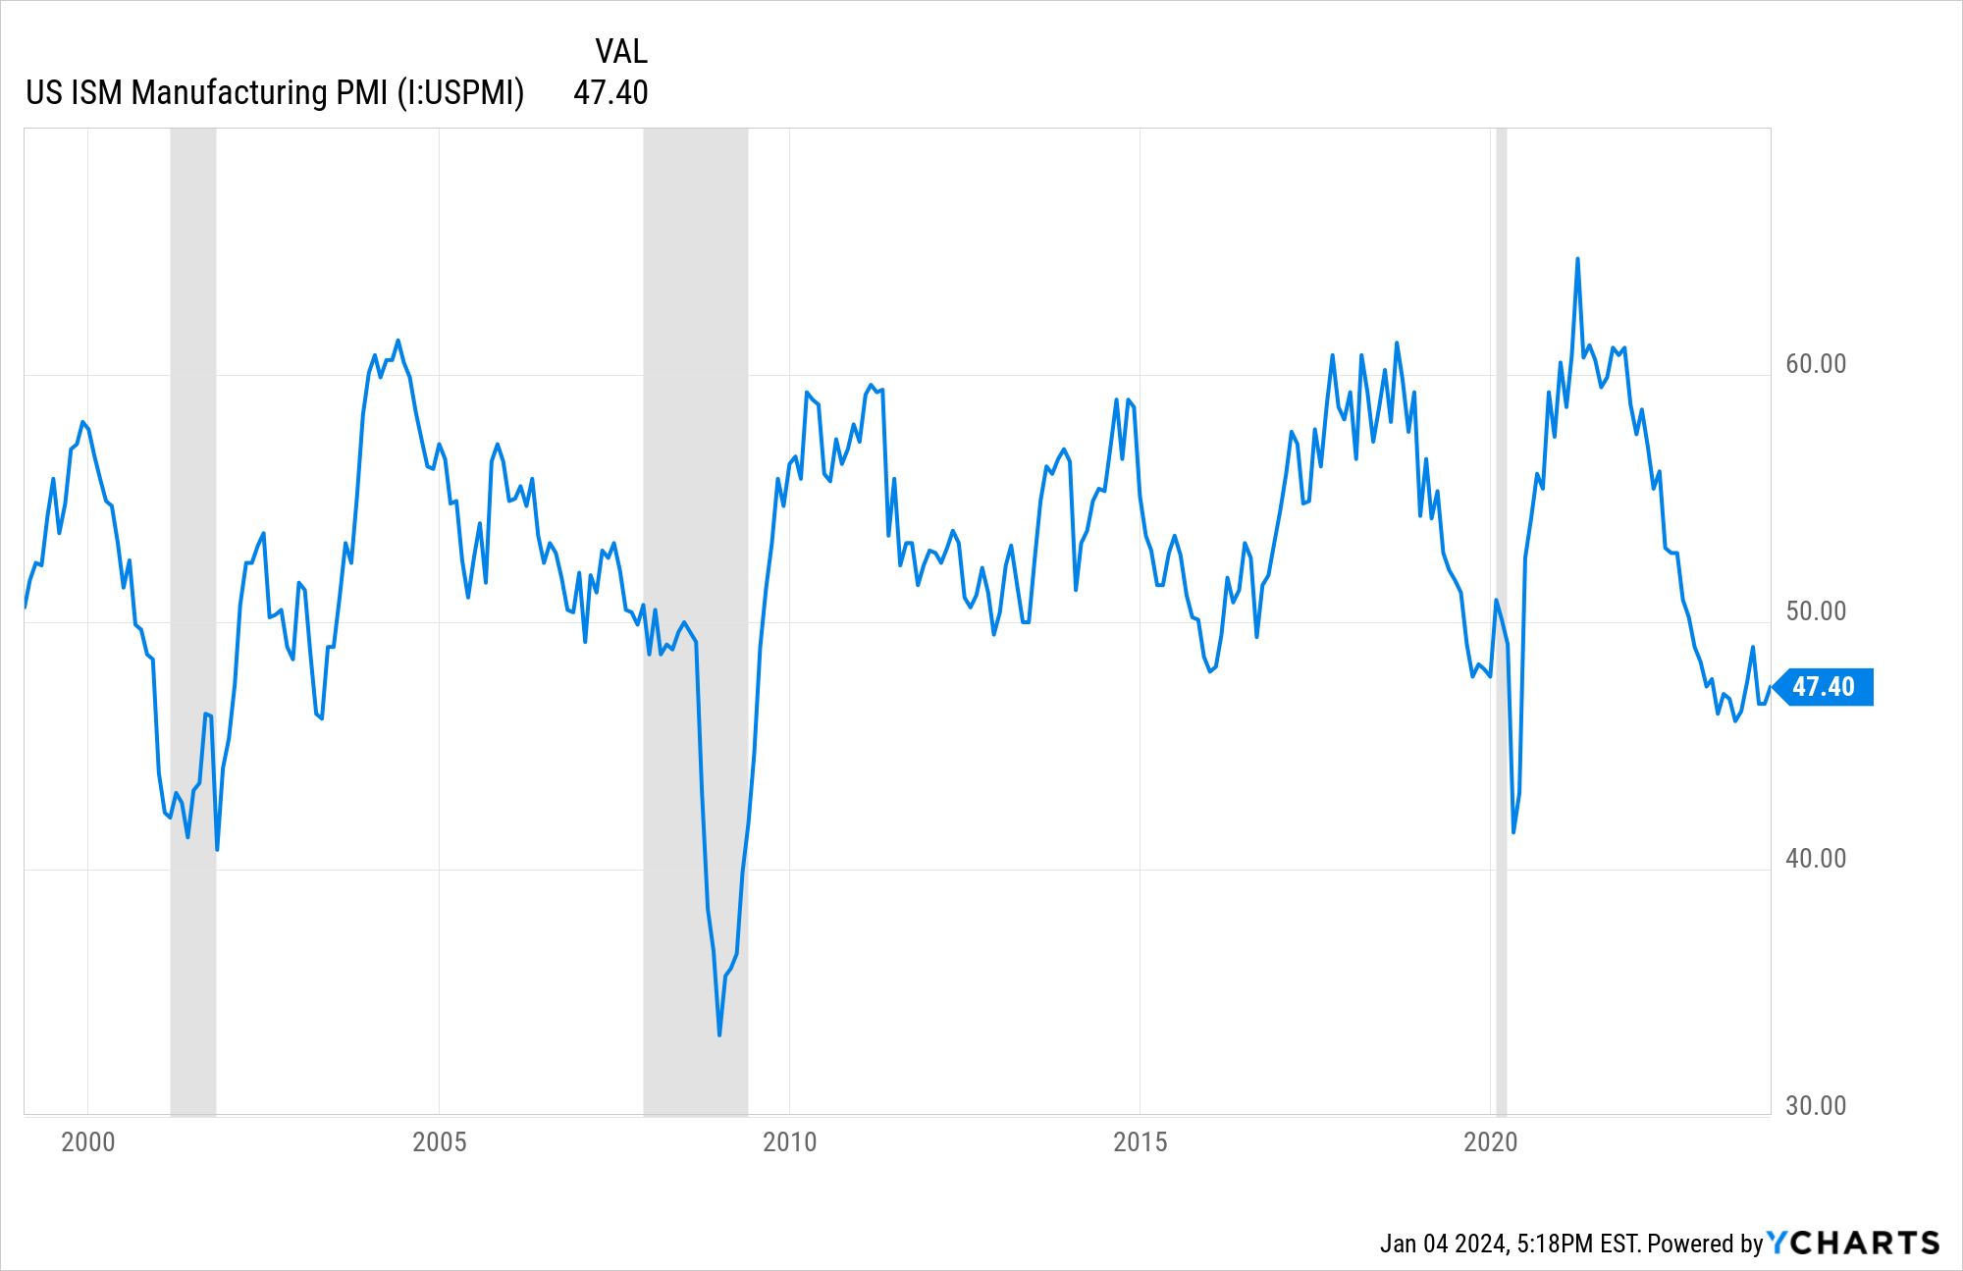
Recession on the doorstep?
State of The Economy
Purchasing Managers Expectations
(Purchasing Managers Index, Institute for Supply Management)
Expansion
Expansion
Expansion
Contraction
Contraction
Contraction??
The ‘Important Disclosures’ section provides index definitions. Index data source is YCharts and are inclusive of reinvested dividends.
27 | RSGAdvisory.net

Slide 28
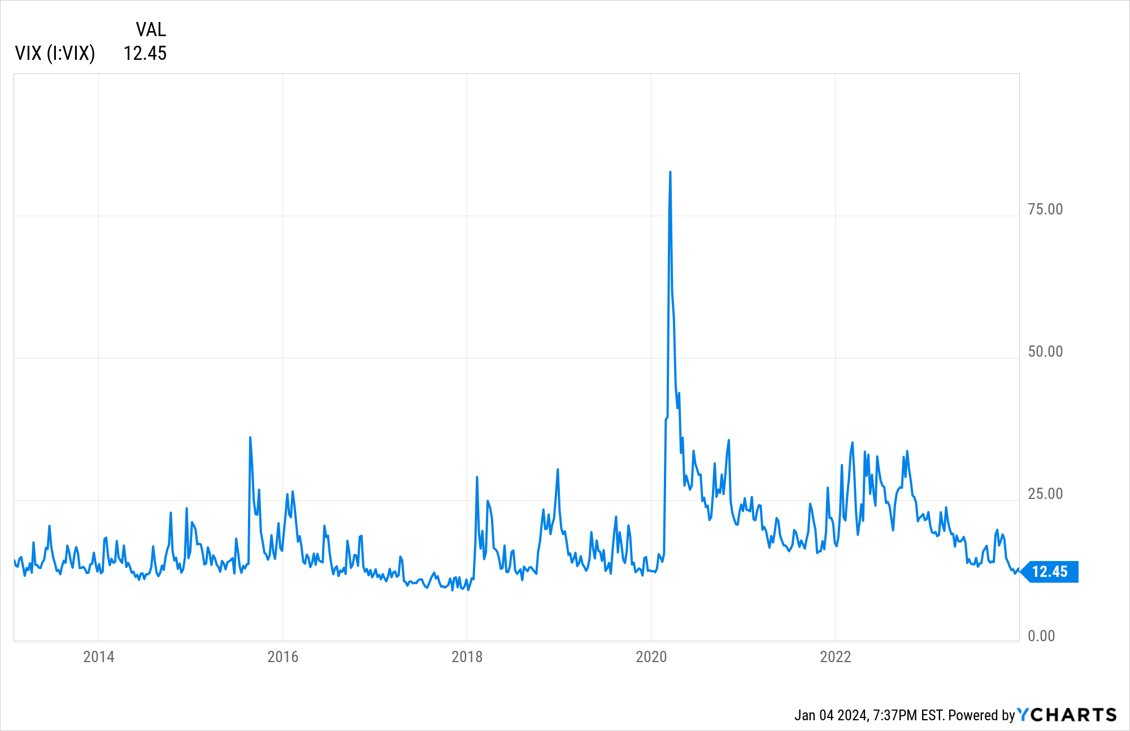
Investor Sentiment is Bullish
Investor’s Perception of How Risky Stocks Are
(VIX Volatility Index, 12/31/2013 - 12/31/2023)
High Risk Perception
Low Risk Perception??
The ‘Important Disclosures’ section provides index definitions. Index data source is YCharts and are inclusive of reinvested dividends.
28 | RSGAdvisory.net

Slide 29
Underweight Mag Seven.
Buy “Remaining” 493 Stocks
Performance of Stocks
Before & After Joining Top 10 Largest List
(January 1926 – December 2022)
Outperformance
Underperformance
Chart source: Dimensional Fund Advisors 2023.
29 | RSGAdvisory.net

Slide 30
Attractive Valuations Improve Their Odds
Asset Class Price-to-Earnings Valuations
(Price-to-Earnings Ratio Multiple, 12/31/2023)
Expensive
Cheap
The ‘Important Disclosures’ section provides index definitions. Index data source is YCharts and are inclusive of reinvested dividends.
30 | RSGAdvisory.net

Slide 31
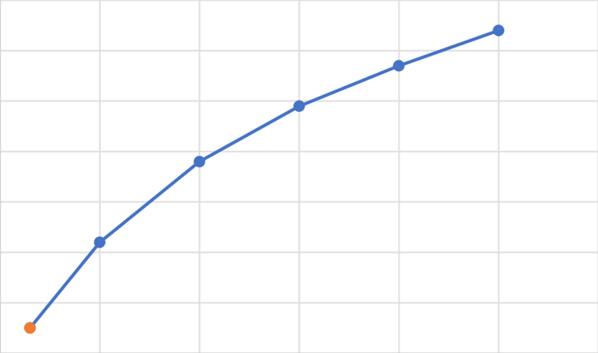
Shifting Back to Our Structural Allocation
Long Term Model Portfolio Allocations
(Illustrative Strategic Asset Allocation Weights)
Growth
90% Stocks
Moderate Growth
75% Stocks
From 100% Stocks
2023 Structural Shift:
Reduction in Stocks
Increase in Bonds
From 85% Stocks
Balanced (current)
60% Stocks
40% Bonds
Balanced (previously)
70% Stocks
30% Bonds
Conservative Growth
45% Stocks
Return
From 55% Stocks
Conservative
30% Stocks
From 45% Stocks
Riskiness
Riskiness
Important Disclaimer: RSG Advisory, For Illustration Purposes as of 12/31/2023.
31 | RSGAdvisory.net

Slide 32

Investment Monitoring
32 | RSGAdvisory.net

Slide 33
Investment Lineup
  Review
  Total Investments: 28 (Target Date Suite = 1)
    Active Investments: 20
    Index Investments: 8
  Weighted Average Investments Expense: 0.31%
  Average Fi360 Score: 23 (out of 100) – 1st quartile
33 | RSGAdvisory.net

Slide 34
Investment Monitoring
  Watch List
  Change Recommendations
Fund Name | Fund Ticker | Current Score | 1 Yr Score | 3 Yr Score | Expense | Participants | Assets
ClearBridge Small Cap Growth I | SBPYX | 65 | 51 | 23 | 0.91 | 20 | $1,030,782.34
Fidelity Advisor Freedom 2005 Z6 | FYGLX | 69 | 66 | 54 | 0.24 | 0 | $0.00
Fidelity Advisor Freedom Income Z6 | FEGLX | 73 | 64 | 47 | 0.24 | 0 | $0.00
34 | RSGAdvisory.net

Slide 35

RecordKeeper Update
35 | RSGAdvisory.net

Slide 36
Enter Slide Title
  Point
  Point
    Participant Expenses: 0.66%
      Average Investment Expense: 0.42%
      Recordkeeping: 0.09%
      RSG Advisory: 0.15%
36 | RSGAdvisory.net

Slide 37

New Business
37 | RSGAdvisory.net

Slide 38




04 | RSG Advisory
Four Point Immediate Action Plan
Implement Systematic Plan Governance
Conduct Comprehensive Investment Review
Enhance Participant Education & Support Services
Market Test
Current
Recordkeeper
38 | RSGAdvisory.net

Slide 39
04 | RSG Advisory
First Step/Point
Initial Findings
Action Plan
  Action 1
  Action 2
  Action 3
  Action 4
  Action 5
  Finding
  Findings
39 | RSGAdvisory.net

Slide 40
04 | RSG Advisory
Second Point/Step
Initial Findings
Action Plan
  Finding
  Finding
  Action 1
  Action 2
  Action 3
  Action 4
  Action 5
40 | RSGAdvisory.net

Slide 41
04 | RSG Advisory
Enhance Participant Education & Support Services
Initial Findings
Action Plan
  Findings
  Findings
  Action 1
    Additional detail
    More details
  Longer action plan step can be described here
    This is where you can put a longer detail
    More detials
41 | RSGAdvisory.net

Slide 42
04 | RSG Advisory
Market Test Current Recordkeeper
Initial Findings
Action Plan
  Findings
  Findings
  Action 1
    Additional detail
    More details
  Longer action plan step can be described here
    This is where you can put a longer detail
    More detials
42 | RSGAdvisory.net

Slide 43


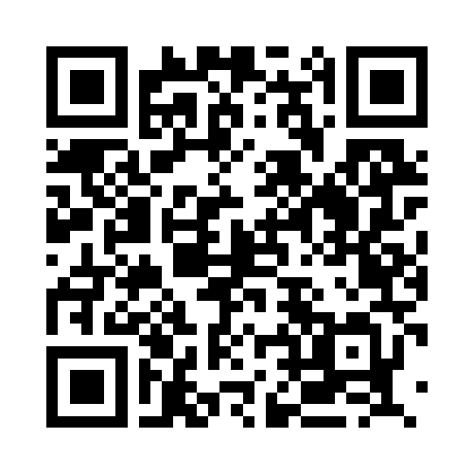
We’re Here to Help
Your Team:
Scott Emering​, MBA, CPFA®
Partner
scott@retirementsolutiongroup.com
ext. 110
Chris Underwood, AIF, CPFA®
Principal
chris@retirementsolutiongroup.com
ext. 160
Scott Emering
Chris Underwood
PARTNER, MBA, CPFA®
PRINCIPAL, AIF, CPFA®
43 | RSGAdvisory.net

Slide 44
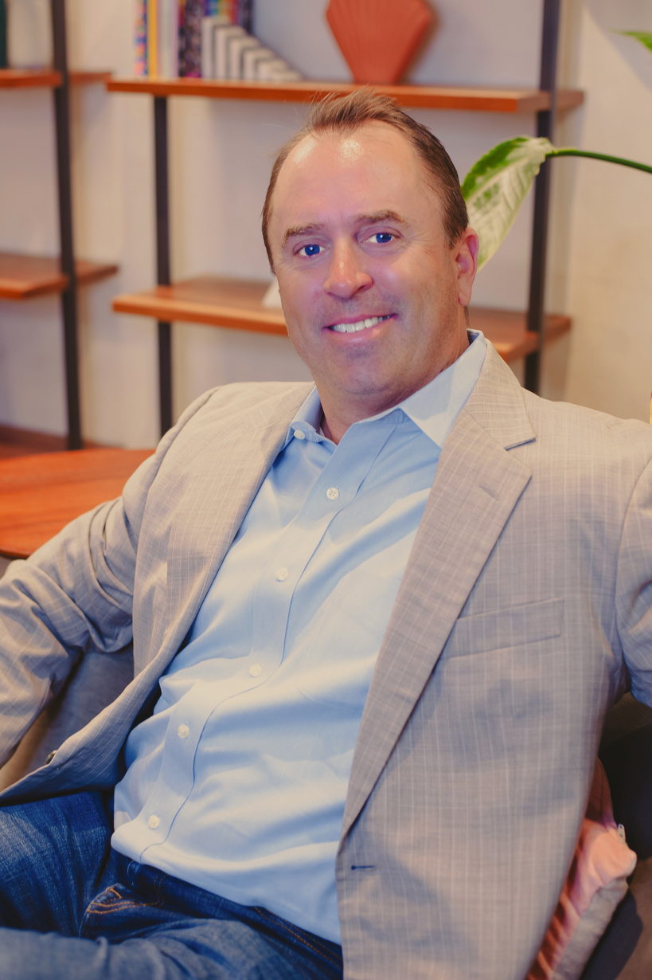




Steve Scott
Kevin Delaney
Elvia Sanchez
Christie Cheng
Judy Gutierrez
PARTNER, AIF, CPFA®
CO-FIDUCIARY
VP OF BUSINESS DEVELOPMENT, CPFA®
PRINCIPAL, CPFA®
PRINCIPAL, CPFA®
SR. RELATIONSHIP MANAGER, CPFA®
44 | RSGAdvisory.net

Slide 45
Important disclosures
Securities are offered through LPL Financial, member FINRA/SIPC. Investment Advisory Services offered through RSG Advisory a registered Investment Advisor. RSG Advisory and LPL Financial are separate, non-affiliated entities.
The opinions voiced in this material are for general information only and are not intended to provide specific advice or recommendations for any individual. We suggest that you discuss your specific situation with your financial advisor prior to investing.
All indices are unmanaged and may not be invested into directly. Unmanaged index returns do not reflect fees, expenses, or sales charges inherent to investing. All performance referenced is historical and is no guarantee of future results.
The economic forecasts set forth in this material may not develop as predicted and there can be no guarantee that strategies promoted will be successful.
Investing in stock includes numerous specific risks including: the fluctuation of dividend, loss of principal and potential illiquidity of the investment in a falling market.
The prices of small cap stocks are generally more volatile than large cap stocks.
The payment of dividends is not guaranteed. Companies may reduce or eliminate the payment of dividends at any given time.
Bonds are subject to market and interest rate risk if sold prior to maturity. Bond values will decline as interest rates rise and bonds are subject to availability and change in price.
High yield/junk bonds (grade BB or below) are not investment grade securities, and are subject to higher interest rate, credit, and liquidity risks than those graded BBB and above. They generally should be part of a diversified portfolio for sophisticated investors.
Government bonds and Treasury bills are guaranteed by the US government as to the timely payment of principal and interest and, if held to maturity, offer a fixed rate of return and fixed principal value.
Investing in Real Estate Investment Trusts (REITs) involves special risks such as potential illiquidity and may not be suitable for all investors. There is no assurance that the investment objectives of this program will be attained.
The fast price swings in commodities and currencies will result in significant volatility in an investor’s holdings.
Precious metal investing involves greater fluctuation and potential for losses.
International investing involves special risks such as currency fluctuation and political instability and may not be suitable for all investors. These risks are often heightened for investments in emerging markets.
Technical analysis is based on the study of historical price movements and past trend patterns. There is no assurance that these movements or trends can or will be duplicated in the near future.
45 | RSGAdvisory.net

Slide 46
Important disclosures
Rebalancing a portfolio may cause investors to incur tax liabilities and/or transaction costs and does not assure a profit or protect against a loss.
There is no guarantee that a diversified portfolio will enhance overall returns or outperform a non-diversified portfolio. Diversification does not protect against market risk.
All investing involves risk including loss of principal. No strategy assures success or protects against loss.
Index definitions and terms:
S&P 500 Index is a capitalization weighted index of 500 stocks designed to measure performance of the broad domestic economy through changes in the aggregate market value of 500 stocks representing all major industries.
NASDAQ Composite Index measures all NASDAQ domestic and non-U.S. based common stocks listed on The NASDAQ Stock Market. The market value, the last sale price multiplied by total shares outstanding, is calculated throughout the trading day, and is related to the total value of the Index.
Russell 3000 Index is a market-capitalization-weighted equity index maintained by the FTSE Russell that provides exposure to the entire U.S. stock market. The index tracks the 3,000 largest U.S.-traded stocks which represent about 98% of all U.S incorporated equity securities.
Russell 3000 Value Index is a market-capitalization weighted equity index maintained by the Russell Investment Group and based on the Russell 3000 Index, which measures how U.S. stocks in the equity value segment perform. Included in the Russell 3000 Value Index are stocks from the Russell 3000 Index with lower price-to-book ratios and lower expected growth rates.
Russell 3000 Growth Index is a market capitalization weighted index based on the Russell 3000 index. The Russell 3000 Growth Index includes companies that display signs of above average growth. The index is used to provide a gauge of the performance of growth stocks.
Russell 2000 Index is an index measuring the performance of approximately 2,000 small-cap companies in the Russell 3000 Index. The index serves as a benchmark for U.S. small-cap stocks.
MSCI EAFE Index is a stock index that is a performance benchmark for the major international equity markets as represented by 21 major MSCI indices from Europe, Australia and Middle East.
MSCI EAFE Small Cap Index is an equity index which captures small cap representation across Developed Markets as represented by MSCI indices from Europe, Australia and the Middle East.
MSCI Emerging Markets Index consists of 23 economies: Brazil, Chile, China, Colombia, Czech Republic, Egypt, Greece, Hungary, India, Indonesia, Korea, Malaysia, Mexico, Peru, Philippines, Poland, Qatar, Russia, South Africa, Taiwan, Thailand, Turkey and the UAE.
Dividend Aristocrats Index are S&P 500 index constituents that have increased their dividend payouts for 25 consecutive years or more.
Wilshire REIT Index defines and measures the investable universe of publicly traded real estate investment trusts domiciled in the U.S.
46 | RSGAdvisory.net

Slide 47
Important disclosures
Goldman Sachs Crude Oil Total Return Index reflects available through an unleveraged investment in the West Texas Intermediate (WTI) crude oil futures contract plus the Treasury Bill rate of interest that could be earned on funds committed to the trading of the underlying contracts.
Bank of America Merrill Lynch U.S. Corporate AAA Index is an index of U.S. AAA corporate bonds. The Bank of America Merrill Lynch U.S. Corporate BBB Index includes U.S. BBB corporate bonds.
S&P U.S. Preferred Stock Index is designed to serve the investment community's need for an investable benchmark representing the U.S. preferred stock market. Preferred stocks provide investors with a dividend, but do not offer equity in shares.
Bloomberg High Yield Bond Index measures the USD-denominated, high yield, fixed-rate corporate bond market. Securities are classified as high yield if the middle rating of Moody's, Fitch and S&P is Ba1/BB+/BB+ or below. High Yield bonds are considered low quality bonds.
Market Vectors Floating Rate Bond Index This index provides exposure to the floating rate segment of the U.S. investment grade bond market. Floating rate notes are bonds that have coupon payments that change based on various market characteristics- including rises and falls in interest rates. Holdings are chosen based on amount of debt issued.
Barclays US Aggregate Bond Index is a market capitalization-weighted index, meaning the securities in the index are weighted according to the market size of each bond type. Most U.S. traded investment grade bonds are represented.
Barclays Corporate Bond measures the performance of the investment grade U.S. corporate bond market. Securities must be fixed rate, U.S. dollar denominated, taxable and rated investment grade as defined by the Index methodology. Inclusion is based on currency of issue, not its domicile.
Barclays US Treasury Index is a market-capitalization weighted index that measures the performance of public obligations of the U.S. Treasury that have a maturity of one year or more.
Citigroup USBIG Treasury Bill 3M index “T-bill” is an unmanaged index representing monthly return equivalents of yield averages of the last 3-month Treasury Bill issues.
CBOE Volatility Index® (VIX®) is meant to be forward looking, showing the market's expectation of 30-day volatility in either direction, and is considered by many to be a barometer of investor sentiment and market volatility, commonly referred to as “Investor Fear Gauge”.
Gross Domestic Product (GDP) is the monetary value of all the finished goods and services produced within a country’s borders in a specific time period, though GDP is usually calculated on an annual basis. It includes all of private and public consumption, government outlays, investments and exports less imports that occur within a defined territory.
47 | RSGAdvisory.net

