Slide 1
BEL BRANDS USA
RESPONSE TO
PROPOSAL
401(K) RETIREMENT PLANS
Investment Consulting Services
FEB 2022 // PREPARED BY RETIREMENT SOLUTION GROUP

Slide 2
RETIREMENT SOLUTION GROUP
PAGE | 02
Last February
WE'VE REACHED OUR HIGEST SALES RATE
According to Wikipedia, an annual report is a comprehensive report on a company's activities throughout the preceding year. Annual reports are intended to give shareholders and other interested people information about the company's activities and financial performance. They may be considered as grey literature. Most jurisdictions require companies to prepare and disclose annual reports, and many require the annual report to be filed at the company's registry. Companies listed on a stock exchange are also required to report at more frequent intervals (depending upon the rules of the stock exchange involved).
According to Wikipedia, an annual report is a comprehensive report on a company's activities throughout the preceding year. Annual reports are intended to give shareholders and other interested people information about the company's activities and financial performance. They may be considered as grey literature.
Most jurisdictions require companies to prepare and disclose annual reports, and many require the annual report to be filed at the company's registry. Companies listed on a stock exchange are also required to report at more frequent intervals (depending upon the rules of the stock exchange involved).
Where we are
TODAY

Slide 3
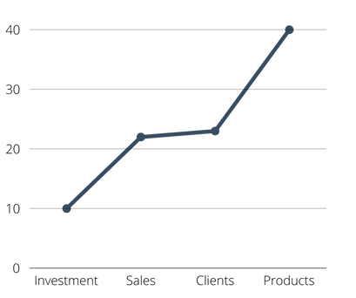
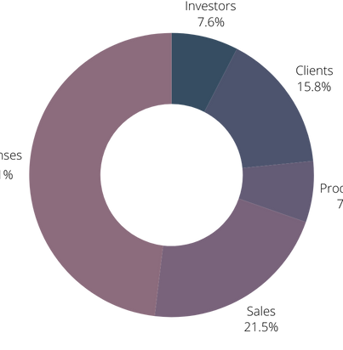
PAGE | 03
RETIREMENT SOLUTION GROUP
According to Wikipedia, an annual report is a comprehensive report on a company's activities throughout the preceding year. Annual reports are intended to give shareholders and other interested people information about the company's activities and financial performance. They may be considered as grey literature. Most jurisdictions require companies to prepare and disclose annual reports, and many require the annual report to be filed at the company's registry. Companies listed on a stock exchange are also required to report at more frequent intervals (depending upon the rules of the stock exchange involved).
According to Wikipedia, an annual report is a comprehensive report on a company's activities throughout the preceding year. Annual reports are intended to give shareholders and other interested people information about the company's activities and financial performance. They may be considered as grey literature.
Most jurisdictions require companies to prepare and disclose annual reports, and many require the annual report to be filed at the company's registry. Companies listed on a stock exchange are also required to report at more frequent intervals (depending upon the rules of the stock exchange involved).
Our Finance
According to Wikipedia, an annual report is a comprehensive report on a company's activities throughout the preceding year. Annual reports are intended to give shareholders and other interested people information.
OVERVIEW

